Slide 1
Developing boot solutions for intel iot unique use cases
Yah-Wen Ho
Senior BIOS & Bootloader Lead
Intel Internet of Things Group (IoTG)

Slide 2
Problem statement
The Internet of Things (IoT) has a wide variety of use cases, and current bootloader solutions do not properly address all the requirements:
Ease of implementation
Security
Extensible design
Scaling across verticals
Open source with permissive licensing
Leverages Intel® Firmware Support Package (Intel® FSP)

Slide 4
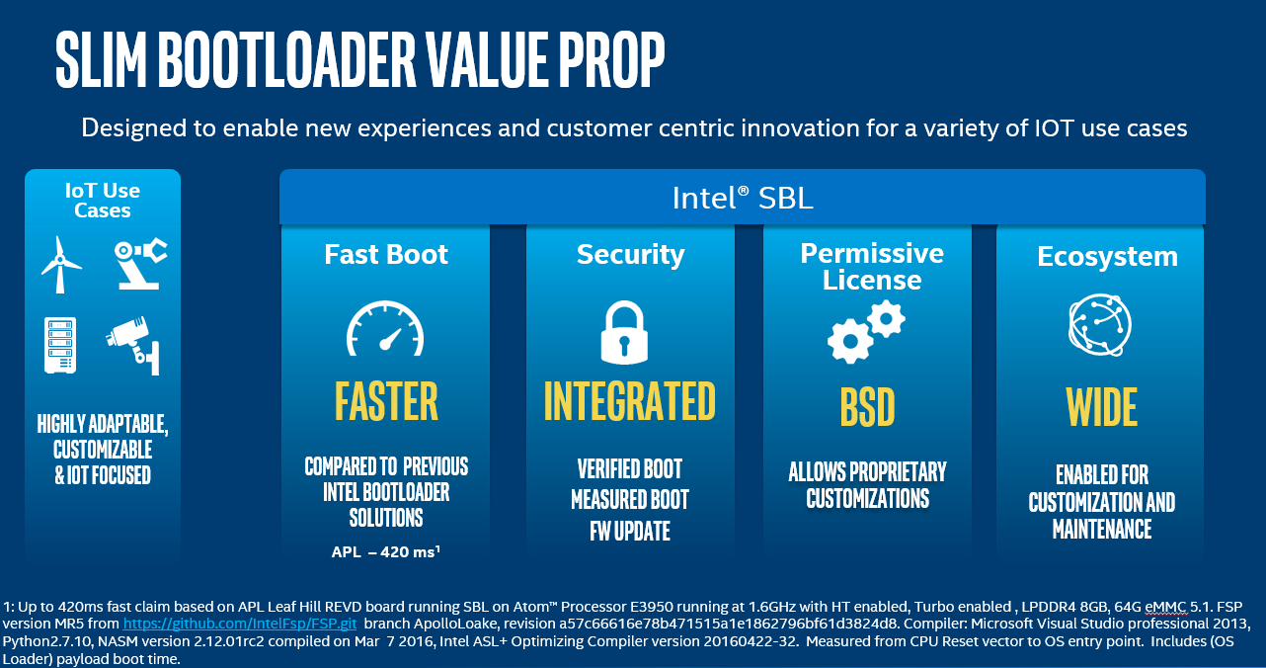
Slim Bootloader

Slide 5
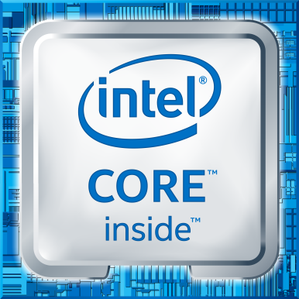
Slim bootloader architecture
OS (Windows, Linux, Android) / Hypervisor
Alternative Payloads
Payload (OS loader & FW update)
Speed optimizations
Binary
Level
Config
Tool
Fail-safe FW Update
Integrated Security Features
Intel® FSP
Intel® Architecture-Based Platforms

Slide 8
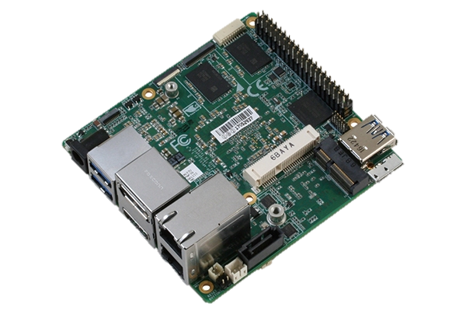
Enabled products AS Development vehicle
Intel® Atom™ E3900 Series (Available now)
(formerly known as Apollo Lake)
Boards Supported:
Aaeon UP Squared
Intel E3900 Series Customer Reference Boards:
Leaf Hill
Oxbow Hill
Juniper Hill
More to come!

Slide 9
Call to action
Try out Slim Bootloader
Intel appreciates your valuable feedback and comments
Participate and contribute to the Slim Bootloader open source community
Links:
Slim Bootloader web page: intel.com/sbl
Source: github.com/slimbootloader
Slim Bootloader mailing list: lists.01.org/mailman/listinfo/sbl-devel

