Slide 1
Advanced Class
Paul Barker, Marco Cavallini, Beth Flanagan, Sean Hudson, Joshua Lock,
Scott Murray, Tim Orling, David Reyna, Rudi Streif, Marek Vasut
Yocto Project Developer Day •
Prague• 26 October 2017

Slide 2
Advanced Class
Class Content:
  https://wiki.yoctoproject.org/wiki/DevDay_Prague_2017
Requirements:
  Wireless
  SSH (Windows: e.g. “putty”)
Wireless Registration:
  TBD

Slide 3
Agenda – The Advanced Class
9:00- 9:15 Opening session, What's New
9:15- 9:30 Account setup
9:30-10:15 Devtool: creating new content
10:15-10:30 Morning Break
10:30-11:15 DT overlays
11:15-12:00 Userspace: packaging, installation, system services
12:00- 1:00 Lunch
1:00- 1:45 License Compliance and Auditing
1:45- 2:15 CROPS
2:30- 2:45 Afternoon Break
2:45- 3:15 Maintaining your Yocto Project Distribution
3:15- 3:50 Kernel Modules with eSDKs
3:50- 4:30 Analytics and the Event System
4:30- 5:00 Recipe specific sysroots
5:00- 5:30 Forum, Q and A

Slide 4
Class Account Setup

Slide 5
Notes for the Advanced Class:
The class will be given with YP-2.4 (Rocko)
Wifi Access:
  SSID: <TBD>
  Password: <TBD>
Your account’s IP access addresses
  SSH (password “devday”):
      ssh ilab01@devdayXXX.yoctoproject.org
  HTTP:
  devdayXXX.yoctoproject.org:8000

Slide 6
Yocto Project Dev Day Lab Setup
The virtual host’s resources can be found here:
  Your Project: "/scratch/working/build “
  Extensible-SDK Install: "/scratch/sdk/qemuarm“
  Sources: "/scratch/src“
  Poky: "/scratch/poky"
  Downloads: "/scratch/downloads"
  Sstate-cache: "/scratch/sstate-cache“
You will be using SSH to communicate with your virtual server.

Slide 7
FYI: How class project was prepared
$
$ cd /scratch
$ git clone -b rocko git://git.yoctoproject.org/poky.git
$ cd poky
$ bash
$ ./scratch/poky/oe-init-build-env build
$ echo "MACHINE = \“qemuarm\"" >> conf/local.conf
$ echo "SSTATE_DIR = \“/scratch/sstate-cache\"" >> conf/local.conf
$ echo "DL_DIR = \“/scratch/downloads\"" >> conf/local.conf
$ echo "IMAGE_INSTALL_append = \" gdbserver openssh libstdc++ \
curl \"" >> conf/local.conf
$ # Capture the build into a Bitbake/Toaster database
$ . toaster start webport=0.0.0.0:8000
$ # Build the project
$ bitbake core-image-base
$ # When you are done ...
$ . toaster stop
$ exit

Slide 8
NOTE: Clean Shells!
We are going to do a lot of different exercises in different build projects, each with their own environments.
To keep things sane, you should have a new clean shell for each exercise.
There are two simple ways to do it:
  Close your existing SSH connection and open a new one
  -- or –
  Do a “bash” before each exercise to get a new sub-shell, and “exit” at the end to remove it, in order to return to a pristine state.

Slide 9
Activity One!
Yocto Project 2.4 (Rocko)

Slide 10
Yocto Project – What is new in 2.4 Rocko
Yocto Project 2.4 Themes
  Process/Tooling/Workflow Improvements - Patchwork, Patchtest, SWAT, Error reporting, Reproducability, Memory Resident Bitbake now default
  Improving Testing/QA Automation/Coverage Efficiency - oeselftest, Test automation, CI/AB - modernization and moving more into YP
  Creating Leading edge Build Technology - Delivering prebuilt binaries to customers, Improve Binary/Build Reproducibility
  Enhancing IoT Application Development - CROPS (eclipse support, dev containers), eSDK (team workflow), devtool (team workflow, extend heuristics), juci from openWRT support

Slide 11
Yocto Project – Release Notes
* Linux kernel 4.12, 4.10, 4.9 (LTS/LTSI), 4.4 (LTS)
* gcc 7.2
* glibc 2.26
* Significant work on binary reproducibility - >98% of packages used to build core-image-sato are now reproducible.
* Support for Vulkan 3D graphics/compute API, enabled by default in poky distro configuration
* New "distrooverrides" class to selectively turn DISTRO_FEATURES into overrides (enabling bbappends with functionality conditional upon DISTRO_FEATURES)
* New VOLATILE_LOG_DIR variable to allow making /var/log persistent
* Support for merged / and /usr with "usrmerge" DISTRO_FEATURES item
* Parallelised ipk and deb package creation for improved performance
* Go improvements:
* Python improvements:
* wic image creator enhancements:
* devtool/recipetool enhancements:
* BitBake improvements:
* Package QA improvements:
* RPM improvements
…
And so much more, including Known Issues, Security Fixes and Recipe Updates!

Slide 12
Activity Two
Devtool
Tim Orling, Sean Hudson, David Reyna

Slide 13
devtool – Overview
devtool is a collection of tools to aid developer workflow:
  Create, update, modify recipes in the build environment
  Streamlines development by performing repetitive tasks via tinfoil (wrapper around bitbake) and recipetool.
  Application development in user space (with eSDK)
The extensible SDK (eSDK) is a portable and standalone development environment , basically an SDK with an added bitbake executive via devtool.
The eSDK runs in a Linux environment, but we will cover running it in a Mac OS X (or Windows) environment in the CROPS session (using Docker containers).
NOTE: this session will focus on the layer maintainer/system integrator’s workflow (build environment)

Slide 14
devtool – Types of projects currently supported
  Autotools (autoconf and automake)
  Cmake
  qmake
  Plain Makefile
  Out-of-tree kernel module
  Binary package (i.e. “-b” option)
  Node.js module
  Python modules that use setuptools or distutils

Slide 15
devtool – Overview
Example Workflow
Development phase
Create a new recipe
Create workspace layer
Build it
Deploy to target
Testing testing testing
Correct any findings in the recipe
Merge new recipe into layer
Host
devtool add
workspace
devtool edit-recipe
Recipe
source code
devtool build
binary
devtool deploy-target
collect issues
devtool finish
Testing phase
test binary
Repo
On target board or in emulator shell
Release phase

Slide 16
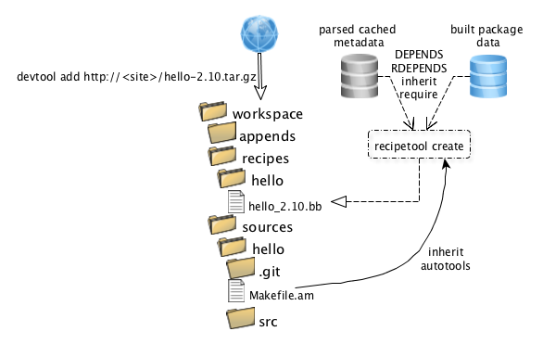
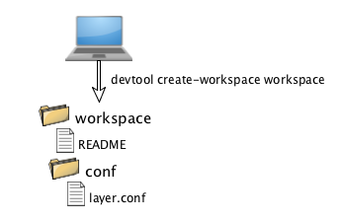
devtool – Overview

Slide 17
devtool - Baking in a sandbox
Class will cover these use cases for devtool
Development cycle with a new recipe
  Create a recipe from a source tree, then we will build, deploy, edit, build, and deploy
Development cycle to modify the source of existing recipe
  Extract recipe and source, then edit, build, and deploy
Development cycle to upgrade an existing recipe
  Extract recipe and source, then edit, build, and deploy

Slide 18
devtool - subcommands
Beginning work on a recipe:
add Add a new recipe
modify Modify the source for an existing recipe
upgrade Upgrade an existing recipe
Getting information:
status Show workspace status
search Search available recipes
Working on a recipe in the workspace:
build Build a recipe
edit-recipe Edit a recipe file in your workspace
configure-help Get help on configure script options
update-recipe Apply changes from external source tree to recipe
reset Remove a recipe from your workspace
Testing changes on target:
deploy-target Deploy recipe output files to live target machine
undeploy-target Undeploy recipe output files in live target
build-image Build image including workspace recipe packages
Advanced:
create-workspace Set up workspace in an alternative location
extract Extract the source for an existing recipe
sync Synchronize the source tree for an existing recipe

Slide 19
Activity 0 – Setup our build enviroment
Start a new Shell! Otherwise, the existing bitbake environment can cause unexpected results
<open new clean shell>
$ cd /scratch
Source the build environment
$ . ./poky/oe-init-build-env build-devday
  Use the pre-populated downloads and sstate-cache
  $ sed -i -e 's:#DL_DIR ?= "${TOPDIR}/downloads":DL_DIR ?= "/scratch/downloads":g' conf/local.conf
  $ sed -i -e 's:#SSTATE_DIR ?= "${TOPDIR}/sstate-cache":SSTATE_DIR ?= "/scratch/sstate-cache":g' conf/local.conf
  Set machine to qemuarm
  $ sed -i -e 's:#MACHINE ?= "qemuarm":MACHINE ?= "qemuarm":g' conf/local.conf

Slide 20
Activity 0 – Setup a new layer to receive our work
Best practice is to use a function/application layer, so let’s create one
$ pushd ..
$ yocto-layer create foo
$ popd
Add our new layer to our configuration
$ bitbake-layers add-layer ../meta-foo
  Setup complete! Time to create a new recipe…

Slide 21
Activity 1: Add a new recipe
Optional: build core-image-minimal first
$ pwd
(should be in /scratch/build-devday)
$ devtool build-image core-image-minimal
Add our new recipe
$ devtool add nano \
https://www.nano-editor.org/dist/v2.7/nano-2.7.4.tar.xz
  Examine what devtool created:
  $ ls workspace
  $ find workspace/recipes
  $ pushd workspace/sources/nano/
  $ git log
  $ popd
  Now we are ready to build it:
  $ devtool build nano
  $ devtool build-image core-image-minimal

Slide 22
Activity 1: Add a new recipe (continued)
Run our image in QEMU
$ runqemu slirp nographic qemuarm
(login as root, no password)
  Run our application
  $ nano
  (Ctrl-x to exit nano)
  Examine where it was installed
  $ ls /usr/bin/nano
  $ exit
  (Ctrl-a x to exit qemu)
Notes:
Without slirp, you will need sudo permission to run qemu with the tuntap feature

Slide 23
Activity 1: Add a new recipe (continued)
“Publish” our recipe
$ devtool finish nano ../meta-foo
  Clean up
  $ rm –rf workspace/sources/nano
  Profit!

Slide 24
Activity 2: Modify a recipe
Sanity check
$ pwd
(should be in /scratch/build-devday)
  Re-inforce what we just learned
  $ devtool add hello \ https://ftp.gnu.org/gnu/hello/hello- 2.10.tar.gz
  $ devtool build hello
  $ devtool build-image core-image-minimal
  $ runqemu slirp nographic qemuarm
  (login as root, no password)
  Run our new application
  $ hello
  Hello, world!
Notes:
The first time we compile, an error is thrown. Compile again and it succeeds. Has something to do with how the autotools steps are being run.

Slide 25
Activity 2: Modify a recipe (continued)
Sanity check
$ pwd
(should be in /scratch/build-devday)
  Re-inforce what we just learned
  $ devtool add hello \ https://ftp.gnu.org/gnu/hello/hello- 2.10.tar.gz
  $ devtool build hello
  $ devtool build-image core-image-minimal
  $ runqemu slirp nographic qemuarm
  (login as root, no password)
  Run our new application
  $ hello
  Hello, world!
  $ exit
  (Ctrl-a x to exit qemu)
  Publish our new recipe and cleanup
  $ devtool finish hello ../meta-foo
  $ rm –rf workspace/sources/hello

Slide 26
Activity 2: Modify a recipe (continued)
Might need to let git know who you are
$ git config --global user.email you@example.com
$ git config --global user.name "Your Name”
Modify our application’s source code
$ devtool modify hello
$ pushd workspace/sources/hello
$ sed -i -e 's:"Hello, world!":"Hello, Prague!":g' src/hello.c
$ git log
$ git commit -m "Change world to Prague"
  Build and run our modified application
  $ devtool build-image core-image-minimal
  $ runqemu slirp nographic qemuarm
  (login as root, no password)
  $ hello
  Hello, Prague!
  $ exit
  (Ctrl-a x to exit qemu)

Slide 27
Activity 2: Modify a recipe (continued)
  Publish our modifed source and recipe and cleanup
  $ popd
  $ devtool finish hello ../meta-foo
  $ rm –rf workspace/sources/hello
Review what changed
$ pushd ../meta-foo/recipes-hello/hello
$ ls
$ cat hello_2.10.bb
$ cat hello_%.bbappend
$ cat hello/0001-Change-world-to-Prague.patch
$ popd
  Cleanup
  $ rm –rf workspace/sources/hello
  Profit!

Slide 28
Activity 3: Upgrade a recipe
  Upgrade our nano recipe to the latest version
  $ devtool upgrade nano --version 2.8.7
(Hack) Fix fetch URL to allow upgrade to v2.8.x
$ sed -i -e 's:v2.7:v2.8:g' \
../meta-foo/recipes-nano/nano/nano_2.7.4.bb
NOTE: there is a bugzilla open to add the ability to change the fetch URL [https://bugzilla.yoctoproject.org/show_bug.cgi?id=10722]
  Cleanup our failed upgrade attempt
  $ rm –rf workspace/sources/nano
  Actually upgrade
  $ devtool upgrade nano --version 2.8.7

Slide 29
Activity 3: Upgrade a recipe (continued)
  Review what changed
  $ ls workspace/recipes/nano
  $ cat workspace/recipes/nano/nano_2.8.7.bb
Test our upgraded application
$ devtool build-image core-image-minimal
$ runqemu slirp nographic qemuarm
(login as root, no password)
$ nano
(Ctrl-x to exit nano)
$ exit
(Ctrl-a x to exit qemu)
  Publish our work and cleanup
  $ devtool finish nano ../meta-foo
  $ rm –rf workspace/sources/nano
  Profit!

Slide 30
devtool - References
Yocto devtool documentation
  http://www.yoctoproject.org/docs/current/dev-manual/dev-manual.html#using-devtool-in-your-workflow
Tool Author Paul Eggleton’s ELC Presentation:
  http://events.linuxfoundation.org/sites/events/files/slides/yocto_project_dev_workflow_elc_2015_0.pdf
Trevor Woerner’s Tutorial https://drive.google.com/file/d/0B3KGzY5fW7laQmgxVXVTSDJHeFU/view?usp=sharing
Sean Hudson’s YP Dev Day Presentation (more focused on eSDK workflow):
https://wiki.yoctoproject.org/wiki/images/f/f6/Yocto_DevDay_Advanced_Class_Portland.pdf
Instructor’s ELC Presentation:
https://elinux.org/images/e/e2/2017_ELC_--_Using_devtool_to_Streamline_your_Yocto_Project_Workflow.pdf
https://www.youtube.com/watch?v=CiD7rB35CRE

Slide 31
Activity Three
DT overlays
Marek Vasut

Slide 32
Device Tree
Data structure describing hardware
Usually passed to OS to provide information about HW topology where it cannot be detected/probed
Tree, made of named nodes and properties
    Nodes can contain other nodes and properties
    Properties are a name-value pair
    See https://en.wikipedia.org/wiki/Device_tree
DT can contain cycles by means of phandles
ePAPR specification of DT:
    https://elinux.org/images/c/cf/Power_ePAPR_APPROVED_v1.1.pdf

Slide 33
Device Tree Example
arch/arm/boot/dts/arm-realview-eb-a9mp.dts
/dts-v1/;
#include "arm-realview-eb-mp.dtsi"
/ {
model = "ARM RealView EB Cortex A9 MPCore";
[...]
cpus {
#address-cells = <1>;
#size-cells = <0>;
enable-method = "arm,realview-smp";
A9_0: cpu@0 {
device_type = "cpu";
compatible = "arm,cortex-a9";
reg = <0>;
next-level-cache = <&L2>;
};
[...]
&pmu {
interrupt-affinity = <&A9_0>, <&A9_1>, <&A9_2>, <&A9_3>;
};

Slide 34
Problem – Variable hardware
DT started on machines the size of a little fridge
  HW was mostly static
  DT was baked into ROM, optionally modified by bootloader
DT was good, so it spread
  First PPC, embedded PPC, then ARM …
There always was slightly variable hardware
  Solved by patching DT in bootloader
  Solved by carrying multiple DTs
  Solved by co-operation of board files and DT
  ^ all that does not scale

Slide 35
Problem – Variable hardware – 201x edition
Come 201x, variable HW became easy to make:
  Cheap devkits with hats, lures, capes, …
  FPGAs and SoC+FPGAs became commonplace …
  => Combinatorial explosion of possible HW configurations
Solution retaining developers’ sanity
  Describe only the piece of HW that is being added
  Combine these descriptions to create a DT for the system
  Enter DT overlays

Slide 36
Device Tree Overlays
DT: Data structure describing hardware
DTO: necessary change(s) to the DT to support particular feature
  Example: an expansion board, a hardware quirk,...
Example DTO:
/dts-v1/;
/plugin/;
/ {
#address-cells = <1>;
#size-cells = <0>;
fragment@0 {
reg = <0>;
target-path = "/";
__overlay__ {
#address-cells = <1>;
#size-cells = <0>;
hello@0 {
compatible = "hello,dto";
reg = <0>;
}; }; }; };

Slide 37
Advanced DTO example
/dts-v1/;
/plugin/;
[...]
fragment@2 {
reg = <2>;
target-path = "/soc/usb@ffb40000";
__overlay__ {
[...]
status = "okay";
};
};
fragment@3 {
reg = <3>;
target-path = "/soc/ethernet@ff700000";
__overlay__ {
[...]
status = "okay";
phy-mode = "gmii";
};
};

Slide 38
DTO Hands-on
Use pre-prepared meta-dto-microdemo layer
meta-dto-demo contains:
    Kernel patch with DTO loader with ConfigFS interface
    Kernel config fragment to enable the DTO and loader
    Demo module
    Demo DTO source ( hello-dto.dts )
    core-image-dto-microdemo derivative from
    core-image-minimal with added DTO examples and DTC

Slide 39
DTO Hands-on 1/2
Add meta-dto-demo to bblayers.conf BBLAYERS:
Rebuild virtual/kernel and core-image-dto-microdemo
Start the new image in QEMU
$ ${EDITOR} conf/bblayers.conf
$ bitbake -c cleansstate virtual/kernel
$ bitbake core-image-dto-microdemo
$ runqemu qemuarm

Slide 40
DTO Hands-on 2/2
Compile DTO
Load DTO
Unload DTO
$ dtc -I dts -O dtb /lib/firmware/dto/hello-dto.dts \
/tmp/hello-dto.dtb
$ mkdir /sys/kernel/config/device-tree/overlays/mydto
$ cat /tmp/hello-dto.dtb > \
/sys/kernel/config/device-tree/overlays/mydto/dtbo
$ rmdir /sys/kernel/config/device-tree/overlays/mydto

Slide 41
DTO encore
DTOs can be used to operate SoC+FPGA hardware
Done using FPGA manager in Linux
fragment@0 {
reg = <0>;
/* controlling bridge */
target-path = "/soc/fpgamgr@ff706000/bridge@0";
__overlay__ {
#address-cells = <1>;
#size-cells = <1>;
area@0 {
compatible = "fpga-area";
#address-cells = <2>;
#size-cells = <1>;
ranges = <0 0x00000000 0xff200000 0x00080000>;
firmware-name = "fpga/bitstream.rbf";
fpga_version@0 {
compatible = "vendor,fpgablock-1.0";
reg = <0 0x0 0x04>;
};

Slide 42
Activity Four
Userspace: Advanced Topics
Rudi Streif
(given by David Reyna)

Slide 43
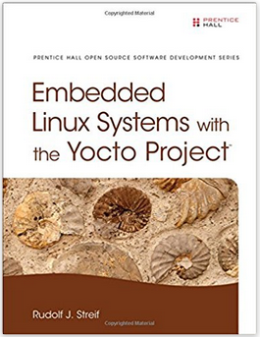
See Rudi Streif’s Book on Yocto Project!
“Embedded Linux Systems with the Yocto Project”,
Hardcover – May 2 2016, Prentice Hall
Amazon: #10 in Books > Computers & Technology > Hardware > Microprocessors & System Design > Embedded Systems

Slide 44
What We Are Going To Do
Most of your development work will likely be developing your own software packages, building them with the Yocto Project and installing them into a root file system built with the Yocto Project.
Let’s look at some typical tasks beyond creating the base recipe:
  Customizing Packaging
  Package Installation Scripts
  System Services

Slide 45
Activity Setup
Initialize the Build Environment (IN A CLEAN SHELL)
  cd /scratch/working
  source ../poky/oe-init-build-env build
Adjust Configuration (DONE FOR YOU)
  vi conf/local.conf
Build (DONE FOR YOU)
  bitbake -k core-image-base
Test
  runqemu qemux86-64 nographic
MACHINE = "qemuarm"
DL_DIR ?= "/scratch/downloads"
SSTATE_DIR ?= "/scratch/sstate-cache"
EXTRA_IMAGE_FEATURES ?= "debug-tweaks dbg-pkgs dev-pkgs package-management"

Slide 46
Activity Setup - Continued
Create Local Devtool Layer “meta-uspapps”
  devtool create-workspace meta-uspapps
Observe your source file directory
  tree /scratch/src/userspace
      /scratch/src/userspace
      \-- fibonacci
      |--- fibonacci-app
      | |--- fibonacci-app.c
      | \-- Makefile
      |--- fibonacci-lib
      | |--- fibonacci-app.c
      | |--- fibonacci.c
      | |--- fibonacci.h
      | |--- fibonacci-lib.bb
      | \-- Makefile
      \-- fibonacci-srv
      |--- fibonacci-srv.bb
      |--- fibonacci-srv.init
      |--- fibonacci-srv.service
      |--- fibonacci-srv-tcp
      |--- fibonacci-srv-tcp.c
      |--- fibonacci-srv-unix
      |--- fibonacci-srv-unix.c
      |--- Makefile
      \-- Makefile.all

Slide 47
Packaging
Packaging is the process of putting artifacts from the build output into one or more packages for installation by a package management system.
Packaging is performed by the package management classes:
  package_rpm – RPM style packages
  package_deb – Debian style packages
  package_ipk – IPK package files used by the OPK package manager
You configure the package management in conf/local.conf:
  You can add more than one of the package classes.
  Only the first one will be used to create the root file system.
  However, this does not install the package manager itself.
Install the package manager in conf/local.conf:
PACKAGE_CLASSES ?= "package_rpm"
EXTRA_IMAGE_FEATURES ?= "package-management"

Slide 48
Package Splitting
Packaging Splitting is the process of putting artifacts from the build output into different packages.
Package splitting allows you to select what you need to control the footprint of your root file system.
Package splitting is controlled by the variables:
  PACKAGES – list of package names, default:
  FILES – list of directories and files that belong into the package:
PACKAGES = "${PN}-dbg ${PN}-staticdev ${PN}-dev ${PN}-doc \
${PN}-locale ${PACKAGE_BEFORE_PN} ${PN}"
SOLIBS = "*.so.*“
FILES_${PN} = "${bindir}/* ${sbindir}/* ${libexecdir}/* \
${libdir}/lib* {SOLIBS} ${sysconfdir} ${sharedstatedir} \
${localstatedir} ${base_bindir}/* ${base_sbindir}/* \
${base_libdir}/*${SOLIBS} ${base_prefix}/lib/udev/rules.d \
${prefix}/lib/udev/rules.d ${datadir}/${BPN}\
${libdir}/${BPN}/* ${datadir}/pixmaps \
${datadir}/applications ${datadir}/idl ${datadir}/omf \
${datadir}/sounds ${libdir}/bonobo/servers"

Slide 49
Package Splitting - Continued
The package classes process the PACKAGES list from left to right, producing the ${PN}-dbg package first and the ${PN} package last.
The order is important, since a package consumes the files that are associated with it.
The ${PN} package is pretty much the “kitchen sink”: it consumes all standard leftover artifacts.
BitBake syntax only allows prepending (+=) or appending (=+) to variables:
  Prepend PACKAGES – place standard artifacts into different packages
  Append PACKAGES – place any leftover packages in non-standard installation directories those packages.
The variable PACKAGE_BEFORE_PN allows you to insert packages right before the ${PN} package is created.

Slide 50
Packaging QA
The insane class adds plausibility and error checking to the packaging process.
You can find a list of the checks in the Reference Manual: http://www.yoctoproject.org/docs/2.3/ref-manual/ref-manual.html#ref-classes-insane
Some of the more common ones:
  already-stripped – debug symbols already stripped
  installed-vs-shipped – checks for artifacts that have not been packaged
  ldflags – checks if LDFLAGS for cross-linking has been passed
  packages-list – same package has been listed multiple times in PACKAGES
Sometimes the checks can get into your way…
  INSANE_SKIP_<packagename> += “<check>”
  Skips <check> for <packagename>.

Slide 51
Example – The Fibonacci Library
Source code in /scratch/working/uspsrc/fibonacci-lib
  Builds static and dynamic libraries to calculate the Fibonacci series and an application to test it.
Create development environment in the project
  devtool add fibonacci-lib /scratch/src/userspace/fibonacci/fibonacci-lib
Build the recipe
  bitbake fibonacci-lib
Add to your image (conf/local.conf):
Build and test image
  bitbake core-image-minimal
  runqemu qemux86-64 nographic
  ...
  root@qemuarm:~# fibonacci
  Enter the number of terms: 4
  First 4 terms of Fibonacci series are:
  0 1 1 2
IMAGE_INSTALL_append = " fibonacci-lib"

Slide 52
Example – The Fibonacci Library (continued)
Edit the recipe meta-uspapps/recipes/fibonacci-lib/fibonacci-lib.bb and place the fibonacci test application into its own package ${PN}-examples
Add to your image (conf/local.conf):
Build and test image
  bitbake core-image-minimal
  runqemu qemux86-64 nographic
PACKAGE_BEFORE_PN = "${PN}-examples"
FILES_${PN}-examples = "${bindir}/fibonacci"
IMAGE_INSTALL_append = " libfibonacci libfibonacci-examples"

Slide 53
Package Installation Scripts
Package management systems have the ability to run scripts before and after a package is installed, upgraded, or removed.
These are typically shell scripts and they can be provided by the recipe using these variables:
  pkg_preinst_<packagename>: Preinstallation script that is run before the package is installed.
  pkg_postinst_<packagename>: Postinstallation script that is run after the package is installed.
  pkg_prerm_<packagename>: Pre-uninstallation script that is run before the package is uninstalled.
  pkg_postrm_<packagename>: Post-uninstallation script that is run after the package is uninstalled.
pkg_postinst_${PN}() {
#!/bin/sh
# shell commands go here
}
Script Skeleton
pkg_postinst_${PN}() {
#!/bin/sh
if [ x"$D" = "x" ]; then
# target execution
else
# build system execution
fi
}
Conditional Execution

Slide 54
Example – Conditionally running ldconfig
The Fibonacci library installs a dynamic library libfibonacci.so.1.0 on the target system in /usr/lib.
For ld to be able to locate the library it must be added to the ld cache and its symbolic name (soname) must be linked. That is done by running ldconfig on the target.
Add a post installation script to the ${PN} package that only runs ldconfig when it is run on the target but not when the build system creates the root file system.
pkg_postinst_${PN}() {
#!/bin/sh
if [ x"$D" = "x" ]; then
# target execution
ldconfig
exit 0
else
# build system execution
exit 1
fi
}

Slide 55
Installation for Packaging
Makefile Installation
Recipe Installation
  Providing/overriding the do_install task
  The build system defines a series of variables for convenience:
      bindir = "/usr/bin"
      sbindir = "/usr/sbin"
      libdir = "/usr/lib"
      libexecdir = "/usr/lib"
INSTALL ?= install
.PHONY: install
Install:
$(INSTALL) -d $(DESTDIR)/usr/bin
$(INSTALL) -m 0755 $(TARGET) $(DESTDIR)/usr/bin
do_install() {
install –d ${D}${bindir}
install –m 0755 ${B}/bin/* ${D}{bindir}
}
  sysconfdir = "/etc/"
  datadir = "/usr/share"
  mandir = "/use/share/man"
  includedir = "/usr/include"

Slide 56
Debugging Packaging
Check the packaging logfiles in ${WORKDIR}/temp
Check installation of artifacts in ${WORKDIR}/image
  The do_install task installs the artifacts into this directory.
  If artifacts are missing they are packaged.
Check packaging artifacts in ${WORKDIR}/package
  This where the artifacts are staged for packaging, including the ones created for the debug packages.
Check package splitting in ${WORKDIR}/packages-split
  Packages and their content are staged here by package name before they are wrapped by the package manager.
  Allows you to verify if the artifacts have indeed been placed into the correct package.
Check created packages in ${WORKDIR}/deploy-<pkgmgr>

Slide 57
Package Architecture
The build system distinguishes packages by their hardware dependencies into three main categories:
  Tune – Generic CPU architecture such as core2_32, corei7, armv7, etc. This is the default and typically appropriate for userspace packages.
  Machine – Specific machine architecture. Appropriate for packages that require particular hardware features of a machine. Typically applicable to kernel, drivers, and bootloader.
  All – Package applies to all architectures such as shell scripts, managed runtime code (Python, Lua, Java, …), configuration files, etc.
Package architecture is controlled by the PACKAGE_ARCH variable:
  Tune (default) – PACKAGE_ARCH = "${TUNE_PKGARCH}"
  Machine – PACKAGE_ARCH = "${MACHINE_ARCH}"
  All – inherit allarch
Note: Package architecture does not simply determine into what category a package is placed but determines compiler and linker flags and other build options.

Slide 58
System Services
If your software package is a system service that eventually needs to be started when the system boots you need to add the scripts and service files.
SysVInit
  Inherit update-rc.d class.
  INITSCRIPT_PACKAGES - List of packages that contain the init scripts for this software package. This variable is optional and defaults to INITSCRIPT_PACKAGES = "${PN}".
  INITSCRIPT_NAME - The name of the init script.
  INITSCRIPT_PARAMS - The parameters passed to update-rc.d. This can be a string such as "defaults 80 20" to start the service when entering run levels 2, 3, 4, and 5 and stop it from entering run levels 0, 1, and 6.
Systemd
  Inherit systemd class.
  SYSTEMD_PACKAGES - List of packages that contain the systemd service files for the software package. This variable is optional and defaults to SYSTEMD_PACKAGES = "${PN}".
  SYSTEMD_SERVICE - The name of the service file.

Slide 59
Example – The Fibonacci Server
Source code in /scratch/src/userspace/fibonacci/fibonacci-srv
  Builds a TCP socket server listening on port 9999 for the number of terms and responds with the list of Fibonacci terms.
Create development environment
  cd /scratch/working/build
  devtool add fibonacci-srv /scratch/src/userspace/fibonacci/fibonacci-srv
Add system service startup to the recipe
meta-uspapps/recipes/fibonacci-srv/fibonacci-srv.bb
Build the recipe
  bitbake fibonacci-lib
Add to your image (conf/local.conf):
Build and test image
  bitbake core-image-minimal
  runqemu qemux86-64 nographic
  nc localhost 9999
inherit update-rc.d systemd
INITSCRIPT_NAME = "fibonacci-srv"
INITSCRIPT_PARAMS = "start 99 3 5 . stop 20 0 1 2 6 ."
SYSTEMD_SERVICE = "fibonacci-srv.service"
IMAGE_INSTALL_append = " fibonacci-srv"

Slide 60
Changing the System Manager
SysVInit is the default system manager for the Poky distribution.
To use systemd add it to your conf/local.conf file, or better, to your distribution configuration:
If you exclusively want to use systemd, you can remove SysVInit from you root file system image with:
DISTRO_FEATURES_append = " systemd"
VIRTUAL-RUNTIME_init_manager = "systemd"
DISTRO_FEATURES_BACKFILL_CONSIDERED = "sysvinit"
VIRTUAL-RUNTIME_initscripts = ""

Slide 61
Activity Five
License Compliance and Auditing
Beth ‘pidge’ Flanagan and Paul Barker
Togán Labs Ltd.

Slide 62
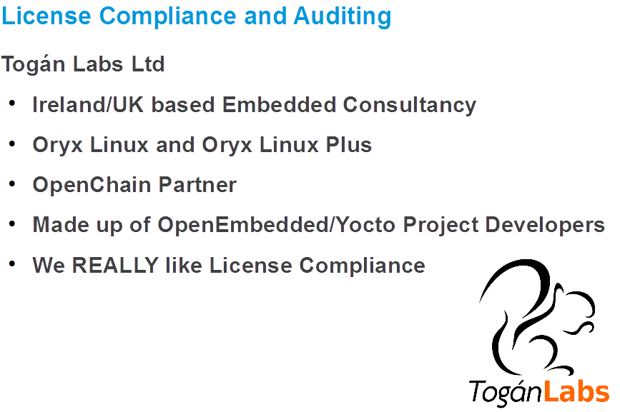

Slide 63
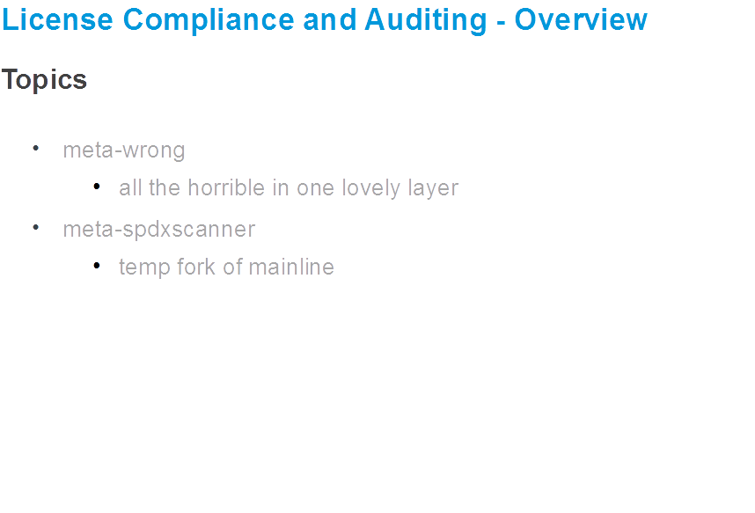

Slide 64
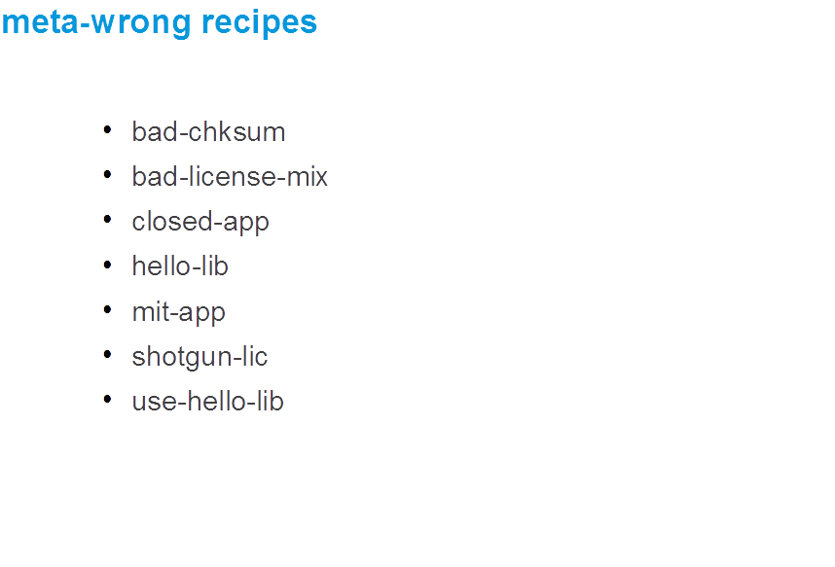

Slide 65
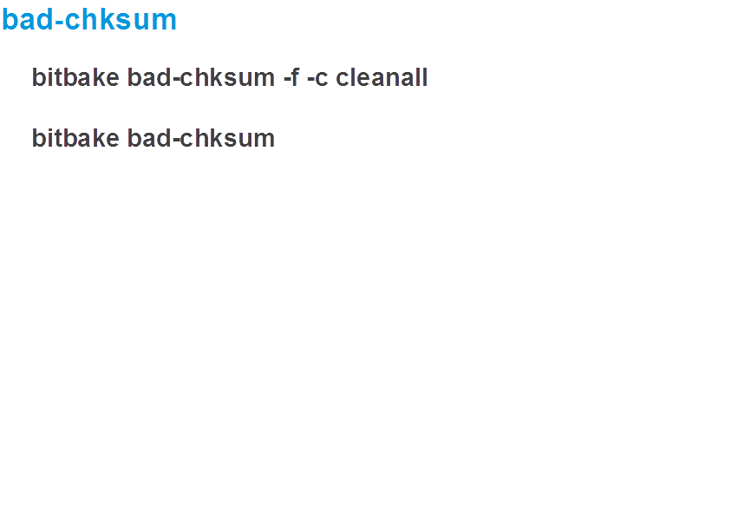

Slide 66
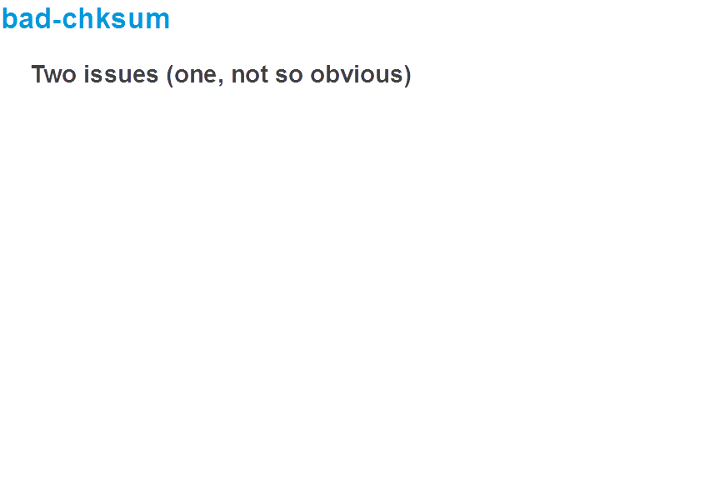

Slide 67
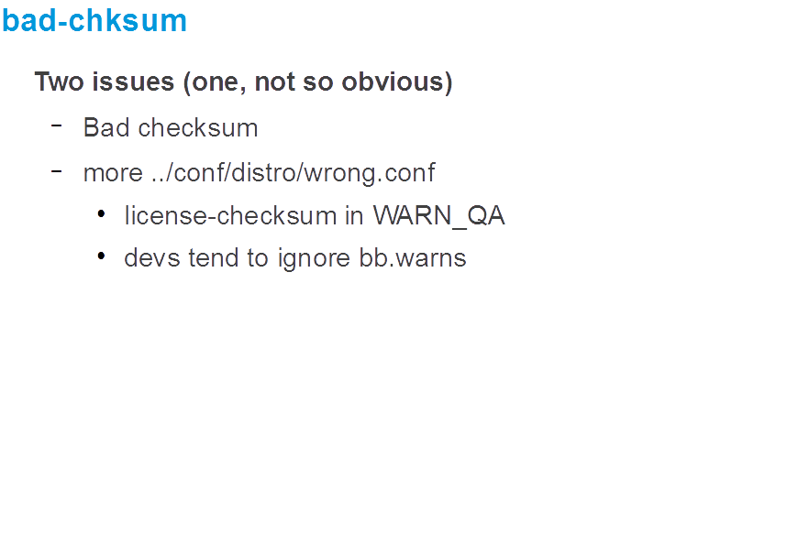

Slide 68
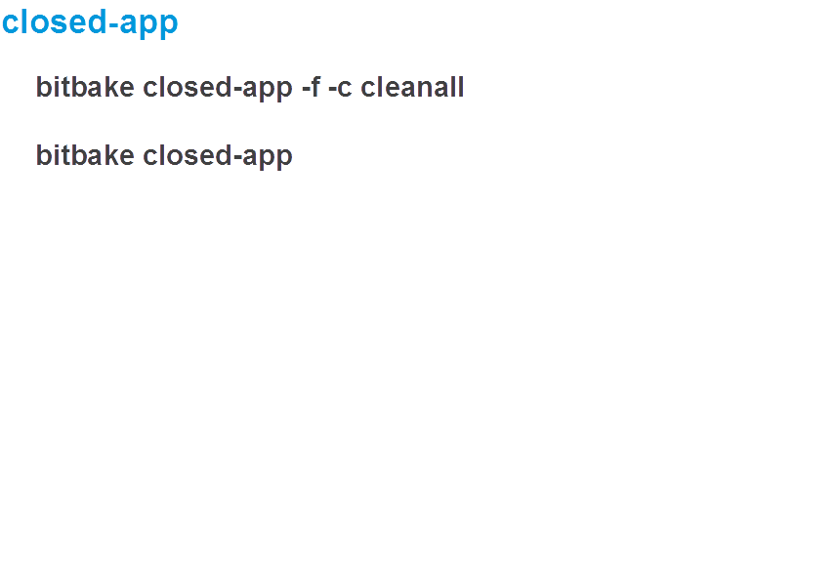

Slide 69
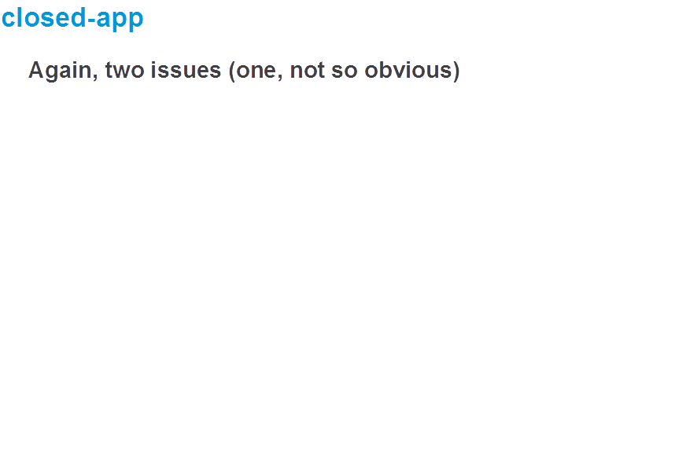

Slide 70
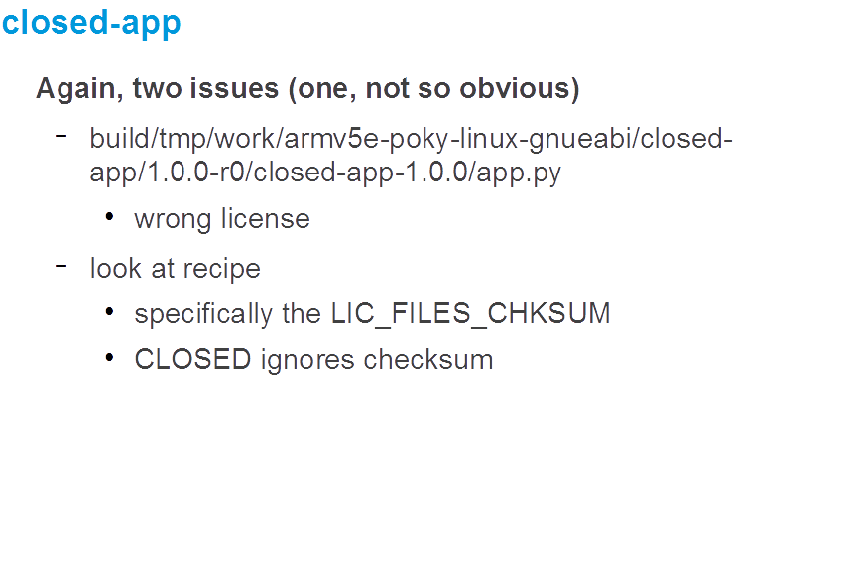

Slide 71
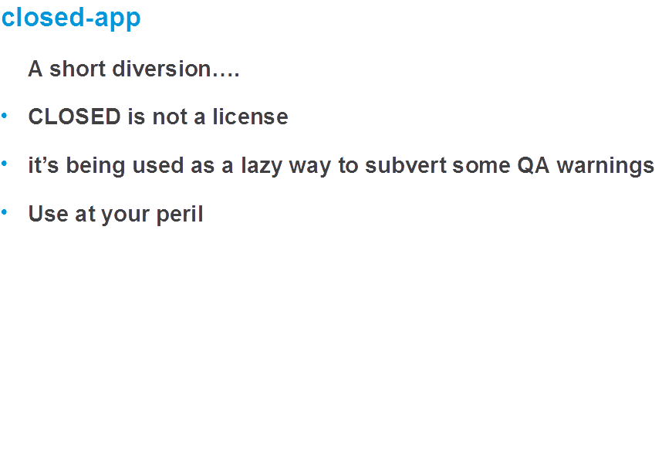

Slide 72
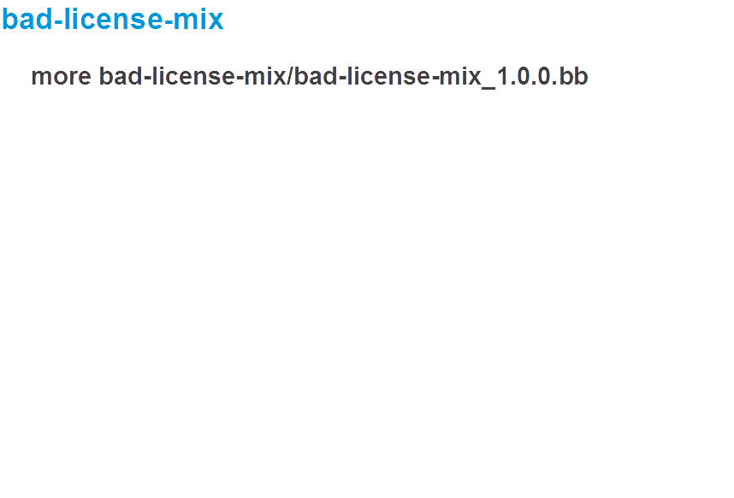

Slide 73
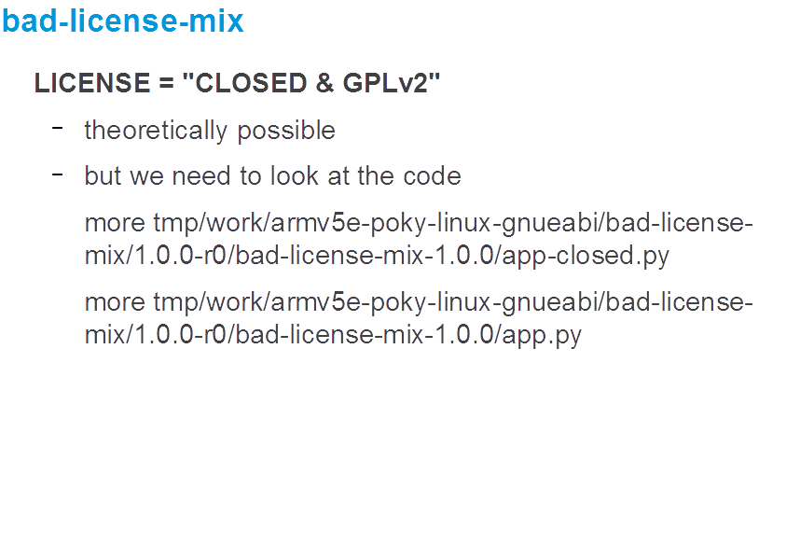

Slide 74
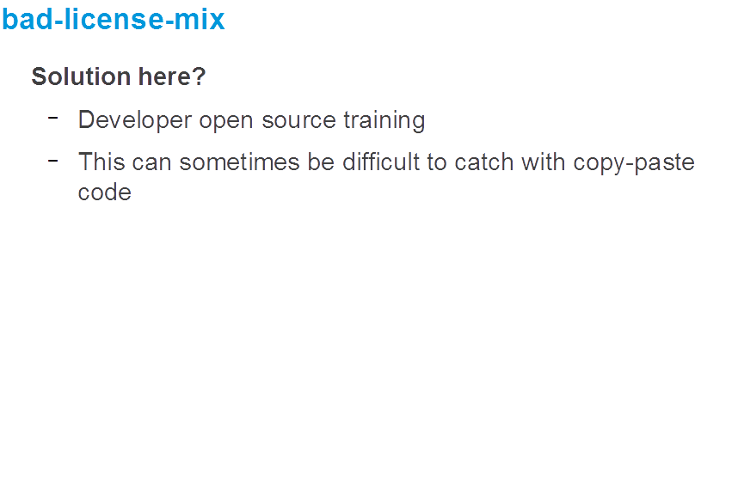

Slide 75


Slide 76
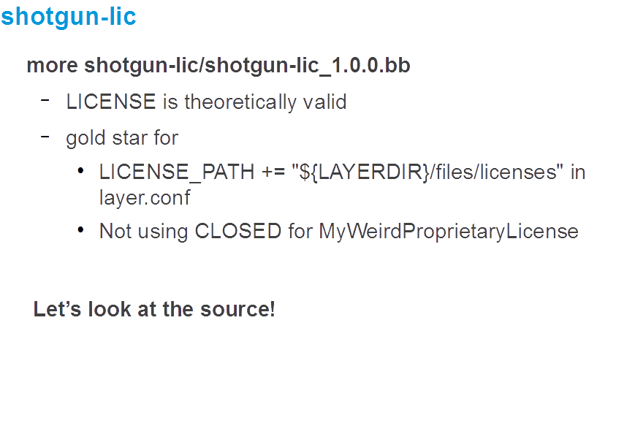

Slide 77
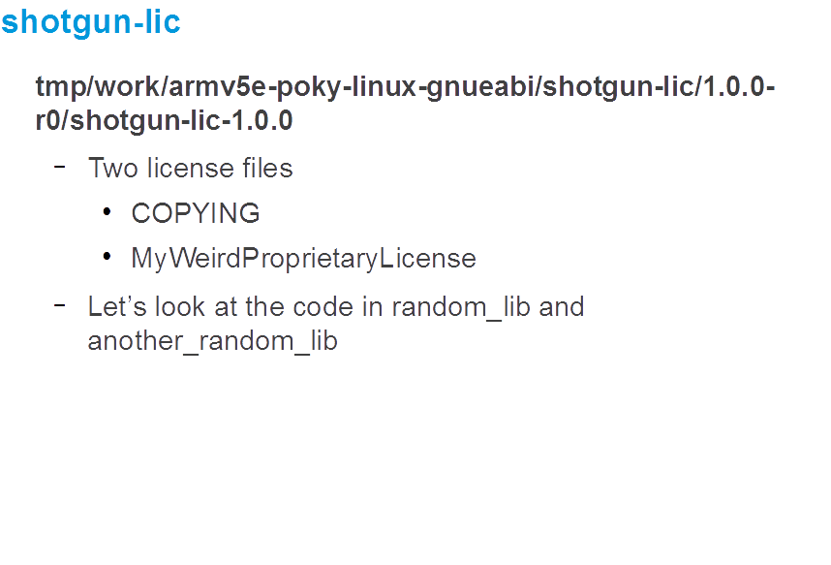

Slide 78
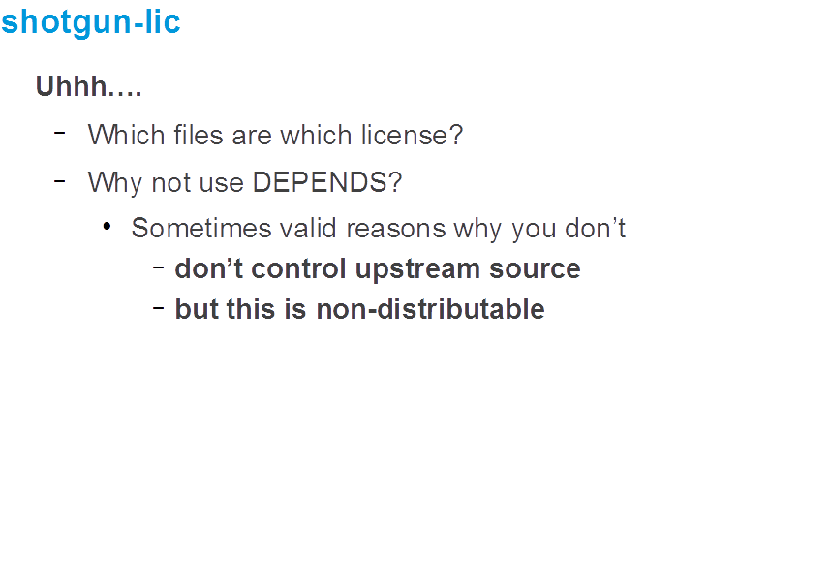

Slide 79
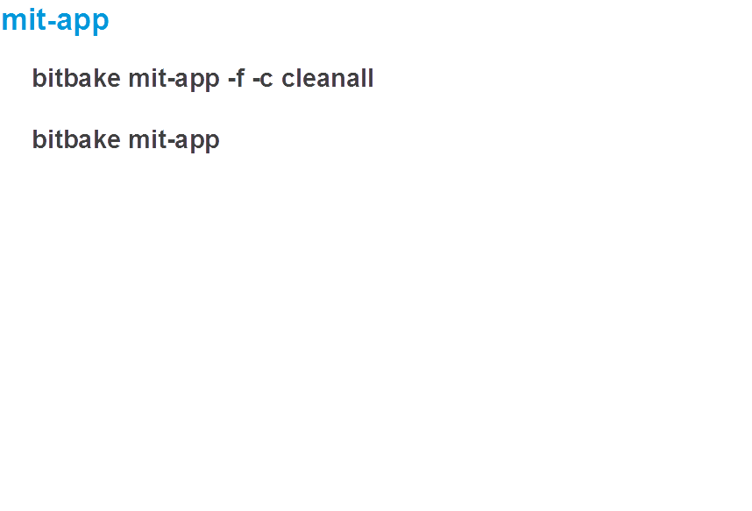

Slide 80
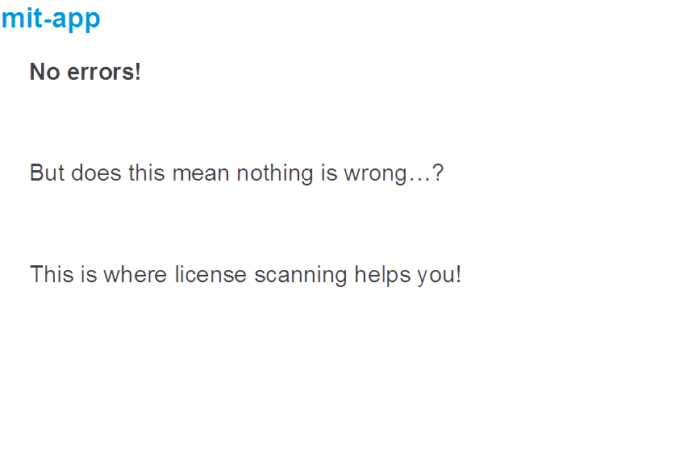

Slide 81
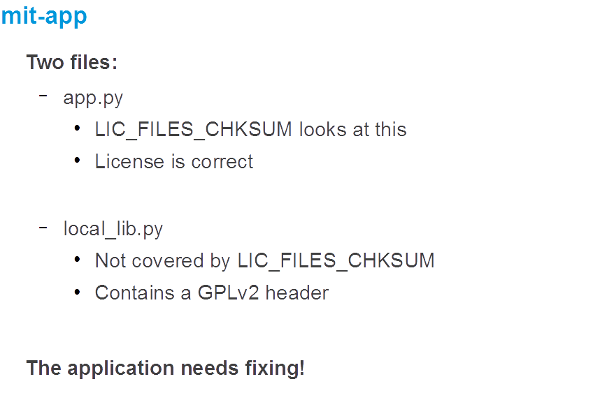

Slide 82
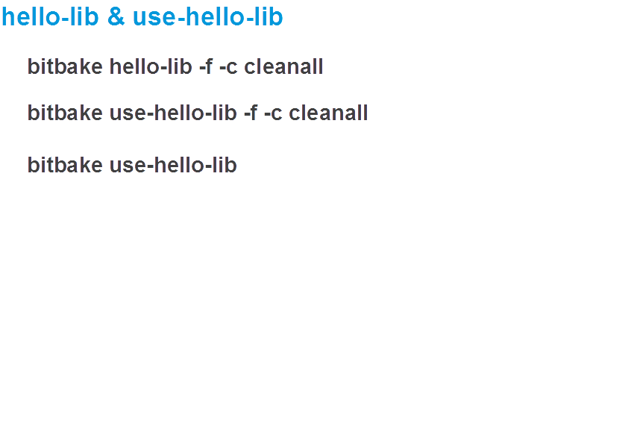

Slide 83
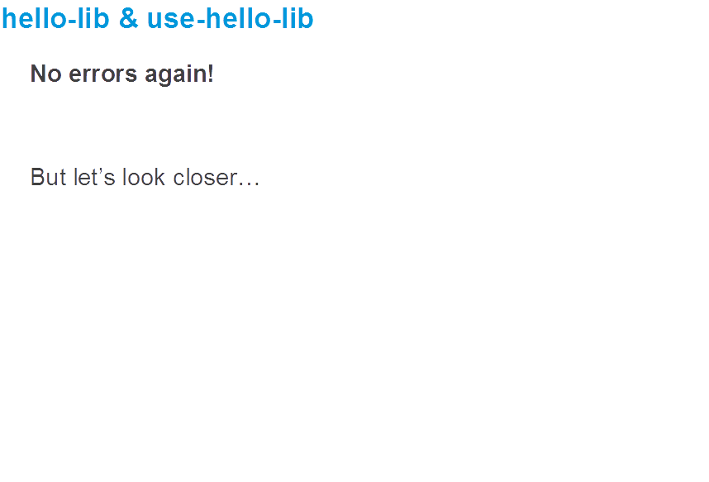

Slide 84
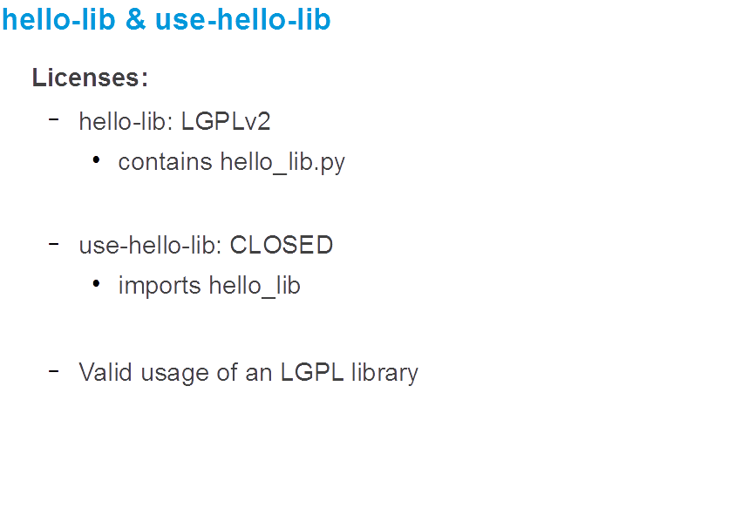

Slide 85
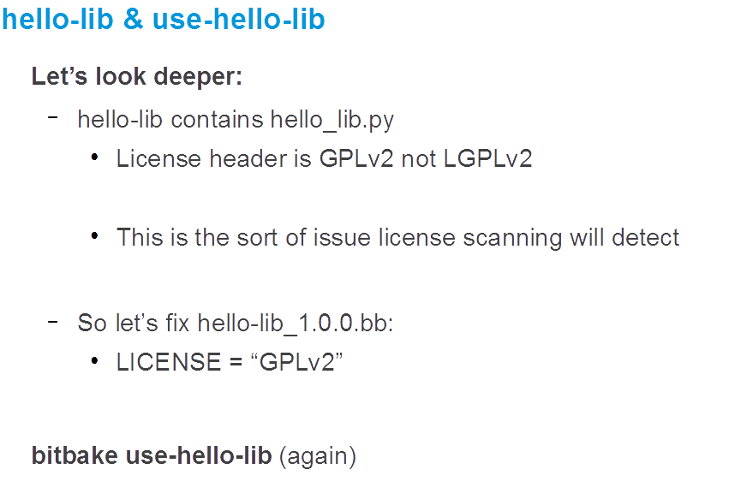

Slide 86
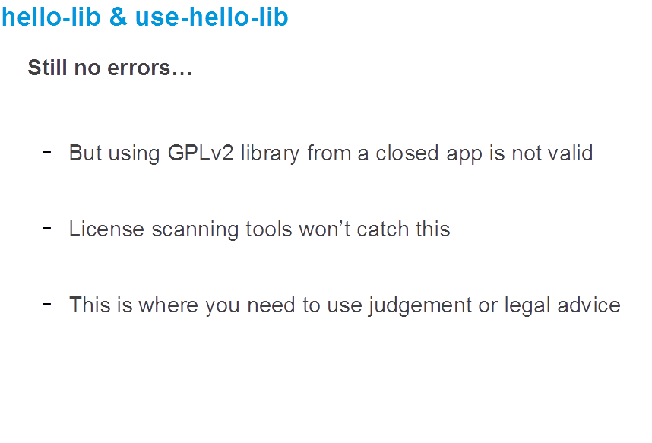

Slide 87
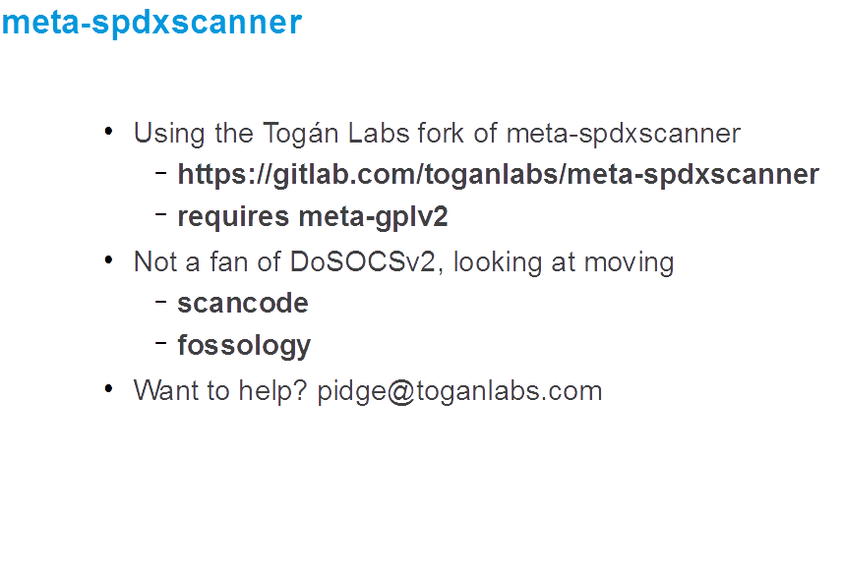

Slide 88
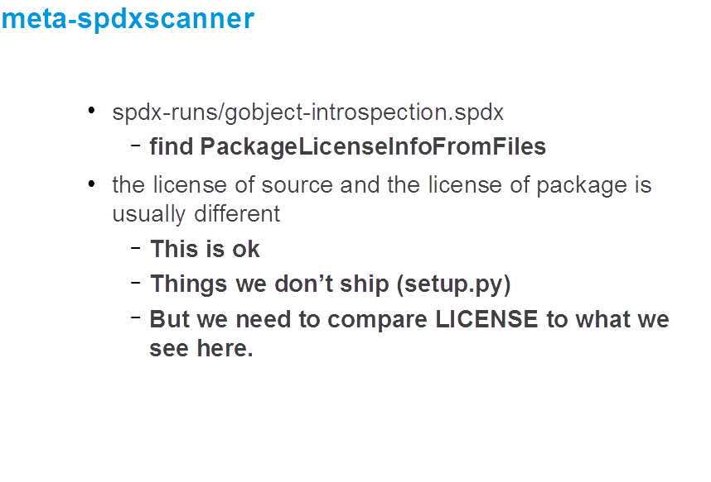

Slide 89
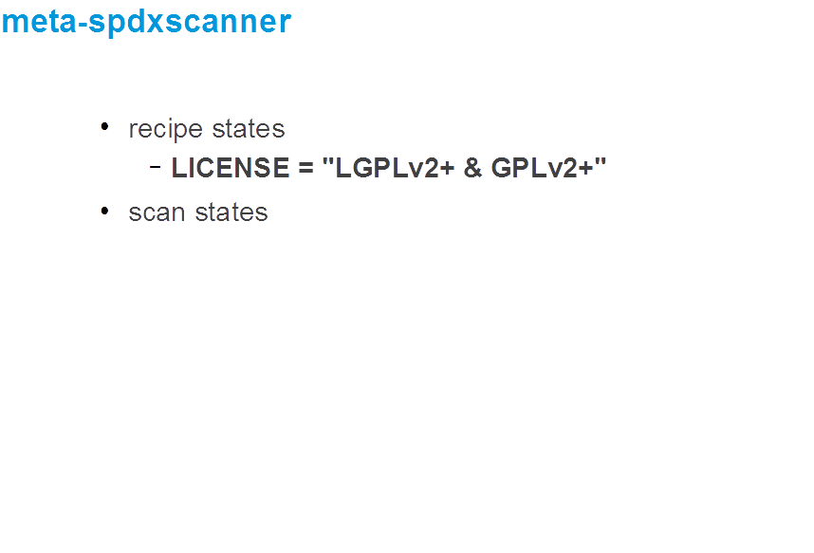

Slide 90
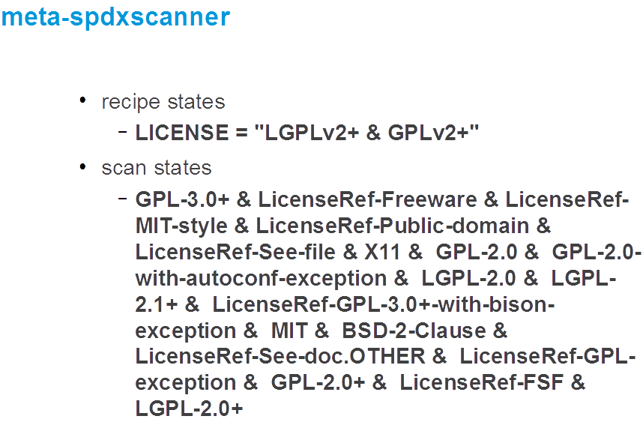

Slide 91
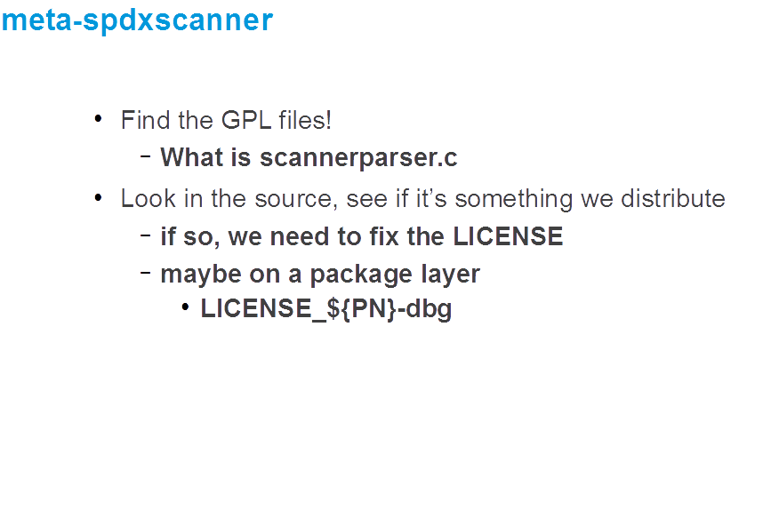

Slide 92
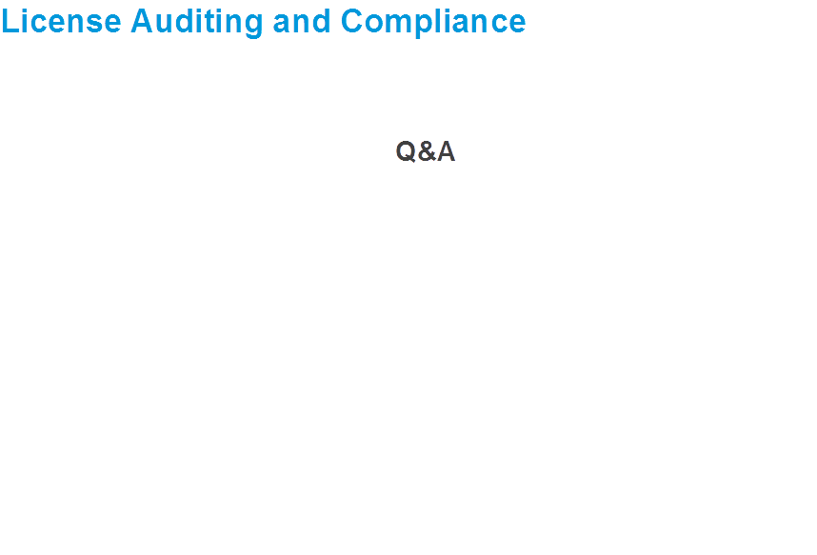

Slide 94
Activity Six
CROPS
Tim Orling, Brian Avery, Randy Witt, David Reyna

Slide 95
CROPS: Containers for Yocto Project
CROss PlatformS (CROPS)* provides a consistent developer experience across Windows, Mac OS X and Linux distros through the use of containers
Why Containers?
  Avoid host contamination
  Easy route to multiple OS support, including Linux!
  Repeatable builds
  Fewer Linux distros to test
  A path to tools in the cloud
  *The instructor also thinks of it as Containers Run Other People’s Software

Slide 96
CROPS: Available Today
crops/extsdk-container
  Container that can support Extensible SDKs
  Also supports standard SDKs
crops/toaster
  Latest released version of toaster/poky currently pyro
crops/toaster-master
  Keeps up with the current master of toaster/poky, kicked off via webhook so it's quite up to date.
crops/poky
  This is an Ubuntu (or other distro) container with the necessary packages to run poky installed, but not poky itself.
  To run poky, you need a copy of it on your file system which you then map into the container.
  This will work equally well for poky or an install of oe-core.

Slide 97
CROPS: Setup Docker
Install Docker
  For Linux, Docker is typically available via the distro package manager, otherwisw go to the Docker web site:
  https://docs.docker.com/engine/installation/linux/
  For Windows and Mac, follow the CROPS Instructions here:
  https://github.com/crops/docker-win-mac-docs/wiki
Note: crops/samba container
  One of the nice features for windows/mac is the crops/samba container that exposes the docker volume to the host side via samba/cifs . This works around the fact that neither the windows nor mac filesystems have sufficient features to support a bitbake build. The docker volume is persistent just like a directory on a linux host would be.

Slide 98
CROPS: eSDK First Time
Follow the instructions at:
https://github.com/crops/extsdk-container
Linux:
$ docker run --rm -it -v /home/myuser/sdkstuff:/workdir crops/extsdk-container --url http://someserver/extensible_sdk_installer.sh
Windows:
$ docker run --rm -it -v myvolume:/workdir crops/extsdk-container --url http://someserver/extensible_sdk_installer.sh
Mac OS X:
$ docker run --rm -it -v myvolume:/workdir crops/extsdk-container --url http://someserver/extensible_sdk_installer.sh

Slide 99
CROPS: eSDK “--url” command
The “--url” tells the CROPS eSDK container where to find the eSDK
That can be a website or you could copy into the container’s workdir, and use:
--url=file:///workdir/extensible_sdk_installer.sh or even –url=/workdir/extensible_sdk_installer.sh
On Mac OS X or Windows, that would be provided via the Samba connection
A useful CROPS eSDK command is “--help”
  This will print out all the startup options for the container.

Slide 100
CROPS: Example eSDK on Mac OS X
The first time, follow the CROPS Mac OS X install instructions
Download the eSDK:
wget http://
Create volume and run the samba container:
$ wget http://downloads.yoctoproject.org/releases/yocto/milestones/\
yocto-2.4_M3/toolchain/x86_64/ \
poky-glibc-x86_64-core-image-sato-armv5e-toolchain-ext-2.3.sh
$ docker volume create --name myvolume
$ docker run -it --rm -v myvolume:/workdir busybox \
chown -R 1000:1000 /workdir
$ docker create -t -p 445:445 --name samba -v myvolume:/workdir crops/samba
$ docker start samba

Slide 101
CROPS: Example eSDK on Mac OS X
Mac OS X specific workaround (not on Windows):
  OS X will not let you connect to a locally running samba share. Therefore, create an alias for 127.0.0.1 of 127.0.0.2.
Open the workdir with file browser:
  Open Finder, then hit 'Command-K'. In the "Server Address" box type smb://127.0.0.2/workdir and click "Connect".
Copy the eSDK installer to the workdir:
$ sudo ifconfig lo0 127.0.0.2 alias up
$ cp ~/Downloads/poky-glibc-x86_64-core-image-sato-armv5e-toolchain-ext-2.3.sh \
/Volumes/workdir/

Slide 102
CROPS: Example eSDK on Mac OS X
Run the container:
In Finder view, right click on hello.c and edit in your favorite editor (e.g. Visual Studio Code)
$ docker run --rm -it -v myvolume:/workdir crops/extsdk-container \
--url file:///workdir/poky-glibc-x86_64-core-image-sato-armv5e-toolchain-ext-2.3.sh
workdir$ . ./environment-setup-armv5e-poky-linux-gnueabi
workdir$ touch hello.c
#include <stdio.h>
int main(void)
{
printf("Hello, Prague 2017!\n");
return 0;
}

Slide 103
CROPS: Example eSDK on Mac OS X
Compile and examine:
/workdir$ $CC hello.c
/workdir$ file a.out
a.out: ELF 32-bit LSB executable, ARM, EABI5 version 1 (SYSV), dynamically linked,
interpreter /lib/ld-linux.so.3, for GNU/Linux 3.2.0,
BuildID[sha1]=17bdf1d27076e3e579c20007f60397c96984a012, not stripped
/workdir$ exit

Slide 104
CROPS: Example eSDK on Mac OS X, Second Time
When you close and then reopen Docker, you will need to restart samba
$ # Restart the Samba container
$ docker start samba
$
$ # The eSDK is already extracted in the eSDK container, so no “--url”
$ docker run --rm -it -v myvolume:/workdir crops/extsdk-container

Slide 105
CROPS: Example Toaster on Mac
Run the container:
$docker run --rm -it -v myvol:/wd -p 127.0.0.1:12000:8000 crops/toaster \
--workdir=/wd
### Shell environment set up for builds. ###
…
Check if toaster can listen on 0.0.0.0:8000
OK
…
Running migrations:
No migrations to apply.
Starting webserver...
Webserver address: http://0.0.0.0:8000/
Successful start.
toasteruser@f07ebe8b10fe:/workdir/build$

Slide 106
CROPS: Example Poky on Mac
Run the container:
docker run --rm -it -v pokyvol:/wd crops/poky --workdir=/wd
pokyuser@5451bf7edfec:/wd$ ls
pokyuser@5451bf7edfec:/wd$ git clone git://git.yoctoproject.org/poky
Cloning into 'poky'...
remote: Counting objects: 354342, done.
remote: Compressing objects: 100% (85618/85618), done.
remote: Total 354342 (delta 263023), reused 353729 (delta 262410)
Receiving objects: 100% (354342/354342), 130.36 MiB | 11.28 MiB/s, done.
Resolving deltas: 100% (263023/263023), done.
Checking connectivity... done.
pokyuser@5451bf7edfec:/wd$ . ./poky/oe-init-build-env
pokyuser@5451bf7edfec:/wd/build$

Slide 107
CROPS: Toaster and Poky
The CROPS Poky can be found here:
https://hub.docker.com/r/crops/poky/
The CROPS Toaster release can be found here:
https://hub.docker.com/r/crops/toaster/
The CROPS extsdk-container can be found here:
https://hub.docker.com/r/crops/extsdk-container/

Slide 108
CROPS: Future
Target for 2.5 is an Eclipse environment where no Yocto Project specific plugin is needed. We are actively working with upstream Linux Tools/Docker Tools and CDT (C/C++ Development Tools).
The Yocto Project magic will be in the metadata inside the toolchain container.
This approach is also expected enable remote/Cloud Docker container instances.
Some of the required upstream functionality expected to be in a December point release of CDT & Linux Tools.

Slide 109
CROPS: Reference
You can use the Docker infrastructure (docker commit to an image, docker save to a tar.gz ) to capture your container and pass it to others for exact analysis, for example for errors and regressions.

Slide 110
CROPS: Call to Action
Users are typically able to get Docker and CROPs up and running on a Mac OS X or Windows host in less than 30 minutes, most of that is the Docker and CROPS container installation time.
See if you can do that as fast on your host today or this week, and build and run “hello.c”.

Slide 111
Reference
The CROPs community is very active. Here is how you can update your cached containers:
Here is a quick “hello.c” for your eSDK container
Lead Developers:
randy.e.witt@intel.com
brian.avery@intel.com
docker pull crops/extsdk-container
docker pull crops/poky
docker pull crops/toaster
#include <stdio.h>
int main(void)
{
printf("Hello Berlin 2016!\n");
return 0;
}

Slide 112
Resources
Randy Witt’s ELC Presentation (this is a must see):
  https://elinux.org/images/9/94/2017_ELC_-_Yocto_Project_Containers.pdf
  https://www.youtube.com/watch?v=JXHLAWveh7Y
Yocto Project Dev Day Portland, 2017 Presentation (Windows):
  https://wiki.yoctoproject.org/wiki/images/f/f6/Yocto_DevDay_Advanced_Class_Portland.pdf
Github:
  https://github.com/crops
Docker Hub:
  https://hub.docker.com/r/crops
Freenode IRC:
  #crops

Slide 113
Activity Seven
Maintaining Your Yocto Project Based Distribution
Scott Murray

Slide 114
Activity Eight
Kernel Modules with eSDKs
Marco Cavallini

Slide 115
Kernel modules with eSDKs – Overview
The Extensible SDK (eSDK) is a portable and standalone development environment , basically an SDK with an added bitbake executive via devtool.
The “devtool” is a collection of tools to help development, in particular user space development.
We can use devtool to manage a new kernel module:
  Like normal applications is possible to import and create a wrapper recipe to manage the kernel module with eSDKs.

Slide 116
Kernel modules with eSDKs –
Compiling a kernel module
We have two choices
Out of the kernel tree
  When the code is in a different directory outside of the kernel source tree
Inside the kernel tree
  When the code is managed by a KConfig and a Makefile into a kernel directory

Slide 117
Kernel modules with eSDKs –
Pro and Cons of a module outside the kernel tree
When the code is outside of the kernel source tree in a different directory
Advantages
  Might be easier to handle modifications than modify it into the kernel itself
Drawbacks
  Not integrated to the kernel configuration/compilation process
  Needs to be built separately
  The driver cannot be built statically

Slide 118
Kernel modules with eSDKs –
Pro and Cons of a module inside the kernel tree
When the code is inside the same directory tree of the kernel sources
Advantages
  Well integrated into the kernel configuration and compilation process
  The driver can be built statically if needed
Drawbacks
  Bigger kernel size
  Slower boot time

Slide 119
Kernel modules with eSDKs – The source code
#include <linux/module.h>
#include <linux/kernel.h>
static int __init hello_init(void)
{
printk("When half way through the journey of our life\n");
return 0;
}
static void __exit hello_exit(void)
{
printk("I found that I was in a gloomy wood\n");
}
module_init(hello_init);
module_exit(hello_exit);
MODULE_LICENSE("GPL");
MODULE_DESCRIPTION("Greeting module from the Divine Comedy");
MODULE_AUTHOR("Dante Alighieri");

Slide 120
Kernel modules with eSDKs – The Makefile
obj-m += hellokernel.o
SRC := $(shell pwd)
all:
$(MAKE) -C $(KERNEL_SRC) M=$(SRC) modules
modules_install:
$(MAKE) -C $(KERNEL_SRC) M=$(SRC) modules_install
KERNEL_SRC is the location of the kernel sources.
This variable is set to the value of the STAGING_KERNEL_DIR within the module class (module.bbclass)
Sources available on https://github.com/koansoftware/simplest-kernel-module.git
Notes:
Note in do_install, the ‘/’ is NOT missing between ${D}${bindir}
We cd ${S} because default is ${B}, no source in ${B} (not default same as ${S} anymore)

Slide 121
Kernel modules with eSDKs – Devtool setup
Start a new Shell! Otherwise, the existing bitbake environment can cause unexpected results
Here is how the eSDK was prepared for this class account:
This installed the eSDK into:
/scratch/sdk/qemuarm
< DO NOT ENTER THE FOLLOWING COMMANDS : ALREADY EXECUTED >
$ cd /scratch/working/build/tmp/deploy/sdk/
$ ./poky-glibc-x86_64-core-image-base-armv5e-toolchain-ext-2.4.sh \
-d /scratch/sdk/qemuarm -y

Slide 122
Kernel modules with eSDKs – Overview
Starting from now we are using the eSDK and not the project
During this exercise we using two different machines
  The HOST containing the eSDK (providing devtool)
  The TARGET running the final qemuarm image
Host
eSDK:~$
Target
root@qemuarm:~$

Slide 123
Kernel modules with eSDKs – Globalsetup
Open two terminal windows and setup the eSDK environment in each one
SDK environment now set up
Additionally you may now run devtool to perform development tasks.
Run devtool --help for further details
$ source /scratch/sdk/qemuarm/environment-setup-armv5e-poky-linux-gnueabi

Slide 124
Kernel modules with eSDKs – build the target image
Open two terminal windows and setup the eSDK environment in each one
This will create a new image into:
/scratch/sdk/qemuarm/tmp/deploy/images/qemuarm
$ devtool build-image

Slide 125
Kernel modules with eSDKs – build the target image
Run the image to check if everything is OK
This will run the Qemu machine in the TARGET shell you were using
Login using user : root (no password required)
$ runqemu qemuarm nographic

Slide 126
Kernel modules with eSDKs – Hooking a new module into the build
Run the devtool to add a new recipe (on the HOST side)
  This generates a minimal recipe in the workspace layer
  This adds EXTERNALSRC in an workspace/appends/simplestmodule_git.bbappend file that points to the sources
  In other words, the source tree stays where it is, devtool just creates a wrapper recipe that points to it
Note: this does not add your image to the original build engineer’s image, which requires changing the platform project’s conf/local.conf
$ devtool add --version 1.0 simplestmodule \
/scratch/src/kmod/simplest-kernel-module/

Slide 127
After the add
Workspace layer layout
$ tree /scratch/sdk/qemuarm/workspace/
/scratch/sdk/qemuarm/workspace/
├── appends
│ └── simplestmodule_git.bbappend
├── conf
│ └── layer.conf
├── README
└── recipes
└── simplestmodule
└── simplestmodule_git.bb
Notes:
The build directory

Slide 128
Kernel modules with eSDKs – Build the Module
Build the new recipe (on the HOST side)
This will create the simplestmodule.ko kernel module
This downloads the kernel sources (already downloaded for you):
linux-yocto-4.12.12+gitAUTOINC+eda4d18ce4_67b62d8d7b-r0 do_fetch
$ devtool build simplemodule

Slide 129
Kernel modules with eSDKs – Deploy the Module
Get the target’s IP address from the target serial console
root@qemuarm:~# ifconfig
In the eSDK (HOST) shell, deploy the output
(the target’s ip address may change)
NOTE: the ‘-s’ option will note any ssh keygen issues, allowing you to (for example) remove/add this IP address to the known hosts table
$ devtool deploy-target -s simplestmodule root@192.168.7.2

Slide 130
Kernel modules with eSDKs – Deploy Details
In the target (qemuarm), observe the result of deployment
devtool_deploy.list 100% 108 0.1KB/s 00:00
devtool_deploy.sh 100% 1017 1.0KB/s 00:00
./
./lib/
./lib/modules/
./lib/modules/4.12.12-yocto-standard/
./lib/modules/4.12.12-yocto-standard/extra/
./lib/modules/4.12.12-yocto-standard/extra/hellokernel.ko
./usr/
./usr/include/
./usr/include/simplestmodule/
./usr/include/simplestmodule/Module.symvers
./etc/
./etc/modprobe.d/
./etc/modules-load.d/
NOTE: Successfully deployed
/scratch/sdk/qemuarm/tmp/work/qemuarm-poky-linux-gnueabi/simplestmodule/

Slide 131
Kernel modules with eSDKs – Load the Module
In the target (qemuarm), load the module and observe the results
root@qemuarm:~# depmod -a
root@qemuarm:~# modprobe hellokernel
[ 874.941880] hellokernel: loading out-of-tree module taints kernel.
[ 874.960165] When half way through the journey of our life
root@qemuarm:~# lsmod
Module Size Used by
hellokernel 929 0
nfsd 271348 11

Slide 132
Kernel modules with eSDKs – Unload the Module
In the target (qemuarm), unload the module
root@qemuarm:~# modprobe -r hellokernel
[ 36.005902] I found that I was in a gloomy wood
root@qemuarm:~# lsmod
Module Size Used by
nfsd 271348 11

Slide 133
Kernel modules with eSDKs – automatic load of the module at boot
In the target (qemuarm), edit the file below and add a new line containing the module name ‘hellokernel’
• Then reboot the Qemu machine and verify
root@qemuarm:~# vi /etc/modules-load/hello.conf
< insert the following line and save >
hellokernel
root@qemuarm:~# reboot

Slide 134
Activity Nine
Analytics and the Event System
David Reyna

Slide 135
Analytics and the Event System - Overview
The Event System
Example 1: Custom command line analytic tool
Example 2: Custom Event Interface (knice)
Example 3: Custom event types
Example 4: Debugging coincident data in bitbake
Example 5: Toaster

Slide 136
Introduction
Thesis:
  The bitbake event system, together with the event database that comes with Toaster, can be used to generate and provide access to analytical data and provide a new unique toolset to solve difficult problems
What we will cover today:
  The problem space for extracting and analyzing data
  Introduce the bitbake event system, interfaces
  Event Examples: Toaster, CLI tools, customized bitbake UI
  Resources
The full presentation can be found here:
  http://events.linuxfoundation.org/sites/events/files/slides/BitbakeAnalytics_ELC_Portland.pdf
What that presentation additionally covers:
  Deep dive on the event system code and components
  Event database, database schema, custom events, custom tools, use cases, gotchas

Slide 137
The Problem Space (as I see it)
Types of addressable problems with analytics:
  Issues with time or coincident sensitivity
  Issues with transient data values
  Issues with transient UFOs (Unidentified Failing Objects)
  Issues with trends (size, time, cache misses, scaling)
  If the problem is a needle, where is the haystack to look in
We need:
  Easy access to deep data, time, and ordering
  Reliable interaction with bitbake
  Easy access to the data with tools, both provided and custom
  Ability to acquire long term data, from a day to many months
  Keep bitbake as pristine as possible
My builds are working, do I need this?
  Excellent, you are in good shape! However, if they stop working or when you do new work or try to scale, here are additional tools for your toolbox

Slide 138
The Problem Space (2)
Well known and documented data from bitbake builds:
  Logs (Build/Error logs)
  Artifacts (Kernel, Images, SDKs)
  Manifests (Image content, Licenses)
  Variables (bitbake -e)
  Dependencies
However…
  These only capture the final results of the build, not how the build progressed nor the intermediate or analytical information.
  It is hard for example to correlate logs with other logs, let alone with other builds
The Answer!
  The bitbake event system
  The bitbake event database
  Events are easy to create, fire, listen to, and catch
  There are more than 40 existing event types
  Uses IPC over python xmlrpc sockets, with automatic data marshalling

Slide 139
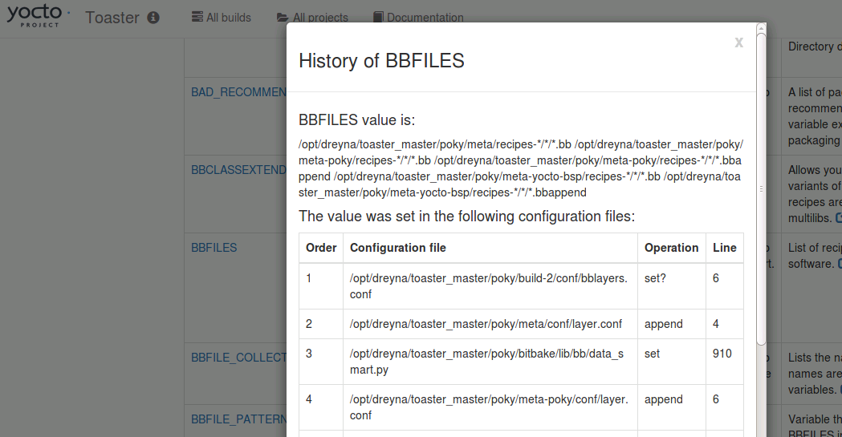
Toaster Analytics – Intermediate Data Example
The Toaster database/GUI can for example display the intermediate values of bitbake variables, specifically each variable’s modification history down to the file and line.

Slide 140
Overview of Available Events
BuildInit|BuildCompleted|BuildStarted
ConfigParsed|RecipeParsed
ParseCompleted|ParseProgress|ParseStarted
MultipleProviders|NoProvider
runQueueTaskCompleted|runQueueTaskFailed|runQueueTaskSkipped|
runQueueTaskStarted
TaskBase|TaskFailed|TaskFailedSilent|TaskStarted|
TaskSucceeded
sceneQueueTaskCompleted|sceneQueueTaskFailed|sceneQueueTaskStarted
CacheLoadCompleted|CacheLoadProgress|CacheLoadStarted
TreeDataPreparationStarted|TreeDataPreparationCompleted
DepTreeGenerated|SanityCheck|SanityCheckPassed
MetadataEvent
LogExecTTY|LogRecord
CommandCompleted|CommandExit|CommandFailed
CookerExit

Slide 141
Event Clients (you are already an event user!)
Bitbake actually runs in a separate context, and expects an event client (called a “UI") to display bitbake's status and output
Here are the existing bitbake event clients:
  Knotty: this is the default bitbake command line user interface that you know and love. It uses events to display the famous dynamic task list, and to show the various progress bars
  Toaster: this is the bitbake GUI, which provides both a full event database and a full feature web interface. We will be using this as our primary example since it contains the most extensive implementation and support for events
  Depexp: this executes a bitbake command to extract dependency data events, and then uses a GTK user interface to interact with it
  Ncurses: this provides a simple ncurses-based terminal UI

Slide 142
Event Database
The event database is built into Toaster to maintain persistent build data
It can however just as easily be used directly with command line scripts or other SQL compatible tools
User Web Client
Toaster GUI Server
User Console
User Console
Event Database (SQL)
Python Script
Knotty Event Client
Toaster Event Client
Bitbake

Slide 143
Example Event Database with CI Builders
If you enable the Toaster UI in a CI system, you can additionally get the event artifacts together with your build artifacts (you will definitely need to select a production level database)
Continuous Integration Build System
Event Database (SQL)
Lost event data
Knotty Event Client
Toaster Event Client
Bitbake

Slide 144
Adding Build Data to the Event Database
There are two easy ways to get build data into the event database
  Create and execute your builds from within the Toaster GUI
  Start Toaster, and run your command line builds in that environment
The ‘source toaster’ performs these tasks
  Creates the event database if not present, applies any schema updates
  Starts the web client (this can be ignored for command line usage)
  Sets the command line environment to use Toaster as the UI for bitbake (“BITBAKE_UI”)
$ cd /scratch
$ source poky/oe-init-build-env
$ source toaster start webport=0.0.0.0:8000 # local only: “localhost:8000”
$ firefox localhost:8000 # here, connect browser from your using Toaster URL
$ . Poky/oe-init-build-env
$ source toaster start webport=0.0.0.0:8000
$ bitbake <whatever>

Slide 145
Analytics and the Event System - Overview
The Event System
Example 1: Custom command line analytic tool
Example 2: Custom Event Interface (knice)
Example 3: Custom event types
Example 4: Debugging coincident data in bitbake
Example 5: Toaster

Slide 146
Minimal Event Database Python Script
Accessing the data in the event database is very simple. In this example we will print the data from the first-most Build record, and also look up and print the associated Target record
$ cat /scratch/src/events/sample_toaster_db_read.py
#!/usr/bin/env python3
import sqlite3
conn = sqlite3.connect('toaster.sqlite')
c = conn.cursor()
c.execute("SELECT * FROM orm_build")
build=c.fetchone()
print('Build=%s' % str(build))
c.execute("SELECT * FROM orm_target where build_id = '%s'" % build[0])
print('Target=%s' % str(c.fetchone()))
$
$ /scratch/src/events/sample_toaster_db_read.py
Build=(1, 'qemux86-64', 'poky', '2.2.1', '2017-02-12 23:55:52.137355', \
'2017-02-13 00:16:30.794711', 0, '/…/build_20170212_235552.805.log', \
'1.32.0', 1, 1478, 1478, '20170212235604')
Target=(1, 'core-image-base', '', 1, 0, ‘/…/license.manifest', 1, \
'/…/core-image-base-qemux86-64-20170212235604.rootfs.manifest')$

Slide 147
Full Feature Event Database Python Script
In this section we will work with an example python application that extracts and analyzes event data
Specifically, we will attempt to investigate the question:
“How exactly do the tasks of a build overlap execution with other tasks, and on a higher level how to recipes overlap execution with other recipes, plus what data can extract around this question”
While this may not be a deep problem, and there are certainly OE tools that already provide similar information (e.g. pybootchart), the point is that (a) this was very easy and fast to write, and (b) you can now fully customize the analysis and output to your needs and desires.

Slide 148
Task and Recipe Build Analysis Script
Here is the list of available commands and features
$ more /scratch/src/events/event_overlap.py
# see db setup and schema info
$ /scratch/src/events/event_overlap.py --help
Commands: ?
? : show help
b,build [build_id] : show or select builds
d,data : show histogram data
t,task [task] : show task database
r,recipe [recipe] : show recipes database
e,events [task] : show task time events
E,Events [recipe] : show recipe time events
o,overlap [task|0|n] : show task|zero|n_max execution overlaps
O,Overlap [recipe|0|n] : show recipe|zero|n_max execution overlaps
g,graph [task] [> file] : graph task execution overlap
G,Graph [recipe] [> file] : graph recipe execution overlap
h,html [task] [> file] : HTML graph task execution overlap [to file]
H,Html [recipe] [> file] : HTML graph recipe execution overlap [to file]
q,quit : quit
Examples:
* Recipe/task filters accept wild cards, like 'native-*, '*-lib*'
* Recipe/task filters get an automatic wild card at the end
* Task names are in the form 'recipe:task', so 'acl*patch'
will specifically match the 'acl*:do_patch' task
* Use 'o 2' for the tasks in the two highest overlap count sets
* Use 'O 0' for the recipes with zero overlaps

Slide 149
Histogram of Parallel Task/Recipe Execution (‘d’)
Commands: d
Histogram:For each task, max number of tasks executing in parallel
0 1 2 3 4 5 6 7 8 9
----------------------------------------
0) 0 621 16 22 50 49 56 83 94 45
10) 57 82 87 81 47 56 58 62 64 88
20) 121 182 268 221 148
Histogram:For each recipe's task set, max number of recipes executing in parallel
0 1 2 3 4 5 6 7 8 9
----------------------------------------
0) 0 5 1 1 1 1 1 1 3 3
10) 1 2 2 2 2 1 1 3 1 6
20) 1 1 2 1 1 2 2 1 1 1
30) 1 1 2 2 1 3 1 2 2 1
40) 1 1 1 1 1 1 1 1 3 1
50) 1 2 4 2 2 1 1 1 1 2
60) 1 2 1 1 1 2 1 1 1 2
70) 1 1 2 2 2 2 1 3 3 1
80) 3 2 1 1 1 10 7 8 8 8
90) 7 7 2 2 3 2 2 1 1 2
100) 2 1 1 1 2 2 1 3 2 3
110) 2 1 2 1 1 1 1 2 1 1
120) 2 1 1 2 1 1 1 2 1 2
130) 1 1 1 1

Slide 150
Histogram of Overlapping Task/Recipe Execution
…
Histogram:For each task, max number of tasks that overlap its build
0 1 2 3 4 5 6 7 8 9
----------------------------------------
0) 614 9 10 29 28 42 46 55 51 47
10) 56 52 48 59 28 33 63 29 43 60
20) 60 94 119 223 105 95 53 57 36 40
30) 20 26 15 17 13 8 11 9 9 2
40) 7 10 9 7 3 6 6 3 6 6
50) 6 6 6 2 2 5 3 1 3 1
60) 4 2 5 1 2 2 1 2 3 5
... (sparse) ...
980) 0 0 1
Histogram:For each recipe's task set, max number of recipes that overlap its build
0 1 2 3 4 5 6 7 8 9
----------------------------------------
0) 67 0 0 0 0 0 0 0 0 0
10) 0 0 0 0 0 0 0 0 0 0
... (all zeros) ...
80) 0 0 0 0 5 1 1 8 4 1
90) 3 2 0 1 4 4 3 0 0 0
100) 0 0 0 0 0 0 2 1 0 0
110) 2 0 1 2 0 0 3 0 1 2
120) 0 0 0 0 0 0 0 0 2 0
130) 0 26 8 5 2 6 5 0 0 1
... (sparse) ...
170) 0 4 0 0 0 0 0 0 0 0
180) 0 0 0 0 0 0 69

Slide 151
Initial Results
Here are some initial results when examining a “core-image-minimal” project with Task Count=2658 and Recipe Count=254
We have as many as 148 tasks being able to run with all 24 available threads used
There were 621 tasks that ran solo
There were zero recipes that ran solo
There was one task “linux-yocto:do_fetch” whose execution overlapped with 983 other tasks; the second most overlap was “python3-native:do_configure” with an overlap count of 798
There were 69 recipes that overlaps with 186 other recipes, with the next highest overlap being 4 recipes that overlap with 171 other recipes
The below sample HTML output page on task overlaps shows the amount of information available, with the recipe page too large to show in this context

Slide 152
Initial Results
Let us see the available builds:
Select the minimal build #4
Run the commands d,t,r,o,O,g,G to get a sense of the minimal outputs
Command: b
List of available builds:
BuildId=1) CompletedOn=2017-02-13 00:16:30.794711, Outcome=SUCCEEDED,
Project=Command line builds, Target=core-image-base, Task=''
BuildId=2) CompletedOn=2017-02-13 00:46:40.724932, Outcome=FAILED,
Project=Command line builds, Target=core-image-base, Task=populate_sdk_ext
BuildId=3) CompletedOn=2017-02-13 00:46:26.513568, Outcome=SUCCEEDED,
Project=Command line builds, Target=core-image-base, Task=''
BuildId=4) CompletedOn=2017-02-23 09:02:31.109727, Outcome=SUCCEEDED,
Project=Command line builds, Target=quilt-native, Task=''
Command: b 4
Fetching build #4
Build: CompletedOn=2017-02-23 09:02:31.109727, Outcome=SUCCEEDED,
Project='Command line builds‘ Target='quilt-native', Task='', Machine='qemux86-64'
Success: build #4, Task Count=9, Recipe Count=1

Slide 153
Initial Results
Now select the large build (#1) and explore. We shall use the recipe filter ‘zlib’ to limit the output:
Make sure your window is very wide, and then run this command to see a graph of the task overlaps for zlib:
Command: b 1
Command: o zlib
Command: e zlib
Command: t zlib
Command: r zlib
Command: o zlib
Command: O 0
Command: g zlib

Slide 154
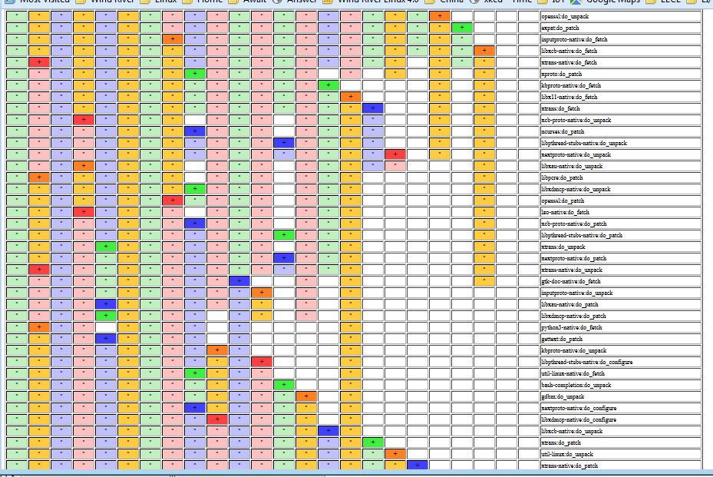
Sample HTML Output of Task Overlap

Slide 155
Analytics and the Event System - Overview
The Event System
Example 1: Custom command line analytic tool
Example 2: Custom Event Interface (knice)
Example 3: Custom event types
Example 4: Debugging coincident data in bitbake
Example 5: Toaster

Slide 156
Custom Event UI
If the knotty UI is too simple (since it does not collect data) and the Toaster UI too large for your analytic needs, you can make your own bitbake UI and have it handle specific events as you need. Here is a simple tutorial on how to do that.
What we will do is start with the “knotty” UI, and then customize it as the “knice” UI.
We make a simple change:
Now we run it:
$ pushd ../bitbake/lib/bb/ui
$ cp knotty.py knice.py
$ sed –i –e "s/notty/nice/g" knice.py
$ vi knice.py
-print("Nothing to do. Use 'bitbake world' to build everything, \
or run 'bitbake --help' for usage information.")
+print(“NICE: Nothing to do. Use 'bitbake world' to build everything, \
or run 'bitbake --help' for usage information.")
$ popd
$ bitbake -u knice
NICE: Nothing to do. Use 'bitbake world' to build everything, or run
'bitbake --help' for usage information.

Slide 157
Custom Event UI (2)
Now let us instrument an event by updating “knice.py”.
First, let us add "bb.event.DepTreeGenerated“ to the event list
Now let us add a print statement to the otherwise empty "bb.event.DepTreeGenerated“ handler code
Now we run it and see our code run!
$ vi ../bitbake/lib/bb/ui/knice.py
- "bb.event.ProcessFinished"]
+ "bb.event.ProcessFinished","bb.event.DepTreeGenerated"]
if isinstance(event, bb.event.DepTreeGenerated):
+ logger.info("NICE: bb.event.DepTreeGenerated received!")
continue
[build]$ bitbake -u knice quilt-native [ | grep NICE ]
...
NOTE: NICE: bb.event.DepTreeGenerated received! | ETA: 0:00:00
...

Slide 158
Resources
Source code and example event database
  This is available as part of the Yocto Project Developer Day Advanced Class (see https://www.yoctoproject.org/yocto-project-dev-day-north-america-2017, and https://wiki.yoctoproject.org/wiki/DevDay_US_2017 )
Here is the Toaster documentation, and Youtube video!
  http://www.yoctoproject.org/docs/latest/toaster-manual/toaster-manual.html#toaster-manual-start
  https://youtu.be/BlXdOYLgPxA
Basic information about bitbake UI’s
  http://elinux.org/Bitbake_Cheat_Sheet
Here is design information on the event model for Toaster
  https://wiki.yoctoproject.org/wiki/Event_information_model_for_Toaster
Here is the original design information on Toaster and bitbake communication
  https://wiki.yoctoproject.org/wiki/Toaster_and_bitbake_communications

Slide 159
Analytics and the Event System - Overview
The Event System
Example 1: Custom command line analytic tool
Example 2: Custom Event Interface (knice)
Example 3: Custom event types
Example 4: Debugging coincident data in bitbake
Example 5: Toaster

Slide 160
Custom events
Normally, for a custom event you merely sub-class the event class or some other existing class, and add your new content
In this example, we show how we can easily extend "MetadataEvent" and use it on the fly, since the sub-event 'type' is an arbitrary string and the data load is a simple dictionary.
Event creation:
Event handler:
my_event_data = {
"TOOLCHAIN_OUTPUTNAME": d.getVar("TOOLCHAIN_OUTPUTNAME")
}
bb.event.fire(bb.event.MetadataEvent("MyMetaEvent", my_event_data), d)
if isinstance(event, bb.event.MetadataEvent):
if event.type == "MyMetaEvent":
my_toochain = event.data["TOOLCHAIN_OUTPUTNAME"]

Slide 161
Analytics and the Event System - Overview
The Event System
Example 1: Custom command line analytic tool
Example 2: Custom Event Interface (knice)
Example 3: Custom event types
Example 4: Debugging coincident data in bitbake
Example 5: Toaster

Slide 162
Using Events for debugging bitbake
You can also use the event system in debugging bitbake or your classes.
Example 1: The quintessential example is to use “logger.info()” to insert print statements into the code. This is implemented as an event, meaning that will it be passed to the correct external UI and not lost in some random log file.
Example 2: The ESDK file used to be copied to the build’s “deploy/sdk” directory as part of the task “populate_sdk_ext”. However, it is somehow happening later, and it is hard reading the code to determine when and where that is now occurring. We can use the event stream to help narrow down the candidates.
  First, we add a log call into the event read loop in “bitbake/lib/bb/ui/toasterui.py”. This will provide a log of the received events as they go by, and also reveal when the ESDK file is created.
I then run a build (in the Toaster context):
logger.info(“FOO:"+str(event)+","+
str(os.path.isfile('<path_to_esdk_file>')) )

Slide 163
Using Events for debugging bitbake (2)
  Second, we then run a build (in the Toaster context) and collect the events:
  Third, we examine the log to find when the file’s state changed.
  We see that the existing ESDK file was removed after “bb.event.DepTreeGenerated”, and placed after “sstate-build-populate_sdk_ext”. In other words it was moved out of the main “populate_sdk_ext” task and into its sstate task. QED.
$ bitbake do_populate_sdk_ext > my_eventlog.txt
...
NOTE: FOO:<bb.event.DepTreeGenerated object at 0x7f94ec829710>,True
NOTE: FOO:<bb.event.MetadataEvent object at 0x7f94ec829358>,False
...
NOTE: FOO:<LogRecord: ... "Executing buildhistory_get_extra_sdkinfo ...">,False
...
NOTE: FOO:<LogRecord: BitBake.Main, ... sstate-build-populate_sdk_ext ...">,False
NOTE: FOO:<bb.build.TaskSucceeded object at 0x7f94e7f5f358>,True
…

Slide 164
Analytics and the Event System - Overview
The Event System
Example 1: Custom command line analytic tool
Example 2: Custom Event Interface (knice)
Example 3: Custom event types
Example 4: Debugging coincident data in bitbake
Example 5: Toaster

Slide 165
Adding Build Data to the Event Database
There are many existing analytic views in Toaster
Start the Toaster GUI in the build directory (with open ports)
On your host, open your browser to:
devdayXXX.yoctoproject.org:8000
Click on “All Builds”, and select a build
Click on “Time”, “CPU Usage”, and “Disk I/O”
Click on “Tasks”, and see the task order and cache usage
$ source toaster start webport=0.0.0.0:8000

Slide 166
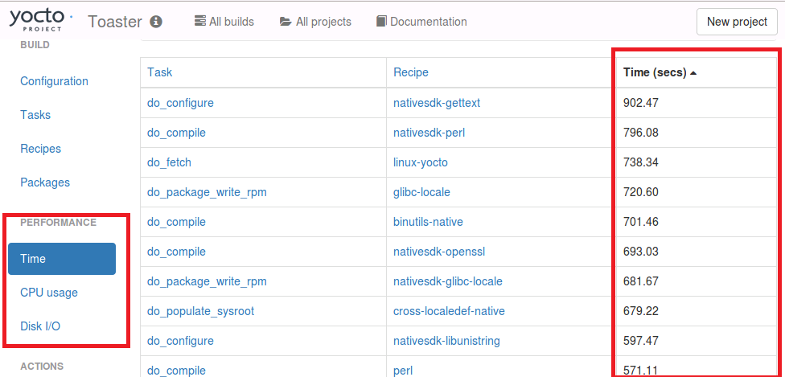
Existing Toaster Analytics
The Toaster GUI already provides analytical data on builds, for example on sstate cache success rate, task execution time, CPU usage, and Disk I/O

Slide 167
Activity Ten
Recipe Specific Sysroots
Joshua Lock
(given by Sean Hudson)

Slide 168
Recipe Specific Sysroots - Overview
Topics
  Definitions
  Determinism improvements in YP 2.3 +
  Future reproducibility work

Slide 169
Recipe Specific Sysroots
Reproducible
  Repeatable: rerun a build and have it succeed (or fail) in the same way
  Deterministic: given the same inputs the build system should produce equivalent outputs
  Binary reproducible: given the same inputs the system should produce bit-for-bit identical outputs

Slide 170

Recipe Specific Sysroots
Reproducibility and Yocto Project
Repeatability was a founding goal of the Yocto Project
  Not as common place at the time of the project’s inception
Determinism of the YP build system has improved over time
  Vast leap forward with most recent, Pyro, release
Being able to build binary reproducible artefacts is a goal for future development
  Some concrete tasks planned for 2.4

Slide 171
Recipe Specific Sysroots
Binary Reproducible
Fully deterministic build system, producing bit-for-bit identical output given the same inputs
Build environment is recorded or pre-defined
Mechanism for users to:
  Recreate the environment
  Repeat the build
  Verify the output matches
https://reproducible-builds.org/

Slide 172
Recipe Specific Sysroots
Yocto Project Reproducibility Features
DL_DIR – shareable cache of downloads
Easily replicated build environment - configuration in known locations, printed build header
Shared state mechanism – reusable intermediary objects when inputs haven’t changed
SSTATE_MIRRORS – remotely addressable cache of shared state objects
Uninative – static libc implementation for use with native tools, improves sstate reuse
Fixed locale – ensures consistent date/time format, sort order, etc

Slide 173
Recipe Specific Sysroots
Topics
  Definitions
  Determinism improvements in YP 2.3 +
  Future reproducibility work

Slide 174
Recipe Specific Sysroots
Shared sysroots – a long-standing source of non-determinism
Shared sysroot used by YP build system until 2.3/Pyro release
Cause of non-determinism, particularly with long-lived workspaces
  automatic detection of items in the sysroot which weren't explicitly marked as a dependency
  items which appear lower in common YP build graphs such as libc, kernel or common native dependencies such as glib-2.0-native

Slide 175
Recipe Specific Sysroots
Recipe specific sysroots improve determinism
per-recipe sysroot which only includes sysroot components of explicit dependencies
sysroot artefacts are installed into a component specific location
built by hard-linking dependencies files in from their component trees
reinstall sysroot content when the task checksum of the dependency changes
resolves the issue of autodetected dependencies and implicit dependencies through build order

Slide 176
Recipe Specific Sysroots
Implementations challenges
Artefacts in the component sysroots can include hard-coded paths – we need to be able to fix them for installed location
  The code knows to look at certain common sites for hard-coded paths and can be taught to fixup in more locations by appending to the EXTRA_STAGING_FIXMES variable
A recipe is composed of several tasks to run in the course of building its output; fetch, unpack, configure, etc.
  Many of these tasks have task-specific dependencies, we need to re-extend the sysroot when tasks explicitly require items in the sysroot. i.e. do_package_write_deb need dpkg-native do_fetch for a git repo requires git-native

Slide 177
Recipe Specific Sysroots
Implementations challenges (II)
post-install scriptlets need to be executed for each recipe-specific sysroot
  We handle this by installing postinst scriptlets into the recipe-specifc sysroot with a postinst- prefix and running all of the scriptlets as part of the sysroot setup
Still need to be able to replicate old shared-sysroot behaviour in certain scenarios, i.e. eSDK
  bitbake build-sysroot recipe target takes everything in the components directory which matches the current MACHINE and installs it into a shared sysroot

Slide 178
Recipe Specific Sysroots
Adapting to recipe specific sysroots
Would have liked to be pain-free transition, but there is some conversion required for recipe-specific sysroots.
fix missing dependencies – commonly native dependencies, i.e. glib-2.0-native
SSTATEPOSTINSTFUNCS → SYSROOT_PREPROCESS_FUNCS
  SSTATEPOSTINSTFUNCS are a hook to call specific functions after a recipe is populated from shared state, commonly used for fixing up paths.
  As shared state objects will now be installed into the recipe-component location, then linked into the recipe specific sysroot, we need to be able to perform such fixes in each constructed sysroot.
  SYSROOT_PREPROCESS_FUNCS: is list of functions to run after sysroot contents are staged and the right place to perform relocation in RSS world

Slide 179
Recipe Specific Sysroots
Adapting to recipe specific sysroots (II)
Add PACKAGE_WRITE_DEPS for any postinsts requiring native tools at rootfs construction
  YP build system tries to run preinst and postinsts at rootfs construction time, deferring any which fail to first boot.
  Any special native tool dependencies of pkg_preinst and pkg_postinst must be explicitly listed in PACKAGE_WRITE_DEPS to ensure they are available on the build host at rootfs construction time.

Slide 180
Recipe Specific Sysroots
Unexpected consequences
Recipe specific sysroots aggravated an existing source of non-determinism
PATH included locations in the host for boot-strapping purposes
Host tools were being used, where available, when native dependencies were missing

Slide 181
Recipe Specific Sysroots
Resolved with PATH filtering
All required host utilities must be explicitly listed
These are all symlinked into a directory
PATH is then cleared and set to this filtered location
  HOSTTOOLS: being unavailable causes an early failure (when they can't be linked in place)
  HOSTTOOLS_NONFATAL: aren't a build failure when absent, i.e. optional tools like ccache or proxy helpers

Slide 182
Recipe Specific Sysroots - Overview
Topics
  Definitions
  Determinism improvements in YP 2.3 +
  Future reproducibility work

Slide 183
Recipe Specific Sysroots
Improved build system determinism
Next set our sights on the next level reproducible definition: binary reproducible builds.
Common issues that affect binary reproducibility include:
Compressing files with different levels of parallelism
Dates, times, and paths embedded in built artefacts
Timestamps of outputs changing

Slide 184
Recipe Specific Sysroots
Future reproducibility work
Layer fetcher/Workspace setup tool – to improve ease of build environment replication
SOURCE_DATE_EPOCH – open spec to ensure consistent date/time stamps in generated artefacts
strip-nondeterminism – post-processing step to forcibly remove traces of non-determinism
etc...

Slide 185
Example Patches for Recipe Specific Sysroots
Juro Bystricky (34):
license.bbclass: improve reproducibility
classutils.py: deterministic sorting
e2fsprogs-doc: binary reproducible
python3: improve reproducibility
busybox.inc: improve reproducibility
image-prelink.bbclass: support binary reproducibility
kernel.bbclass: improve reproducibility
image.bbclass: support binary reproducibility
gmp: improve reproducibility
python2.7: improve reproducibility
attr: improve reproducibility
acl_2.25: improve reproducibility
zlib_1.2.11.bb: remove build host references
flex_2.6.0.bb: remove build host references
bash.inc: improve reproducibility
package_manager.py: improve reproducibility …
…

Slide 186

Questions and Answers

Slide 187
Open Topics
Kernel:
  Is the YP-2.4 kernel already obsolete?
  Kernel fragments for any kernel without explicit inherit?
  Enhanced kernel audit details?
  Distro and kernel feature integration?
Security
  The Yocto Project has a general policy for sustaining (released) branches. We tend to fix individual security issues (CVE) instead of upgrade.
  There is a Yocto Project security mailing list: yocto-security@yoctoproject.org
  Low volume. We are working on automatically mailing patches that include the CVE tag to the mailing list so it is searchable, but we have not yet done so.

Slide 188
Open Topics
This is tracked by including the relevant CVE tag, pointing to the CVE information in the patches themselves, such as:
The above version includes a fix, documents it (CVE: CVE-2016-6321), and then also documents where the fix came from (upstream commit 7340f67 of that project).
+From 7340f67b9860ea0531c1450e5aa261c50f67165d Mon Sep 17 00:00:00 2001
+From: Paul Eggert <eggert@Penguin.CS.UCLA.EDU>
+Date: Sat, 29 Oct 2016 21:04:40 -0700
+Subject: [PATCH] When extracting, skip ".." members
+
+* NEWS: Document this.
+* src/extract.c (extract_archive): Skip members whose names contain
+"..".
+
+CVE: CVE-2016-6321
+Upstream-Status: Backport
+
+Cherry picked from commit: 7340f67 When extracting, skip ".." members
+
+Signed-off-by: Sona Sarmadi <sona.sarmadi@enea.com>

Slide 189
Thank you for your participation!

Slide 190
Appendix: Board Bring-up

Slide 191
MinnowBoard Max Turbot SD Card Prep
Here is how to flash the microSD card for the MBM
Insert the microSD card into your reader, and attach that to your host
  Find the device number for the card (e.g. “/dev/sdc”). For example run “dmesg | tail” to find the last attached device
  Unmount any existing partitions from the SD card (for example “umount /media/<user>/boot”)
  Flash the image
  $ sudo dd if=tmp/deploy/images/intel-corei7-64/core-image-base-intel-corei7-64.hddimg of=<device_id> bs=1M
  On the host, right-click and eject the microSD card’s filesystem so that the image is clean

Slide 192
MinnowBoard Max Turbot SD Card Prep
Note: you can instead use the automatically generated WIC image
  Flash the image
  $ sudo dd if=scratch/working/build-mbm/tmp/deploy/images/intel-corei7-64/core-image-base-intel-corei7-64.wic of=<device_id> bs=1M
  Note that when the target boots, the WIC version of the image the kernel boot output does not appear on the serial console. This means that after 14 seconds of a blank screen you will then see the login prompt

Slide 193
MinnowBoard Max Turbot Board Bring-up
Setting up the board connections
  Unpack the target
  Insert the provided micro-SD card (pin side up)
  Attach the ethernet cable from the target to the hub
  Attach the FTDI 6-pin connector. The BLACK wire is on pin 1, which has an arrow on the silk-mask and is on the center-side of the 6-pin inline connector near the microSD connector
  Connect the FTDI USB connector to your host
  (Note: the USB serial connection will appear on your host as soon as the FTDI cable is connected, regardless if the target is powered)
Start your host’s console for the USB serial console connection
  On Linux, you can use the screen command, using your host’s added serial device (for example “/dev/ttyUSB0):
      $ screen /dev/ttyUSB0 115200,cs8 (FYI: “CTRL-A k” to kill/quit)
  On Windows, you can use an application like “Teraterm”, set the serial connection to the latest port (e.g. “COM23”), and set the baud rate to 115200 (“Setup > Serial Port… > Baud Rate…”)

Slide 194
MinnowBoard Max Turbot Board Bring-up (2)
Start the board
  Connect the +5 Volt power supply to the target
  You should see the board’s EFI boot information appear in your host’s serial console
Run these commands to boot the kernel
Shell> connect -r
Shell> map -r
Shell> fs0:
Shell> bootx64
You should now see the kernel boot
At the login prompt, enter “root”
Note: see the appendix on instructions on how we create the microSD card images

Slide 195
Beaglebone Black - Setup
Create project directory, update local.conf and bblayers.conf
Nothing to change in bblayers.conf, beaglebone is supported in meta-yocto-bsp
$ export INSTALL_DIR=`pwd`
$ git clone -b rocko git://git.yoctoproject.org/poky
$ source poky/oe-init-build-env `pwd`/build_beagle
$ echo 'MACHINE = "beaglebone"' >> conf/local.conf
$ echo 'IMAGE_INSTALL_append = " gdbserver openssh"' \
>> conf/local.conf
$ echo 'EXTRA_IMAGEDEPENDS_append = " gdb-cross-arm"' \
>> conf/local.conf
$ bitbake core-image-base

Slide 196
BeagleBone Black - MicroSD
# Format blank SD Card for Beaglebone Black
$ export DISK=/dev/sd[c] <<<Use dmesg to find the actual device name
$ sudo umount ${DISK}1 <<<Note the addition of the '1'
$ sudo dd if=/dev/zero of=${DISK} bs=512 count=20
$ sudo sfdisk --in-order --Linux --unit M ${DISK} <<-__EOF__
1,12,0xE,*
,,,-
__EOF__
$ sudo mkfs.vfat -F 16 ${DISK}1 -n boot
$ sudo mkfs.ext4 ${DISK}2 -L rootfs
# Now unplug and replug your SD Card for automount
$ cd tmp/deploy/images/beaglebone
$ sudo cp -v MLO-beaglebone /media/guest-mXlApE/BOOT/MLO
$ sudo cp -v u-boot.img /media/guest-mXlApE/BOOT/
$ sudo tar xf core-image-base-beaglebone.tar.bz2 \
-C /media/guest-mXlApE/rootfs
$ sync (flush to device, not neccesary, but illustrative)
$ umount /media/guest-mXlApE/rootfs /media/guest-mXlApE/boot

Slide 197
Dragonboard 410c - Setup
See this URL to see instructions on how to install Yocto Project:
https://github.com/Linaro/documentation/blob/master/Reference-Platform/CECommon/OE.md
To get a serial boot console, you will need to get a specialized FTDI cable. Here are some sources:
https://www.96boards.org/products/accessories/debug/
For the slow GPIO bus (at 1.8V), it is recommended to use a protected and/or voltage shifting shield, for example the new Grove baseboard for the Dragonboard

Slide 198
Bonus Activity
Node.js
Henry Bruce

Slide 199
Introduction
Credits: Brendan Le Foll and Paul Eggleton
Notes:
We're here to learn about devtool's recently added support for Node.js
This is not a Node.js masterclass, but some knowledge of npm and JavaScript will be helpful.
I am not a Node.js expert, but am a proponent of this work due to its growing popularity in the IoT space
A shout out to Brendan Le Foll who started Node.js support and Paul Eggleton who has greatly enhanced it.

Slide 200
What we’ll be doing
Understanding Node.js support in Open Embedded
Using devtool to auto-generate Node.js recipes
Building and deploying a package
On-target Node.js application development
Using devtool to package the application
Discuss known issues and plans for future work

Slide 201
Node.js and Open Embedded
Layer index recipe search returns ~10 hits
  We’ll be working with the meta-oe recipe
  (4.x, oldest LTS version)
More versions are available in meta-nodejs
Devtool support was introduced in krogoth
  Use pyro
There’s still work to do. See bug #10653.

Slide 202
Using devtool to generate recipe
Go to the build directory (with a clean shell)
$ cd /scratch
$ . poky/oe-init-build-env
Create recipe from module in registry
  $ devtool add "npm://registry.npmjs.org;name=mraa;version=1.5.1“
  -- or --
  b) $ devtool add /scratch/src/nodejs/mraa-1.5.1.tgz
Parses package.json for basis of recipe
  Package name and version
  Description, homepage
  Location of source
  Licenses
Recursively goes through dependencies
  Creates shrinkwrap and lockdown files
$ devtool edit-recipe mraa

Slide 203
Under the hood
NPM makes it hard to limit network access to fetch task
Fetch task walks dependency tree fetching tarballs from NPM registry
Build task uses ‘npm install’ with registry disabled (OE specific patch) to create node_modules
Install tasks puts node_modules in correct place

Slide 204
Building and deploying
Build is really a pre-package task (apart from native gyp builds)
$ devtool build mraa
Deploy as normal
$ devtool deploy-target -s mraa root@target_addr
Is module installed on the target?
# npm -g ls mraa
Notes:
Note that package version does not match module version. Ideally it should

Slide 205
Running on target
# export NODE_PATH=/usr/lib/node_modules
# node
> var mraa = require(‘mraa’)
> console.log(‘mraa board: ‘ + mraa.getPlatformName())
> var gpio = new mraa.Gpio(360, true, true)
> gpio.dir(mraa.DIR_OUT)
> gpio.write(1)

Slide 206
Developing on target
Many ways of doing this. Let’s keep it simple
On your target
# mkdir mmax-blinker
# cd mmax-blinker
Write some code and test it
  # cp $NODE_PATH/mraa/examples/javascript/Blink-IO.js .
  # vi Blink-IO.js
            change GPIO to “raw” id 360
            add #!/usr/bin/node
  # node Blink-IO.js

Slide 207
Create NPM module on target
Create package.json
  # cp $NODE_PATH/mraa/COPYING .
  # npm init
  # vi package.json
          Add “bin” entry. Local dependency for mraa (or skip)
Install
  # npm -g install
Test
  # mmax-blinker

Slide 208
Create package for your application
Copy files to build host
  scp –r root@x.x.x.x:mmax-blinker mmax-blinker
Check dependencies
  Local dependencies are for development only
Now create package
  $ devtool add /path/to/mmax-blinker
  $ devtool edit-recipe mmax-blinker

Slide 209
Build, deploy and run application
Build
  $ devtool build mmax-blinker
Deploy
  $ devtool deploy-target mmax-blinker root@x.x.x.x
  # ln -s /usr/lib/node_modules/mmax-blinker/Blink-IO.js /usr/bin/mmax-blinker
  # chmod +x /usr/bin/mmax-blinker
Run
  # mmax-blinker

Slide 210
Keep in Touch
https://wiki.yoctoproject.org/wiki/Nodejs_Workflow_Improvements

Slide 211
FYI: How to add Nodejs to your project
$
$ cd /scratch/poky
$ git clone -b morty git://git.openembedded.org/meta-openembedded
$ git clone -b morty git://git.yoctoproject.org/meta-intel
$ source /scratch/poky/oe-init-build-env
$ echo "MACHINE = \"intel-corei7-64\"" >> conf/local.conf
$ echo "IMAGE_INSTALL_append = \" nodejs nodejs-npm curl \"" \
>> conf/local.conf
$ echo "BBLAYERS += \"/scratch/poky/meta-intel \"" \
>> conf/bblayers.conf
$ echo "BBLAYERS += \"/scratch/poky/meta-openembedded/meta-oe \"" \
>> conf/bblayers.conf
$ bitbake core-image-base
$ bitbake nodejs-native
$ bitbake cmake-native
$ bitbake parted-native dosfstools-native mtools-native
$

