Slide 1
Yocto Project Summit – Lyon Day 2 : Friday 1 November 2019
Marco Cavallini, Leon Anavi, Jaewon Lee, Bernardo A. Rodrigues,
Manjukumar Harthikote Matha, Chandana Kalluri, Tim Orling, David Reyna
Presenter Slides: https://wiki.yoctoproject.org/wiki/YP_Summit_Lyon_2019

Slide 2
Agenda – Yocto Project Summit - Day 2
9:00- 9:45 Strengthen your Yocto deployments with Autobuilder2 CI tool
9:50- 10:35 Working with NVIDIA Tegra BSP and Supporting Latest CUDA Versions
10:40-10:50 Morning Break
10:55-11:40 Sstate-cache Magic!
11:45-12:30 Bringing IOTA Distributed Ledger Technology (DLT) into Yocto/OpenEmbedded
12:35-1:20 Lunch
1:25- 2:55 Class: Devtool hands-on Seminar
3:00- 3:10 Afternoon Break
3:15- 4:45 Class: User Space 2.0 Seminar
https://wiki.yoctoproject.org/wiki/YP_Summit_Lyon_2019

Slide 3
1. Strengthen your Yocto deployments with Autobuilder2 CI tool
Marco Cavallini, KOAN https://koansoftware.com

Slide 4
Agenda
What is a Continuous Integration (CI) system
Autobuilder2 History
Buildbot, the foundations
Buildbot mechanics
Buildbot installation
Autobuilder2 installation
Autobuilder2 configuration
Autobuilder2 usage (as-is)
Autobuilder2 customization
Autobuilder2 usage for CI on a single machine

Slide 5
What is Autobuilder
Autobuilder is a project based on Buildbot
Buildbot is a Python open-source application used to build, test, and release a wide variety of software.
Autobuilder and Buildbot are licensed under GPLv2

Slide 6
CI overview
Typical CI on a single machine
‘slave’
WORKER
‘master’
CONTROLLER
‘slave’
WORKER
‘slave’
WORKER

Slide 7
CI overview
Typical CI on a distributed system
‘slave’
WORKER
‘master’
CONTROLLER
‘slave’
WORKER
‘slave’
WORKER

Slide 8
Our goal
Speed Yocto builds by populating premirrors with Autobuilder2
‘slave’
WORKER
‘master’
CONTROLLER
image
SSTATE
DL_DIR
bitbake

Slide 9
Autobuilder overview
yocto-autobuilder2
yocto-autobuilder-helper

Slide 10
Autobuilder history *
Creation of Autobuilder
The autobuilder started life as something OpenedHand used for testing Poky linux.
Yocto-autobuilder
It became "yocto-autobuilder" under Beth's stewardship in December 2012 when it was totally re-implemented.
Autobuilder2
In Feburary 2018 it was rewritten again, in particular to move from the long obsolete "buildbot eight" codebase to the "buildbot nine" one but also to fix many long running issues and get back to using an upstream codebase.
* Thanks to Richard Purdie who provided these information

Slide 11
People behind Autobuilder *
Project Autobuilder
Richard Purdie, Elizabeth Flanagan, Joshua Lock as well as contributions from Tracy Graydon, Anibal Limón and Bill Randle.
Project Autobuilder2
Richard Purdie and Joshua Lock.
Michael Halstead is the project sysadmin who maintains the infrastructure it all runs on top of.
* Thanks to Richard Purdie who provided these information

Slide 12
Buildbot
Notes:
Buildbot installation has:
* one or more masters
* a collection of workers.
The masters monitor source-code repositories for changes, coordinate the activities of the workers, and report results to users and developers.
Workers run on a variety of operating systems.
You configure Buildbot by providing a Python configuration script to the master.

Slide 13
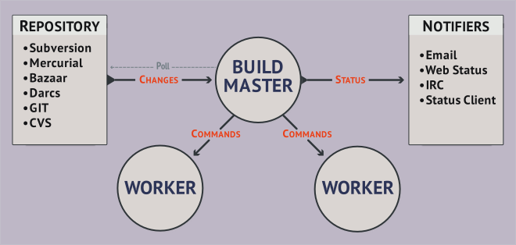
Buildbot basics
Buildbot is a job scheduling system
it queues jobs, executes the jobs when the required resources are available, and reports the results
Notes:
Buildbot installation has:
* one or more masters
* a collection of workers.
The masters monitor source-code repositories for changes, coordinate the activities of the workers, and report results to users and developers.
Workers run on a variety of operating systems.
You configure Buildbot by providing a Python configuration script to the master.

Slide 14
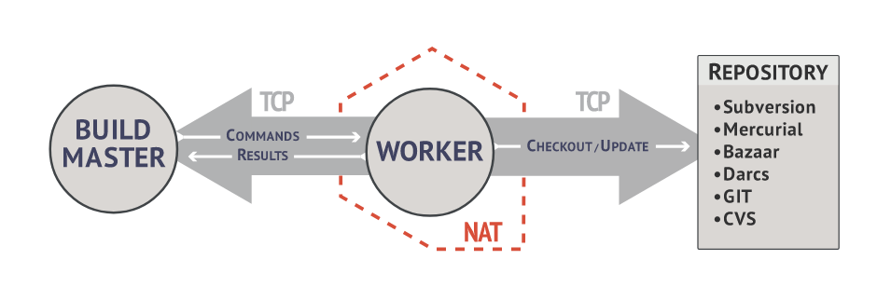
Buildbot basics
Workers are typically run on separate machines
Notes:
The workers are typically run on a variety of separate machines, at least one per platform of interest.
These machines connect to the buildmaster over a TCP connection to a publicly-visible port.
As a result, the workers can live behind a NAT box or similar firewalls, as long as they can get to buildmaster.
The TCP connections are initiated by the worker and accepted by the buildmaster, but commands and results travel both ways within this connection.
The buildmaster is always in charge, so all commands travel exclusively from the buildmaster to the worker.

Slide 15
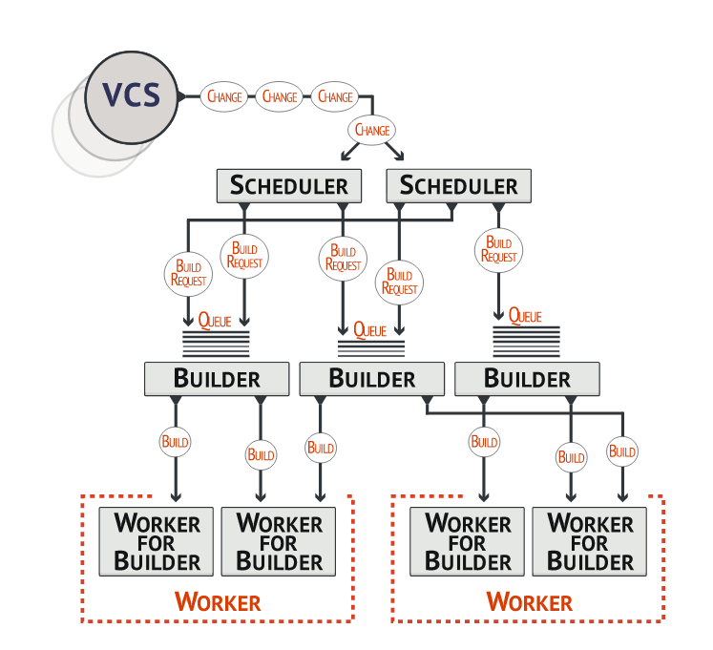
Buildbot basics
Notes:
The workers are typically run on a variety of separate machines, at least one per platform of interest.
These machines connect to the buildmaster over a TCP connection to a publicly-visible port.
As a result, the workers can live behind a NAT box or similar firewalls, as long as they can get to buildmaster.
The TCP connections are initiated by the worker and accepted by the buildmaster, but commands and results travel both ways within this connection.
The buildmaster is always in charge, so all commands travel exclusively from the buildmaster to the worker.

Slide 16
What happens inside the master
VCS
repos
change source
Build master
poll
changes
direct commands
triggers
scheduler
scheduled events
Buildfactory
- step 1
- step 2
.
.
.
builder 1
starts builder
builder 2
builder n
reporter
checkout
. . .
status/results
↓cmds ↑results
worker 1
worker 2
. . .
worker n
* artwork by Mauro Salvini
Notes:
16

Slide 17
Buildbot installation
On a native system
Probably the fastest solution
In a Python sandbox
Isolates it from the host system
Using pip
In a Docker container
Isolates it from the host system
https://docs.buildbot.net/2.4.0/full.html

Slide 18
Buildbot installation (in a Python sandbox) [1/3]
Create a sandbox
Install master
Install worker
mkdir abot-sandbox
cd abot-sandbox
python3 -m venv sandbox
source sandbox/bin/activate
pip install --upgrade pip
pip install 'buildbot[bundle]'
pip install --upgrade pip
pip install buildbot-worker

Slide 19
Buildbot installation (in a Python sandbox) [2/3]
Create the master
Create the worker
buildbot create-master master
mv master/master.cfg.sample master/master.cfg
pip install setuptools-trial
buildbot-worker create-worker worker localhost example-worker pass

Slide 20
Buildbot installation (in a Python sandbox) [3/3]
Content of the sandbox
(sandbox) koan@amonra:~/abot-sandbox$ tree -L 2
.
├── master
│ ├── buildbot.tac
│ ├── master.cfg → c['workers'] = [worker.Worker("example-worker", "pass")] (*)
│ └── state.sqlite
├── sandbox
│ ├── bin
│ ├── include
│ ├── lib
│ ├── lib64 -> lib
│ ├── pip-selfcheck.json
│ ├── pyvenv.cfg
│ └── share
└── worker
├── buildbot.tac → workername = 'example-worker' (*)
└── info
(*)
ftp://ftp.koansoftware.com/public/opensource/buildbot/

Slide 21
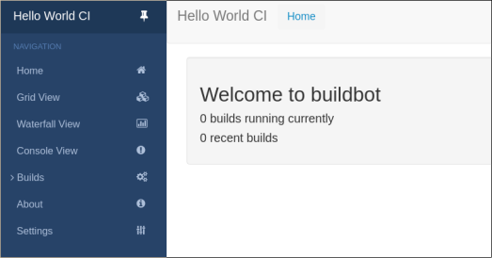
Buildbot execution
Execution of master
Control of the build system (using your browser)
buildbot start master
http://localhost:8010/

Slide 22
Buildbot
To be continued in a dedicated session…
Now let’s have a look at Autobuilder

Slide 23
Ab2
Autobuilder2
Ab2

Slide 24
Ab2
Buildbot vs. Autobuilder2 lexicon
Buildbot | Autobuilder2
Master | Controller
Worker | Worker

Slide 25
Ab2
Autobuilder2 installation
After you created the sandbox
Create the master and worker directories
yocto-controller is the directory for master
--umask sets the proper permissions
yocto-worker is the directory for worker
localhost is the network address of the master
example-worker is the name of the worker
pass is the password (master.cfg)
buildbot create-master -r yocto-controller
buildbot-worker create-worker -r /
--umask=0o22 yocto-worker localhost example-worker pass

Slide 26
Ab2
Autobuilder2 installation
Clone yocto-autobuilder2
yoctoabb is the mandatory Autobuilder2 directory name
Clone yocto-autobuilder-helper
cd yocto-controller
git clone https://git.yoctoproject.org/git/yocto-autobuilder2 yoctoabb
ln -rs yoctoabb/master.cfg master.cfg
cd ..
git clone https://git.yoctoproject.org/git/yocto-autobuilder-helper

Slide 27
Ab2
Autobuilder2 tree
Content of the Autobuilder2 sandbox
(sandbox) koan@amonra:~/ab2-sandbox$ tree -L 3
.
├── autobuilder
├── git
├── sandbox
├── yocto-autobuilder-helper
├── yocto-controller
│ └── yoctoabb
│ └── master.cfg
└── yocto-worker
└── buildbot.tac
* Simplified tree list

Slide 28
Ab2
Autobuilder2 installation
Complete installation instructions
http://git.yoctoproject.org/cgit.cgi/yocto-autobuilder2/tree/README-Guide.md
html
ftp://ftp.koansoftware.com/public/talks/YoctoSummit-2019/autobuilder2/Autobuilder2-README-Guide.pdf

Slide 29
Autobuilder2
Autobuilder default configuration
Notes:
29

Slide 30
Ab2
Autobuilder2 configuration
Ab2 default configuration
The default configuration of Ab2 uses a lot of workers to generate images for several MACHINES

Slide 31
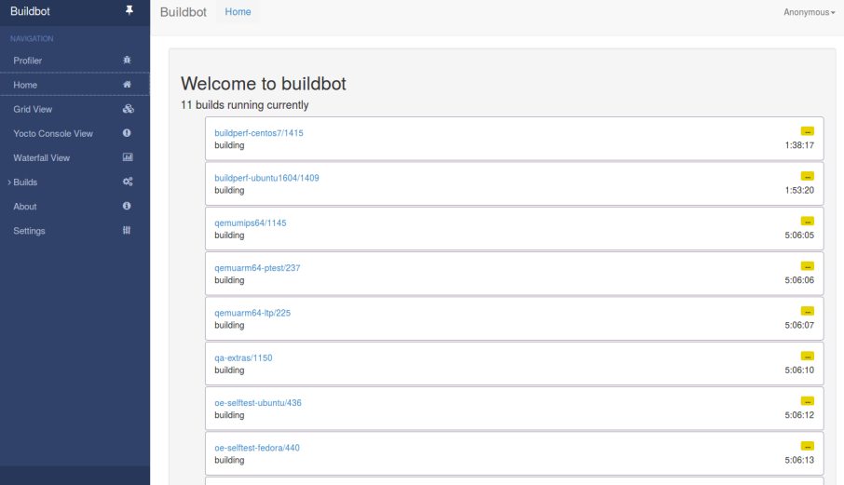
Autobuilder2 official website
https://autobuilder.yoctoproject.org/typhoon/
Notes:
31

Slide 32
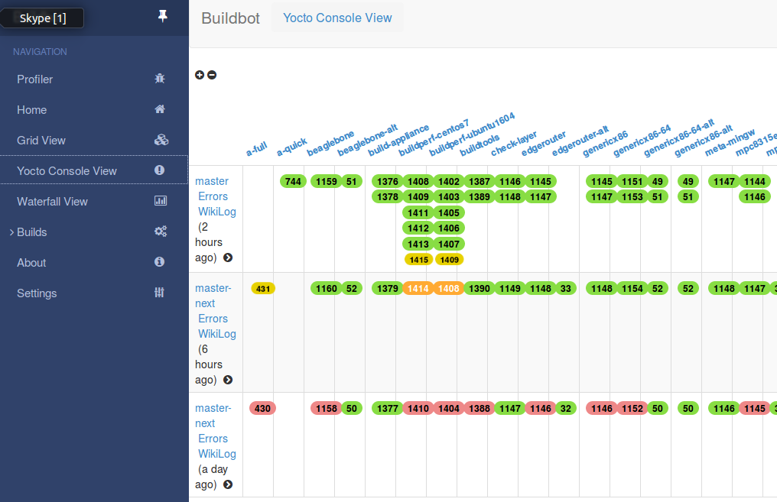
Autobuilder2 website navigation
Notes:
32

Slide 33
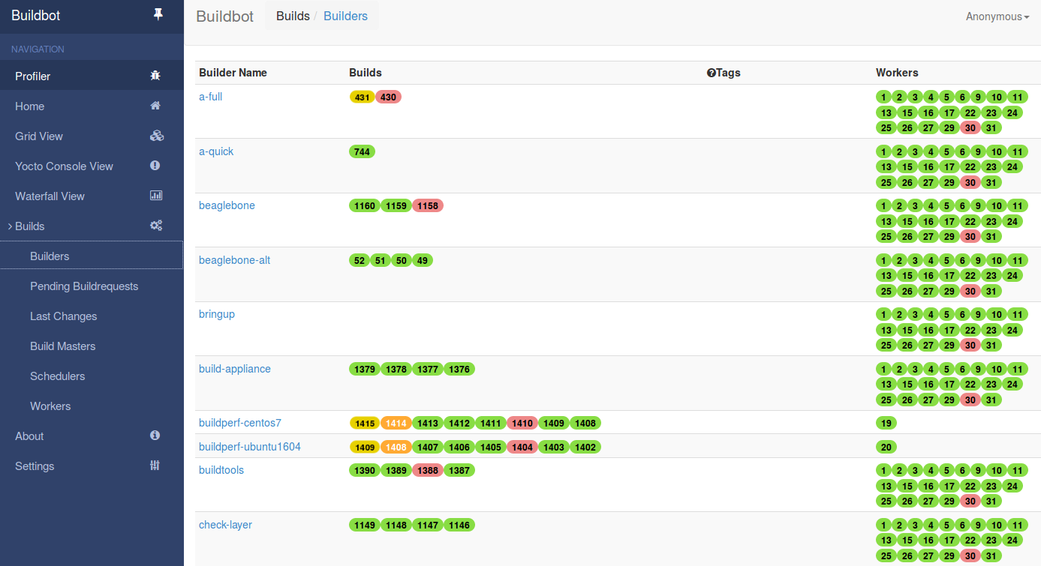
Autobuilder2 website navigation
Notes:
33

Slide 34
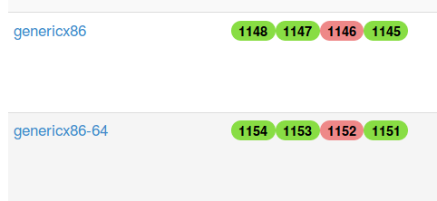
Autobuilder2 - builds
Notes:
34

Slide 35
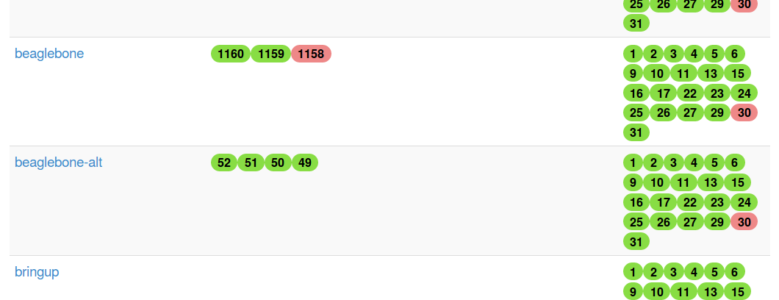
Autobuilder2 - workers
Notes:
35

Slide 36
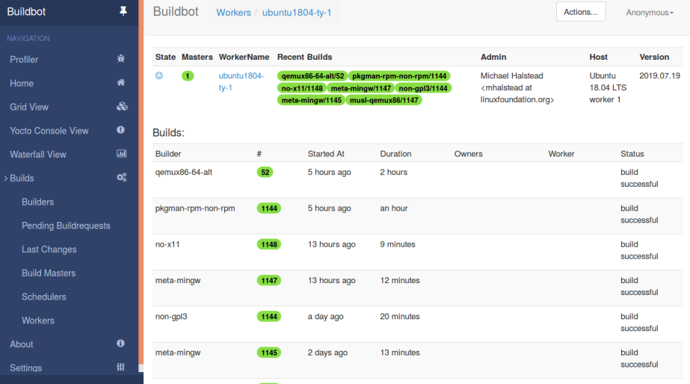
Autobuilder2 – worker details
Notes:
36

Slide 37
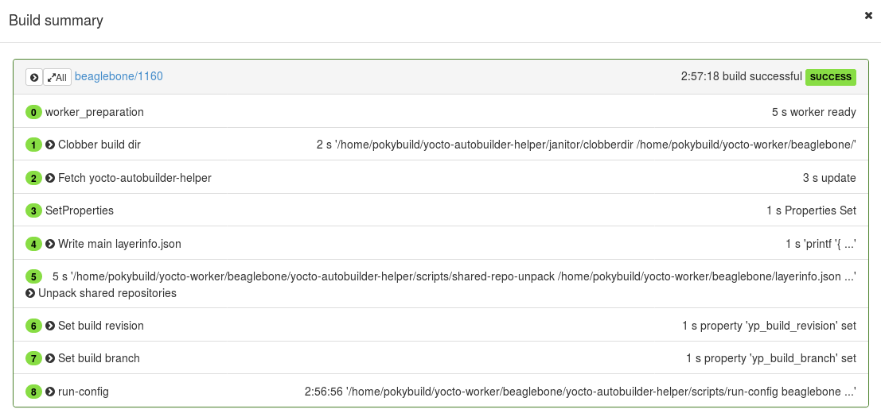
Autobuilder2 – build details
Notes:
37

Slide 38
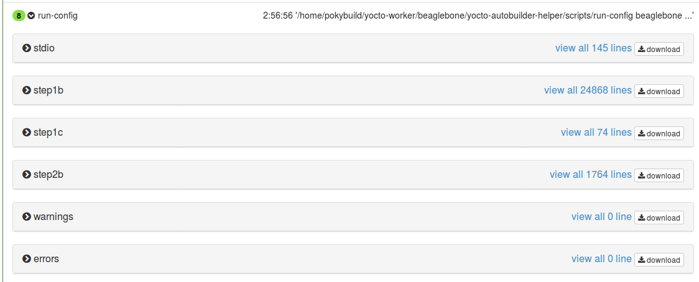
Autobuilder2 – build details
Notes:
38

Slide 39
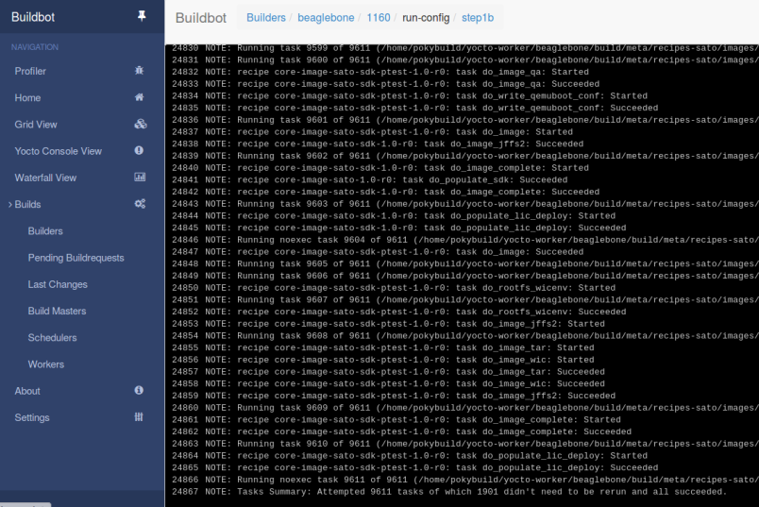
Autobuilder2 – build details
Notes:
39

Slide 40
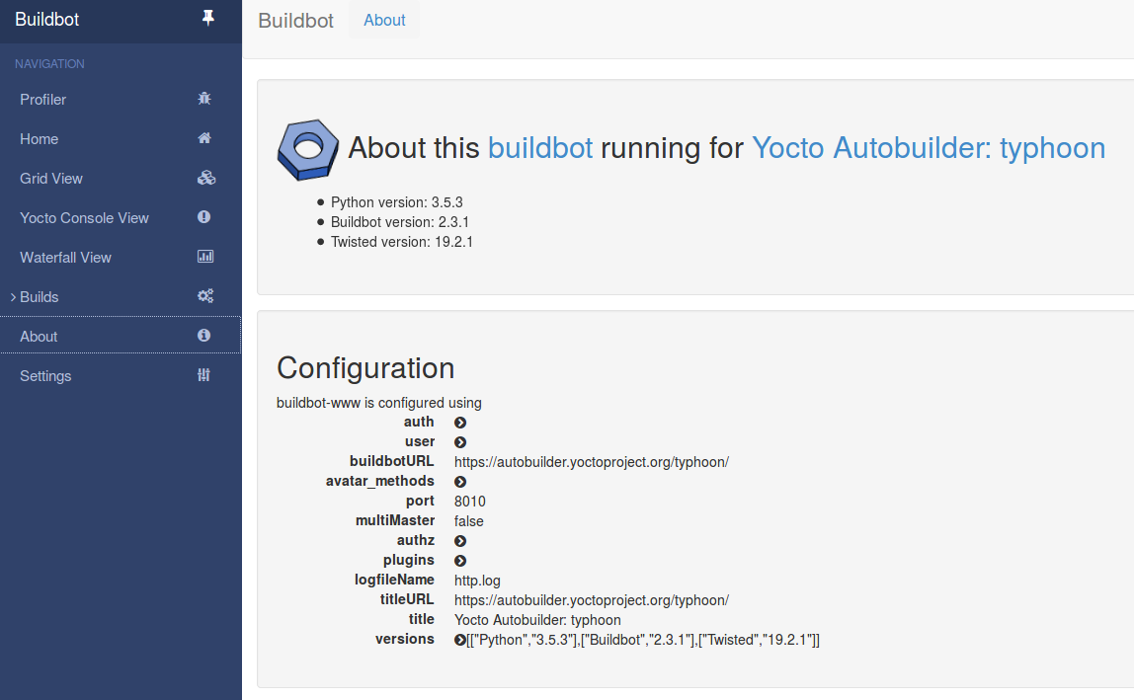
Autobuilder2 – build details
Notes:
40

Slide 41
Autobuilder2
Autobuilder custom ‘lighter’ configuration
Notes:
41

Slide 42
Ab2
Autobuilder2 reduced configuration
Reduce complexity
The goal is to setup a configuration for an image for a single MACHINE only
This will help yo strenghten the deployments thanks to recurring builds, tipically nightly

Slide 43
Ab2
Autobuilder2 reduced configuration
Files to be modified
.
├── yocto-autobuilder-helper
│ └── config.json
├── yocto-controller
│ └── yoctoabb
│ ├── builders.py
│ ├── config.py
│ ├── master.cfg
│ └── schedulers.py
└── yocto-worker
└── buildbot.tac

Slide 44
Ab2
Autobuilder2 configuration
In yocto-autobuilder-helper
Edit yocto-autobuilder-helper/config.json
In yocto-controller
Edit yocto-controller/yoctoabb/master.cfg
"BASE_HOMEDIR" : "/home/koan/ab2-sandbox",
"BASE_SHAREDDIR" : "${BASE_HOMEDIR}/autobuilder",
"BASE_PUBLISHDIR" : "${BASE_HOMEDIR}/downloads",
c['title'] = "KOAN lite Yocto Autobuilder"
c['titleURL'] = "http://localhost:8010/"
c['buildbotURL'] = "http://localhost:8010/"

Slide 45
Ab2
Autobuilder2 configuration
In yocto-controller (again)
Edit yocto-controller/yoctoabb/config.py
Specify the helper directory
workers_koan = ["example-worker"]
workers = workers_koan
all_workers = workers,
sharedrepodir = "/home/koan/ab2-sandbox/repos"
publish_dest = "/home/koan/ab2-sandbox/pub"
repos = {
"yocto-autobuilder-helper":
["file:///home/koan/ab2-sandbox/yocto-autobuilder-helper",
"master"],

Slide 46
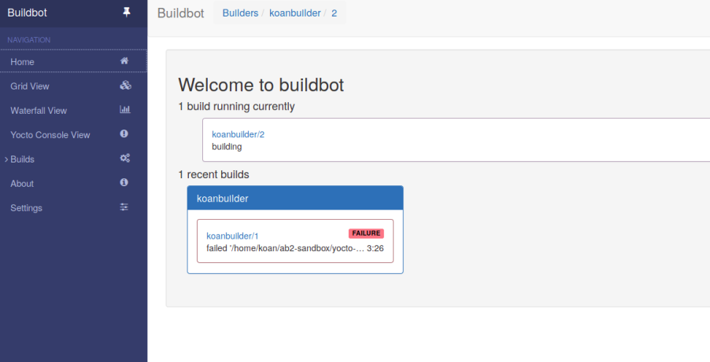
Autobuilder2 ‘lite’ customized
http://localhost:8010/
Notes:
46

Slide 47
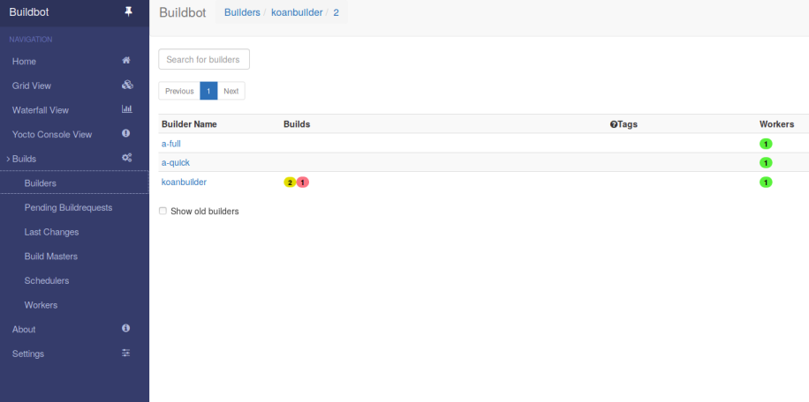
Autobuilder2 ‘lite’ customized
Notes:
47

Slide 48
Ab2
Autobuilder2 to speed up Yocto build
Share the artefacts with Yocto
Edit local.conf
Share downloads
Share SSTATE
PREMIRRORS_prepend = "\
git://.*/.* file:///home/koan/ab2-sandbox/autobuilder/current_sources/ \n \
ftp://.*/.* file:///home/koan/ab2-sandbox/autobuilder/current_sources/ \n \
http://.*/.* file:///home/koan/ab2-sandbox/autobuilder/current_sources/ \n \
https://.*/.* file:///home/koan/ab2-sandbox/autobuilder/current_sources/ \n \
"
SSTATE_MIRRORS = "file://.* \
file:///home/koan/ab2-sandbox/autobuilder/pub/sstate/PATH"

Slide 49
Autobuilder2 to speed up Yocto build
‘slave’
WORKER
‘master’
CONTROLLER
image
SSTATE
DL_DIR
bitbake

Slide 50
Questions?
https://yoctoproject.org
https://koansoftware.com

Slide 51
2. Working with NVIDIA Tegra BSP and Supporting Latest CUDA Versions
Leon Anavi

Slide 52
Download the slides from here:
https://wiki.yoctoproject.org/wiki/File:Yocto-dev-summit-leon-anavi-2019.pdf

Slide 53
3. Sstate-cache Magic!
Jaewon Lee
Presented by Mark Hatle

Slide 54
Abstract
From-scratch builds, even using server grade machines (with 40+ cores) will take just under an hour to complete. Additionally this estimate is just for minimal, stripped down images; Bigger images that bring up more than just core functionality and support things like web browsers/multimedia would take much longer (on the order of several hours).
Use of the sstate cache drastically cuts down on build times, especially for fresh projects. Xilinx makes full use of the sstate cache to speed up builds for its customers by hosting a comprehensive sstate cache (for all packages for different types of architectures) and allowing users to point their builds to this prebuilt and maintained sstate cache.

Slide 55
Abstract
There are different ways of distributing the sstate. When building an esdk (An extensible software development kit), the sstate of all non-native components is packaged so that any build using the esdk will happen in the blink of an eye. However, when building an sdk from within another sdk, the sstate for the native components were missing , hence making the sdk build disproportionately long compared to regular builds.
We introduced a patch into core that allows users to toggle the inclusion of nativesdk packages into the esdk by correctly handling sstate cache artifacts themselves as well as the corresponding signatures that are used to reference if anything has changed. With this change, a bigger esdk will be built, when required, that will skip rebuilding native components.

Slide 56
Agenda

Slide 57
Agenda
What is sstate-cache and how is it used
Tips and tricks
How is sstate-cache used in Xilinx
Upstreamed native sdk patch

Slide 58
What is sstate-cache and how is it used?

Slide 59
What is the sstate-cache?
All of this and more can be found in the sstate-cache section of the mega-manual
https://www.yoctoproject.org/docs/latest/mega-manual/mega-manual.html#shared-state-cache

Slide 60
What is the sstate-cache?
The sstate-cache allows incremental builds
Checksums are calculated on a per-task basis to minimize rebuilding unnecessarily
If the hash of any task is changed, task will be re-run
Configuration (local.conf, distro.conf, etc)
Recipe (.bb / .bbappend / dependency / function)
Files (src_uri)
If all inputs remained the same, build artifacts will be copied from the sstate-cache to the destination
This task as well all tasks this was dependent on, will be skipped

Slide 61
What is the sstate-cache?
To illustrate how useful the sstate-cache can be:
Build, no external sstate-cache: ~1.5 Hours
How long it takes to parse all of the files, execute all of the tasks.
Re-build with no changes: ~10 sec
How long it takes to check all the hashsums and figure out there’s nothing to do, parsing is already cached.
Removing tmp/ and rerunning build: ~1.5 min
How long it takes to restore minimum necessary build artifacts from the sstate-cache, build image, etc.
Note: this is approximately how long it would take customers to do a build if provided with a full sstate-cache, and no additional transfer time was required.

Slide 62
Sstate-cache details
Sstate-cache wiring
The _setscene task is the final wiring needed that will check if the sstate-cache can be used to skip this task
Flags: sstate-inputdirs, sstate-outputdirs, sstate-plaindirs, sstate-lockfile, sstate-lockfile-shared, sstate-interceptfuncs, sstate-fixmedir
Example:
package.bbclass
SSTATETASKS += "do_package"
do_package[cleandirs] = "${PKGDEST} ${PKGDESTWORK}"
do_package[sstate-plaindirs] = "${PKGD} ${PKGDEST} ${PKGDESTWORK}"
do_package_setscene[dirs] = "${STAGING_DIR}"
python do_package_setscene () {
sstate_setscene(d)
}
addtask do_package_setscene

Slide 63
Sstate task flags
sstate-inputdirs – where function places it’s output to be cached
sstate-outputdirs – where the output sstate cache copies to
sstate-plaindirs – use when input/output is the same
sstate-lockfile, sstate-lockfile-shared – special locks
sstate-interceptfuncs – post processing sstate funcs
sstate-fixmedir – directory to scan “fixme” ops

Slide 64
Sstate-cache details (cont)
sstate-cache is stored under build/sstate-cache (default but can be changed)
As an example, In the following:
sstate-cache/01/sstate:sstate:make::4.2.1:r0::3:01397ee06dba53ce572b63b9242fe29c_populate_lic.tgz
The build artifacts that would be copied into the cache, then placed into the outputdir:
do_populate_lic[sstate-inputdirs] = ${LICSSTATEDIR}:
./license-destdir/make/generic_GPLv3
./license-destdir/make/recipeinfo
./license-destdir/make/COPYING
./license-destdir/make/generic_LGPLv2
./license-destdir/make/COPYING.LIB
do_populate_lic[sstate-outputdirs] = ${LICENSE_DIRECTORY}

Slide 65
Tips and Tricks

Slide 66
Tips and tricks
You can point to an external sstate-cache (either on a server or local host)
SSTATE_MIRRORS ?= "\
file://.* http://someserver.tld/share/sstate/PATH;downloadfilename=PATH \n \
file://.* file:///some/local/dir/sstate/PATH”
Using SSTATE_MIRRORS is preferred (read only access)
Using a single shared directory (read write access)
If unfamiliar with mirroring, note the ‘\n’ and ‘\’!

Slide 67
Tips and tricks
There are cases where a scratch build is preferred
Often useful when debugging, or verifying deterministic builds
Clean the sstate-cache for individual packages by running: bitbake $PN –c cleansstate
To invalidate a specific task and rerun everything starting from that task (For ex. If you just want to recompile without rerunning the do_configure task)
bitbake $PN –C compile (Note the capital –C )
you will see: “NOTE: Tainting hash to force rebuild of task”
Since the hash has been tained, output is not shareable!

Slide 68
Tips and tricks
Check differences in sstate-cache
bitbake-dumpsig “/path to .siginfo file”
Dump everything that makes up the inputs of the sstate-cache (all variables, dependencies, hashsums, etc)
For example:
Variable TARGET_CXXFLAGS value is ${TARGET_CFLAGS}
basehash: 033325ee84d07cd82674a6827c1ea4a7b398da10430f41cffcaa488c4d0b3947
List of dependencies for variable EXTRA_OEMAKE is {'BUILD_CFLAGS', 'BUILD_CC’, 'BUILD_LDFLAGS', 'BUILD_CPP'}
Hash for dependent task /workspaces/jaewon/CORE/poky/meta/recipes-kernel/linux/linux-yocto_5.2.bb:do_kernel_configcheck is 36dad4284470c4ca656cfc981630cecbe4afac71a26a26b3ca706381be4f92cc

Slide 69
Tips and tricks
Find out why something rebuilt
bitbake-diffsigs “/path to first .siginfo file” “/path to second .siginfo file”
Example output after rebuilding with comment appended to compile task:

Slide 70
Tips and tricks
Ignore variables:
Often there are variables in the hash that don’t actually affect the output…
For example:
BB_HASHBASE_WHITELIST_append = “TOPDIR”
PACKAGE_ARCHS[vardepsexclude] = “MACHINE”
Manually add variables:
Sometimes there are variables you want to trigger a rebuild.. Often used with vardepsexclude.
For example:
PACKAGE_ARCHS[vardeps] = “MACHINE”

Slide 71
How is sstate-cache used at Xilinx

Slide 72
How sstate cache is used at Xilinx
A full image esdk (Extensible SDK) is built on a daily basis
The sstate-cache packaged within this esdk is extracted and synced daily to an internal NFS mount point and tools internally points builds to this sstate-cache through the SSTATE_MIRRORS variable.
For every release, the final full sstate-cache is also synced http://petalinux.xilinx.com for external use

Slide 73
Sstate cache usage stats
External usage from petalinux.xilinx.com

Slide 74
Upstreamed native sdk patch

Slide 75
Include native sdk in esdk
By default, native components (tools needed on the host) are not packaged into the esdk sstate-cache (originally because an esdk is targeted for a specific host).
We introduced a mechanism to enable including native components so developers could make changes within an esdk, and package that up again to distribute by creating another derivative sdk, in a much shorter time.

Slide 76
Include native sdk in esdk
Users would need to enable the flag, i.e. SDK_INCLUDE_NATIVESDK = "1“
And then build the esdk by running:
bitbake $IMAGE_NAME –c populate_sdk_ext

Slide 77
Include native sdk in esdk
The result is a bigger esdk that enables a much quicker derivative sdk build
Default:
Esdk size of ~1G
Sdk build time of ~20 min
By enabling SDK_INCLUDE_NATIVESDK
Esdk size of ~1.4G
Sdk build time of ~2 min

Slide 78
4. Bringing IOTA Distributed Ledger Technology (DLT) into Yocto/OpenEmbedded
Bernardo A. Rodrigues

Slide 79
Presenters
Bernardo A. Rodrigues
meta-iota Maintainer
bernardoaraujor@gmail.com
Philipp Blum
Developer Advocate (IOTA Foundation)
philipp.blum@iota.org

Slide 80
Table of Contents
What is IOTA?
IOTA Nodes
meta-iota
IOTA Ecosystem Development Fund

Slide 81
What is IOTA?
Context

Slide 82
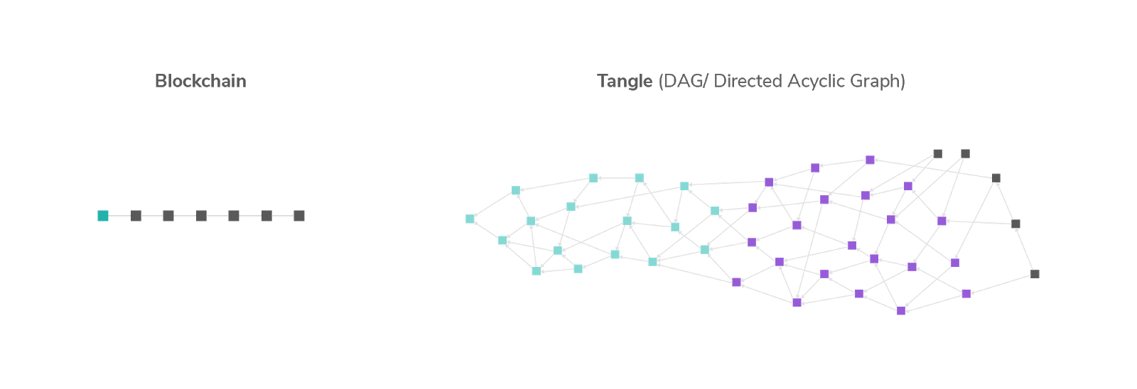
Distributed Ledger Technologies
Blockchain
Tangle
(DAG - Directed Acyclic Graph)

Slide 83
Tangle (DAG)
Each Vertex represents a transaction (squares)
Each Edge represents na approval (lines)

Slide 84
Zero Fee Transactions
-$0.01
+$0.01
​ No mining = No fees = Zero fee micro-transactions

Slide 85
IOTA Foundation
Non-Profit Foundation registered in Berlin
~100 employees in 17 countries
Funded through donations from IOTA Token holders, Research Grants and Project-based corporate financial support

Slide 86
IOTA Foundation

Slide 87
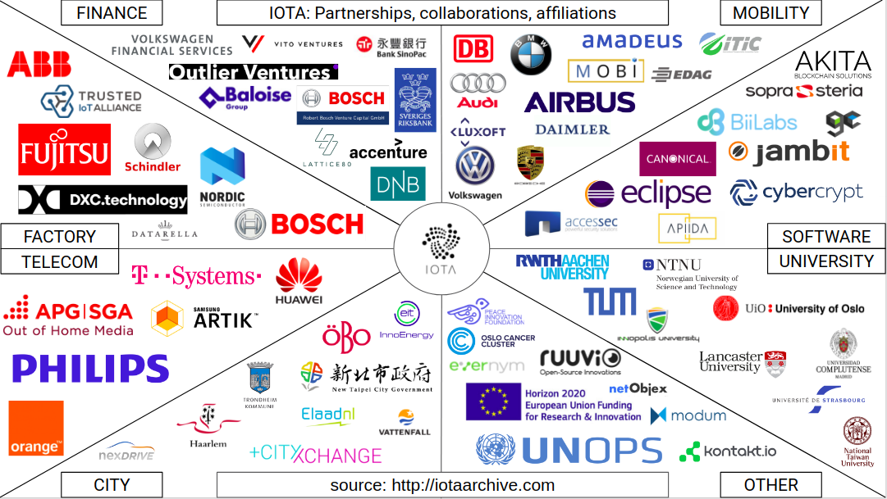
IOTA Foundation: Collaborations & Partnerships

Slide 88
IOTA Nodes
Pre Coordicide vs Post Coordicide

Slide 89
IOTA Nodes
DLT Node:
transaction relay
ledger copy

Slide 90
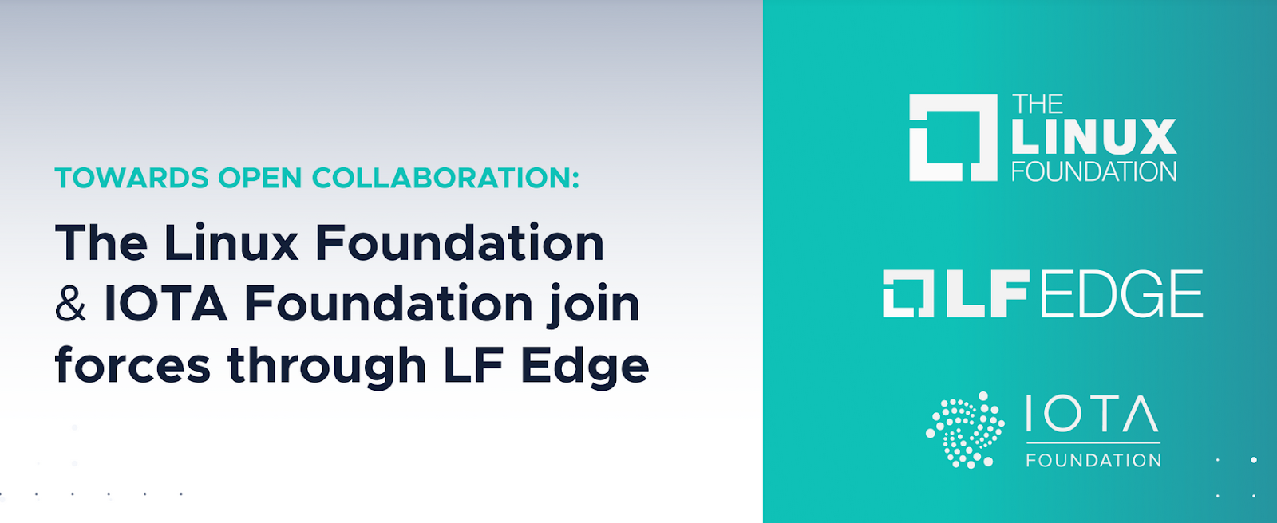
IOTA Nodes
Ethereum, Bitcoin, etc: Nodes on the Cloud (↑ hw resources)
IOTA: Nodes on the Edge (↓ hw resources)
https://blog.iota.org/towards-open-collaboration-1926e94514b8

Slide 91
Coordicide
To make it possible for the network to grow and protect it against certain attacks, IOTA currently relies on a coordinator.
The coordinator checkpoints valid transactions, which are then validated by the entire network.
The coordinator is being run by the IOTA Foundation.
Removing the Coordinator from the IOTA network will realize a long sought after goal in the field of DLT: scalability without centralization.
Coordicide: the death of the Coordinator.

Slide 92
Pre Coordicide vs Post Coordicide
Pre-Coordicide Node implementation:
IRI (Java)
cIRI (C)
Coordicide Proof of Concept Node implementation:
GoShimmer (Go)
Post-Coordicide Node implementation:
Bee (Rust)
Hornet (Go)
Since Coordicide is still a topic under R&D, meta-iota focuses on Pre Coordicide (for the moment).

Slide 93
meta-iota
Recipes

Slide 94
cIRI
low level implementation of an IOTA node in C
Users to become part of the IOTA network:
transaction relay
network information provider
JSON-REST HTTP interface
Suited for Embedded (SoC, SoM):
RAM: down to ~140MB RAM for solid node, ~500MB while syncing

Slide 95
cIRI: Bazel
IF development team chose Bazel as build system for cIRI
I borrowed the Bazel recipe and bbclass from meta-tensorflow
Plans to switch to CMake

Slide 96
ciri_0.1.0.bb
https://github.com/bernardoaraujor/meta-iota/blob/master/recipes-iota/ciri/ciri_0.1.0.bb

Slide 97
Let's ping the cIRI node on the BBB
$ curl http://104.155.135.221:14265/ \ -X POST \ -H 'Content-Type: application/json' \ -H 'X-IOTA-API-Version: 1' \ -d '{"command": "getNodeInfo"}'

Slide 98
CClient
IOTA client library implementation in C.
Recipe exports libcclient.a into the target rootfs/sysroot.
CMake support
Patch CMakeLists.txt to avoid the ExternalProject_add feature of CMake
Recipe for c-iota-workshop repository as an example of how to integrate with libcclient

Slide 99
libcclient_1.0.0.bb
https://github.com/bernardoaraujor/meta-iota/blob/master/recipes-iota/cclient/libcclient_1.0.0.bb
https://github.com/bernardoaraujor/meta-iota/blob/master/recipes-iota/cclient/c-iota-workshop_git.bb

Slide 100
Playing around with c-iota-workshop
Install Bazel: https://docs.bazel.build/versions/master/install.html
Clone repo: $ git clone https://github.com/iota-community/c-iota-workshop
Run an example: $ cd c-iota-workshop $ bazel run -c opt examples:[EXAMPLE_NAME]
Following examples are available:
hello_world send_hello receive_hello generate_address check_balances send_tokens

Slide 101
iota.go
IOTA Go API Library allows:
Create transactions
Sign transactions
Interact with an IRI node
Recipe written, although more testing is needed for validation.
Recipe lists all golang package dependencies explicitly.
Recipe for go-iota-workshop repository as an example of how to integrate with iota.go library

Slide 102
iota.go_1.0.0.bb
https://github.com/bernardoaraujor/meta-iota/blob/go-dev/recipes-iota/iota.go/iota.go_1.0.0.bb
https://github.com/bernardoaraujor/meta-iota/blob/go-dev/recipes-iota/iota.go/go-iota-workshop_git.bb

Slide 103
Playing around with go-iota-workshop
Install Golang (1.10+) https://golang.org/doc/install
Clone repo and download dependencies: $ git clone https://github.com/iota-community/go-iota-workshop $ cd go-iota-workshop; go mod download
Run an example: $ go run iota_go_[EXAMPLE_NAME]/main.go
Following examples are available:
helloworld send_data receive_data create_address check_balance
send_tx receive_tx zmq

Slide 104
iota.lib.py / PyOTA
Official Python library for the IOTA Core.
Implements both the official API, as well as signing, bundles, utilities and conversion.
Python 3.6, 3.5 and 2.7.
inherit setuptools
Integration is planned for the near future
https://github.com/iotaledger/iota.lib.py

Slide 105
Playing around with python-iota-workshop
Install Python 3 and PIP https://www.python.org/downloads/ https://pip.pypa.io/en/stable/installing/
Clone repo and donwload dependencies: $ git clone https://github.com/iota-community/python-iota-workshop $ cd python-iota-workshop; pip install -r requirements.txt
Run an example: $ python code/[EXAMPLE_NAME].py
Following examples are available: e01_hello_world.py e04_generate_address.py e07_send_data.py e02_send_hello.py e05_check_balance.py e08_receive_data.py e03_receive_hello.py e06_send_tokens.py e09_zmq_listen.py

Slide 106
IOTA CLI App
Command Line wallet and node management tool.
It is implemented in nodejs, and it’s available as a npm package.
To be integrated with the help of devtool npm functionality.
Integration planned for the near future.
https://github.com/iotaledger/cli-app
https://wiki.yoctoproject.org/wiki/TipsAndTricks/NPM

Slide 107
recipes-support
In order to fulfill dependencies, I had to write a few support recipes.
nanopb_0.3.9.3.bb: small code-size Protocol Buffers implementation in ansi C. Especially suitable for use in microcontrollers, but fits any memory restricted system
keccak_git.bb: keccak sponge function family including SHA3 implementation. Recipe needs improvement to support more architectures)
logger_4.0.0.bb: simple logging facility for the C language)
libzmq_4.3.2.bb: ZeroMQ core engine in C++
Extra contribution to the OE community.

Slide 108
Future of meta-iota (2020-21)
Bee
Post Coordicide Reference Implementation
Official IOTA Foundation
Rust (meta-rust and meta-rust-bin?)
Hornet
Post Coordicide Implementation
Community based (EDF)
Go

Slide 109
Ecosystem Development Fund
Boards for Proof-of-Concept

Slide 110
IOTA Ecosystem Development Fund
The IOTA EDF will allow me to validate Proof-of-Concepts on a few different boards with potential for IOTA Industrial applications.
There is a big interest for FPGA projects in the IOTA Community. This is due to the Quorum Based computations, as well as accelerated Proof-of-Work (PoW), Address Generation and Signing.
Board | Manufacturer | Comment | OpenEmbedded BSP Layer
STM32MP157C-DK2 | STMicroelectronics | The discovery SBC for STMicroelectronics STM32MP1 Series microprocessors | meta-st-stm32mp
Colibri iMX6 Solo SoM + Viola Carrier | Toradex | Toradex is a swiss manufacturer of Industrial-grade System on Modules. | meta-freescale-3rdparty
Zynq-7000 SoC ZC702 Evaluation Kit | Xilinx | The Zynq-7000 is a SoC+FPGA with great potential to accelerate PoW, Mini-PoW, Address Generation and Signing, as well as future Qubic implementations. | meta-xilinx

Slide 111
IOTA Ecosystem Development Fund
Board | Manufacturer | Comment | OpenEmbedded BSP Layer
DE10-Nano Development Kit | Terasic Technologies | The E10-Nano Development Kit is built around the Intel/Altera CycloneV SoC+FPGA. Also great potential to accelerate PoW, Mini-PoW, Address Generation and Signing, as well as future Qubic implementations. | meta-de10-nano meta-altera
BeagleBone Black | Texas Instruments | The most popular SBC in the Yocto Community. | meta-yocto-bsp meta-ti meta-beagleboard meta-bbb
DragonBoard 410c | 96Boards | SBC with a Qualcomm Snapdragon 400 | meta-qcom
Orange Pi Zero | Orange Pi | Popular small SBC with an AllWinner H2 chip. | meta-sunxi meta-allwinner-hx
Raspberry Pi Zero W | Raspberry Pi Foundation | Miniature version of the RPi, with Wireless support. | meta-raspberrypi

Slide 112
Class Account Setup

Slide 113
Yocto Project Dev Day Lab Setup
The virtual host’s resources can be found here:
Your Project: "/scratch/poky/build-qemux86_64“
Extensible-SDK Install: "/scratch/sdk/qemux86_64“
Sources: "/scratch/src“
Poky: "/scratch/poky"
Downloads: "/scratch/downloads"
Sstate-cache: "/scratch/sstate-cache“
You will be using SSH to communicate with your virtual server.

Slide 114
FYI: How class project was prepared (1/2)
$
$ cd /scratch
$ git clone -b zeus git://git.yoctoproject.org/poky.git
$ cd poky
$
$ bash # set up local shell
$ # Prepare the project
$ ./scratch/poky/oe-init-build-env build
$ echo "SSTATE_DIR = \"/scratch/sstate-cache\"" >> conf/local.conf
$ echo "DL_DIR = \"/scratch/downloads\"" >> conf/local.conf
$ echo "IMAGE_INSTALL_append = \" gdbserver openssh libstdc++ \
curl \"" >> conf/local.conf
$ $ # Build the project
$ bitbake core-image-base
$
Notes:
ilab01@devday010:/scratch/poky/build-qemux86_64$ du -sh tmp/
34G tmp/
ilab01@devday010:/scratch/poky/build-qemux86_64$
$ time bitbake core-image-base
real 1m3.721s
user 0m1.805s
sys 0m0.227s
ilab01@devday010:/scratch/poky/build-qemux86_64$ du -sh tmp/
2.0G tmp/

Slide 115
FYI: How class project was prepared (2/2)
$ # Build the eSDK
$
$ bitbake core-image-base -c populate_sdk_ext
$ cd /scratch/poky/build/tmp/deploy/sdk/
$ ./poky-glibc-x86_64-core-image-base-qemux86_64-toolchain-ext-*.sh \
-y -d /scratch/sdk/qemux86_64
$ exit # return to clean shell
$
$
$ bash # set up local shell
$ cd /scratch/sdk/qemux86_64
$ . /scratch/sdk/qemux86_64/environment-setup-qemux86_64-poky-linux-gnueabi
$ devtool modify virtual/kernel
$ exit # return to clean shell
$
Notes:
ilab01@devday010:/scratch/poky/build-qemux86_64$ du -sh tmp/
34G tmp/
ilab01@devday010:/scratch/poky/build-qemux86_64$
$ time bitbake core-image-base
real 1m3.721s
user 0m1.805s
sys 0m0.227s
ilab01@devday010:/scratch/poky/build-qemux86_64$ du -sh tmp/
2.0G tmp/

Slide 116
NOTE: Clean Shells!
We are going to do a lot of different exercises in different build projects, each with their own environments.
To keep things sane, you should have a new clean shell for each exercise.
There are two simple ways to do it:
Close your existing SSH connection and open a new one -- or –
Do a “bash” before each exercise to get a new sub-shell, and “exit” at the end to remove it, in order to return to a pristine state.

Slide 117
Devtool: Part 1 Kernel recipes and menuconfig
Manjukumar Harthikote Matha, Chandana Kalluri
Presented by Mark Hatle

Slide 118
Summary
Current devtool flow
Devtool flow for kernel
Devtool menuconfig

Slide 119
Initial Devtool flow for kernel
Fetch fresh copy of source from “SRC_URI”
(Takes about 5 mins to complete the command)
Devtool Modify
Make manual changes to .config file and save it
Devtool build
Compile and check for breakages
Devtool finish
Save changes to the recipe
The kernel source is fetched and copied to work-shared during the normal workflow either by running bitbake linux-yocto or bitbake <image-name>
User runs devtool modify linux-yocto
The command will take about 5 mins because it will extract a new copy of source into workspace even though a copy of kernel source is present in a shared location from normal flow. Next it will configure the kernel.

Slide 120
New Devtool flow for kernel – case 1
Devtool Modify
Fetch fresh copy of source from “SRC_URI”
(Takes about 15 seconds )
Devtool menuconfig
Use menuconfig GUI to make
modifications to kernel configs
Devtool build
Compile and check for breakages
Devtool finish
Save changes to the recipe
The kernel source is fetched and copied to work-shared during the normal workflow either by running bitbake linux-yocto or bitbake <image-name>
User runs devtool modify linux-yocto
The devtool modify command will take about 15 seconds because it will copy source from work-shared and configure the kernel.

Slide 121
New Devtool flow for kernel – case 2
Devtool Modify
Fetch fresh copy of source from “SRC_URI”
(Takes about 5 mins )
Devtool menuconfig
Use menuconfig GUI to make
modifications to kernel configs
Devtool build
Compile and check for breakages
Devtool finish
Save changes to the recipe
The kernel source is not fetched and copied to work-shared during the normal workflow either by not running bitbake linux-yocto or bitbake <image-name>
User runs devtool modify linux-yocto
The devtool modify command will take about 5 mins because it will fetch new copy of source into workspace and place a copy in work-shared. Any dependent packages that need kernel-source will now find a copy in work-shared instead of fetching the source again.

Slide 122
Commands

Slide 123
Original Devtool modify flow commands
$ source oe-init-build-env
$ bitbake linux-yocto <this takes about 5 mins>
$ devtool modify linux-yocto <this takes about 5 mins>
New Devtool modify flow commands – Case 1
$ source oe-init-build-env
$ bitbake linux-yocto <this takes about 5 mins>
$ # Observe that the kernel souce was fetched:
$ ls tmp/work-shared/qemux86_64/kernel-source
$ devtool modify linux-yocto <this takes about 15 seconds>

Slide 124
New Devtool modify flow commands – Case 2
$ source oe-init-build-env
$ ls tmp/work-shared/qemux86_64/kernel-source <kernel source not present>
$ devtool modify linux-yocto <this takes about 5 mins>
$ ls tmp/work-shared/qemux86_64/kernel-source <kernel source copied >

Slide 125
Devtool menuconfig:
$ source oe-init-build-env
$ devtool modify linux-yocto
$ devtool menuconfig linux-yocto
1. Enable this kernel option
2. Save this change

Slide 126
Devtool menuconfig summary:
$ devtool menuconfig linux-yocto
…
Sstate summary: Wanted 0 Found 0 Missed 0 Current 48 (0% match, 100% complete)
NOTE: Executing Tasks
NOTE: Setscene tasks completed
NOTE: Tasks Summary: Attempted 380 tasks of which 372 didn't need to be rerun and all
succeeded.
INFO: Updating config fragment /workspaces/ckalluri/poky/builds/menuconfig/
workspace/sources/linux-yocto/oe-local-files/devtool-fragment.cfg

Slide 127
Devtool finish
$ devtool finish linux-yocto meta-yocto-bsp
$cat ../../meta-yocto-bsp/recipes-kernel/linux/linux-yocto_%.bbappend
FILESEXTRAPATHS_prepend := "${THISDIR}/${PN}:"
SRC_URI += "file://devtool-fragment.cfg"
$cat ../../meta-yocto-bsp/recipes-kernel/linux/linux-yocto/devtool-fragment.cfg
# CONFIG_INITRAMFS_FORCE is not set
CONFIG_CMDLINE_FORCE=y

Slide 128
Devtool: Part 2 Kernel Modules with eSDKs
Marco Cavallini

Slide 129
Kernel modules with eSDKs – Overview
The Extensible SDK (eSDK) is a portable and standalone development environment , basically an SDK with an added bitbake executive via devtool.
The “devtool” is a collection of tools to help development, in particular user space development.
We can use devtool to manage a new kernel module:
Like normal applications is possible to import and create a wrapper recipe to manage the kernel module with eSDKs.

Slide 130
Kernel modules with eSDKs – Compiling a kernel module
We have two choices
Out of the kernel tree
When the code is in a different directory outside of the kernel source tree
Inside the kernel tree
When the code is managed by a KConfig and a Makefile into a kernel directory

Slide 131
Kernel modules with eSDKs – Pro and Cons of a module outside the kernel tree
When the code is outside of the kernel source tree in a different directory
Advantages
Might be easier to handle modifications than modify it into the kernel itself
Drawbacks
Not integrated to the kernel configuration/compilation process
Needs to be built separately
The driver cannot be built statically

Slide 132
Kernel modules with eSDKs – Pro and Cons of a module inside the kernel tree
When the code is inside the same directory tree of the kernel sources
Advantages
Well integrated into the kernel configuration and compilation process
The driver can be built statically if needed
Drawbacks
Bigger kernel size
Slower boot time

Slide 133
Kernel modules with eSDKs – The source code
#include <linux/module.h>
#include <linux/kernel.h>
static int __init hello_init(void)
{
printk("When half way through the journey of our life\n");
return 0;
}
static void __exit hello_exit(void)
{
printk("I found that I was in a gloomy wood\n");
}
module_init(hello_init);
module_exit(hello_exit);
MODULE_LICENSE("GPL");
MODULE_DESCRIPTION("Greeting module from the Divine Comedy");
MODULE_AUTHOR("Dante Alighieri");

Slide 134
Kernel modules with eSDKs – The Makefile
obj-m += hellokernel.o SRC := $(shell pwd) all: $(MAKE) -C $(KERNEL_SRC) M=$(SRC) modules modules_install: $(MAKE) -C $(KERNEL_SRC) M=$(SRC) modules_install
KERNEL_SRC is the location of the kernel sources.
This variable is set to the value of the STAGING_KERNEL_DIR within the module class (module.bbclass)
Sources avalable on https://github.com/koansoftware/simplest-kernel-module.git and in /scratch/src/kmod
Notes:
Note in do_install, the ‘/’ is NOT missing between ${D}${bindir}
We cd ${S} because default is ${B}, no source in ${B} (not default same as ${S} anymore)

Slide 135
Kernel modules with eSDKs – Devtool setup
Start a new Shell! Otherwise, the existing bitbake environment can cause unexpected results
Here is how the eSDK was prepared for this class account:
This installed the eSDK into: /scratch/sdk/qemux86_64
< DO NOT ENTER THE FOLLOWING COMMANDS : ALREADY EXECUTED >
$ bitbake core-image-base -c populate_sdk_ext
$ cd /scratch/working/build/tmp/deploy/sdk/
$ ./poky-glibc-x86_64-core-image-base-core2-64-qemux86-64-toolchain-ext-3.0.sh \
-d /scratch/sdk/qemux86_64 –y
$ cd /scratch/sdk/qemux86_64
$ . environment-setup-core2-64-poky-linux
$ devtool modify virtual/kernel

Slide 136
Kernel modules with eSDKs – Overview
Starting from now we are using the eSDK and not the project
During this exercise we using two different machines
The HOST containing the eSDK (providing devtool)
The TARGET running the final qemux86_64 image
Host
eSDK:~$
Target
root@qemux86_64:~$

Slide 137
Kernel modules with eSDKs – Globalsetup
Open two terminal windows and setup the eSDK environment in each one
$ cd /scratch/sdk/qemux86_64
$ bash # safe shell
$ source environment-setup-core2-64-poky-linux
…
SDK environment now set up;
additionally you may now run devtool to perform development tasks.
Run devtool --help for further details.
$

Slide 138
Kernel modules with eSDKs – build the target image
After you have setup the eSDK environment, build an image
This will create a new image into: /scratch/sdk/qemux86_64/tmp/deploy/images/qemux86_64
$ devtool build-image

Slide 139
Kernel modules with eSDKs – build the target image
Run the image to check if everything is OK
This will run the QEMU machine in the TARGET shell you were using
Login using user: root (no password required)
$ runqemu qemux86-64 nographic

Slide 140
Kernel modules with eSDKs – Hooking a new module into the build
Run the devtool to add a new recipe (on the HOST side)
This generates a minimal recipe in the workspace layer
This adds EXTERNALSRC in an workspace/appends/simplestmodule_git.bbappend file that points to the sources
In other words, the source tree stays where it is, devtool just creates a wrapper recipe that points to it
Note: this does not add your image to the original build engineer’s image, which requires changing the platform project’s conf/local.conf
$ devtool add --version 1.0 simplestmodule \
/scratch/src/kmod/simplest-kernel-module/

Slide 141
After the add
Workspace layer layout
$ tree /scratch/sdk/qemux86_64/workspace/ /scratch/sdk/qemux86_64/workspace/ ├── appends │ └── simplestmodule_git.bbappend ├── conf │ └── layer.conf ├── README └── recipes └── simplestmodule └── simplestmodule_git.bb
Notes:
The build directory

Slide 142
Kernel modules with eSDKs – Build the Module
Build the new recipe (on the HOST side)
This will create the simplestmodule.ko kernel module
This downloads the kernel sources (already downloaded for you): linux-yocto-4.12.12+gitAUTOINC+eda4d18ce4_67b62d8d7b-r0 do_fetch
$ devtool build simplestmodule

Slide 143
Kernel modules with eSDKs – Deploy the Module
Get the target’s IP address from the target serial console root@qemux86_64:~# ifconfig
In the eSDK (HOST) shell, deploy the output (the target’s ip address may change)
NOTE: the ‘-s’ option will note any ssh keygen issues, allowing you to (for example) remove/add this IP address to the known hosts table
$ devtool deploy-target -s simplestmodule root@192.168.7.2

Slide 144
Kernel modules with eSDKs – Deploy Details
In the target (qemux86_64), observe the result of deployment
devtool_deploy.list 100% 108 0.1KB/s 00:00
devtool_deploy.sh 100% 1017 1.0KB/s 00:00
./
./lib/
./lib/modules/
./lib/modules/4.12.12-yocto-standard/
./lib/modules/4.12.12-yocto-standard/extra/
./lib/modules/4.12.12-yocto-standard/extra/hellokernel.ko
./usr/
./usr/include/
./usr/include/simplestmodule/
./usr/include/simplestmodule/Module.symvers
./etc/
./etc/modprobe.d/
./etc/modules-load.d/
NOTE: Successfully deployed
/scratch/sdk/qemux86_64/tmp/work/qemux86_64-poky-linux-gnueabi/simplestmodule/

Slide 145
Kernel modules with eSDKs – Load the Module
In the target (qemux86_64), load the module and observe the results
root@qemux86_64:~# depmod –a
root@qemux86_64:~# modprobe hellokernel
[ 874.941880] hellokernel: loading out-of-tree module taints kernel.
[ 874.960165] When half way through the journey of our life
root@qemux86_64:~# lsmod
Module Size Used by
hellokernel 929 0
nfsd 271348 11

Slide 146
Kernel modules with eSDKs – Unload the Module
In the target (qemux86_64), unload the module
root@qemux86_64:~# modprobe -r hellokernel
[ 36.005902] I found that I was in a gloomy wood
root@qemux86_64:~# lsmod
Module Size Used by
nfsd 271348 11

Slide 147
Kernel modules with eSDKs – automatic load of the module at boot
In the target (qemux86_64), edit the file below and add a new line containing the module name ‘hellokernel’
Then reboot the Qemu machine and verify
root@qemux86_64:~# vi /etc/modules-load.d/hello.conf
< insert the following line and save >
hellokernel
root@qemux86_64:~# reboot

Slide 148
Questions

Slide 149
Devtool: Part 3 Bonus Kernel Lab
Tom Zanuss, Darren Hart, Saul Wold, Richard Griffiths, and YOU!

Slide 150
Bonus Kernel Lab!
Here is you chance to learn more about kernel development support, plus help contribute tutorial content to Yocto Project!
There is an important tradition of providing a Kernel Lab to help developers. The problem is that the last one was done for YP-2.6, and it needs an update to YP-3.*.
Give the lab a try. If you find errors, let us know. If it is missing topic that would like addressed, or parts are unclear, let us know. If you can help provide fixes and improvements, then even better!

Slide 151
Bonus Kernel Lab
The current document can be found here:
https://wiki.yoctoproject.org/wiki/File:Kernel-lab-2.6.pdf
https://wiki.yoctoproject.org/wiki/File:Kernel-lab-2.6.odt
The sample source ZIP file can be found here:
TDB
If you want to share your observations with us and others working on this, email myself and/or Tim and we will connect you:
david.reyna@windriver.com

Slide 152
6. User Space Topics
Rudi Streif
Presented by David Reyna

Slide 153
Overview
Activity Setup
Users, Groups and Passwords
Login Shells
Sudo Configuration
SSH Server Configuration
Please ask questions.
Your questions might help others too.

Slide 154
Activity Setup
Create an activity layer and add it to the build environment
$ cd /scratch/poky
$ source oe-init-build-env build-userspace
$ bitbake-layers create-layer meta-activity3
NOTE: Starting bitbake server…
Add your new layer with ‘bitbake-layers add-layer meta-activity3’
$ bitbake-layers add-layer meta-activity3
NOTE: Starting bitbake server…
$ cat conf/bblayers.conf
…
BBLAYERS ?= “ \
/scratch/poky/meta \
/scratch/poky/meta-poky \
/scratch/poky/meta-yocto-bsp \
/scratch/poky/build/meta-activity3 \
“

Slide 155
Activity Setup
Create an image recipe
$ mkdir -p meta-activity3/recipes-core/images
$ pushd meta-activity3/recipes-core/images
$ vi core-image-activity3.bb
SUMMARY = "Activity 3 Test Image"
DESCRIPTION = "Activity 3 Test Image for Yocto Project Summit"
LICENSE = "MIT"
IMAGE_INSTALL = "packagegroup-core-boot \
packagegroup-base-extended \
${CORE_IMAGE_EXTRA_INSTALL} \
"
inherit core-image
$ bitbake core-image-activity3
$ runqemu qemux86-64 nographic

Slide 156
Users, Groups and Passwords
The extrausers class provides a mechanism for managing users, groups and passwords.
Available commands:
useradd
usermod
userdel
groupadd
groupmod
groupdel
Commands are added to the EXTRA_USERS_PARAMS variable.
Passwords must be provided in encrypted form.

Slide 157
Setting root user password and creating a user
$ vi core-image-activity3.bb
SUMMARY = "Activity 3 Test Image"
DESCRIPTION = "Activity 3 Test Image for Yocto Project Summit"
LICENSE = "MIT"
IMAGE_INSTALL = "packagegroup-core-boot \
packagegroup-base-extended \
${CORE_IMAGE_EXTRA_INSTALL} \
"
inherit core-image
inherit extrausers
ROOT_PASSWORD = "secret"
DEV_PASSWORD = "hackme"
EXTRA_USERS_PARAMS = " \
groupadd developers; \
useradd -p `openssl passwd ${DEV_PASSWORD}` developer; \
useradd -g developers developer; \
usermod -p `openssl passwd ${ROOT_PASSWORD}` root; \
"
$ bitbake core-image-activity3
$ runqemu qemux86-64 nographic

Slide 158
Works, but...
Changing the image recipe for new users is not really elegant.
It would be better if we could set the users we want to add and their passwords in a configuration file such as local.conf or a distro configuration.

Slide 159
A little script goes a long way...
$ vi user-setup.inc
# Image post-processing to setup user accounts
inherit extrausers
# Space-delimited list of user:password:<group,group,...> tuples
NEWUSERS ??= ""
# root password
ROOT_PASSWORD ??= ""
python () {
params = ""
# add new users
newusers = (d.getVar("NEWUSERS", True) or "").split()
if newusers:
for user in newusers:
name,password,groups = user.split(":")
for group in groups.split(","):
params += "groupadd -f " + group + "; "
params += "useradd -p `openssl passwd " + password + "` "
if groups:
params += "-G " + groups + " "
params += name + "; "
# modify root password
rootpw = d.getVar("ROOT_PASSWORD", True) or ""
if rootpw:
params += "usermod -p `openssl passwd " + rootpw + "` root; "
d.setVar("EXTRA_USERS_PARAMS", params)
}

Slide 160
Using the script
$ vi core-image-activity3.bb
SUMMARY = "Activity 3 Test Image"
DESCRIPTION = "Activity 3 Test Image for Yocto Project Summit"
LICENSE = "MIT"
IMAGE_INSTALL = "packagegroup-core-boot \
packagegroup-base-extended \
${CORE_IMAGE_EXTRA_INSTALL} \
"
inherit core-image
require user-setup.inc
$ vi /scratch/poky/build/conf/local.conf
# Users to be added: space-delimited list of name:password:groups tuples.
# groups is comma-delimited list of additional group names
NEWUSERS = "developer:hackme:developers"
# Root User Password
ROOT_PASSWORD = "secret"
$ bitbake core-image-activity3
$ runqemu qemux86-64 nographic

Slide 161
5. Devtool hands-on Seminar Part 2

Slide 162
Image Post Processing
Sometimes it is necessary to processing such as adding, modifying files and more after the root file system has been created but before it is packaged into the different formats.
Through the variable ROOTFS_POSTPROCESS_COMMAND you can specify a list of shell functions to be executed.
Commonly the variable and the functions are added to the image recipe.
The functions are executed in the order they appear in the variable.
The search path for shell commands includes the native system root of the build environment and build host PATH from the user environment.
The variable IMAGE_ROOTFS points to the directory where the build system assembles the root file system.

Slide 163
Setting Login Shells
$ vi core-image-activity3.bb
SUMMARY = "Activity 3 Test Image"
DESCRIPTION = "Activity 3 Test Image for Yocto Project Summit"
LICENSE = "MIT"
IMAGE_INSTALL = "packagegroup-core-boot \
packagegroup-base-extended \
${CORE_IMAGE_EXTRA_INSTALL} \
"
inherit core-image
modify_shells() {
printf "# /etc/shells: valid login shells\n/bin/sh\n/bin/bash\n" \
> ${IMAGE_ROOTFS}/etc/shells
}
ROOTFS_POSTPROCESS_COMMAND += "modify_shells;"
$ bitbake core-image-activity3
$ runqemu qemux86-64 nographic

Slide 164
Sudo Configuration
$ vi core-image-activity3.bb
SUMMARY = "Activity 3 Test Image"
DESCRIPTION = "Activity 3 Test Image for Yocto Project Summit"
LICENSE = "MIT"
IMAGE_INSTALL = "packagegroup-core-boot \
packagegroup-base-extended \
${CORE_IMAGE_EXTRA_INSTALL} \
sudo \
"
inherit core-image
modify_sudoers() {
sed 's/# %sudo/%sudo/' < ${IMAGE_ROOTFS}/etc/sudoers > \
${IMAGE_ROOTFS}/etc/sudoers.tmp
mv ${IMAGE_ROOTFS}/etc/sudoers.tmp ${IMAGE_ROOTFS}/etc/sudoers
}
ROOTFS_POSTPROCESS_COMMAND += "modify_sudoers;"
$ bitbake core-image-activity3
$ runqemu qemux86-64 nographic
Note: You have to add a regular user to the sudo group for this to work.

Slide 165
SSH Server Configuration
$ vi core-image-activity3.bb
configure_sshd() {
# disallow password authentication
echo “PasswordAuthentication no” >> ${IMAGE_ROOTFS}/etc/ssh/sshd_config
# create keys in tmp/deploy/keys
mkdir -p ${DEPLOY_DIR}/keys
if [ ! -f ${DEPLOY_DIR}/keys/root-sshkey ]; then
/usr/bin/ssh-keygen -t rsa -N '' \
-f ${DEPLOY_DIR}/keys/root-sshkey
fi
# add public key to authorized_keys for root
mkdir -p ${IMAGE_ROOTFS}/home/root/.ssh
cat ${DEPLOY_DIR}/keys/root-sshkey.pub \
>> ${IMAGE_ROOTFS}/home/root/.ssh/authorized_keys
}
ROOTFS_POSTPROCESS_COMMAND += "configure_sshd;"
$ bitbake core-image-activity3
$ runqemu qemux86-64 nographic
[in a new ssh shell to your build system]
$ ssh -i \
/scratch/poky/build/tmp/deploy/keys/root-sshkey root@192.168.7.2

Slide 166
Nice, but once again not very flexible...
$ vi sshd-setup.inc
# Image post-processing to configure sshd
# Setup ssh key login for these users
SSH_USERS ??= ""
configure_sshd() {
# disallow password authentication
echo "PasswordAuthentication no" >> ${IMAGE_ROOTFS}/etc/ssh/sshd_config
# keys will be stored tmp/deploy/keys
mkdir -p ${DEPLOY_DIR}/keys
# create the keys for the users
for user in ${SSH_USERS}; do
if [ ! -f ${DEPLOY_DIR}/keys/${user}-sshkey ]; then
/usr/bin/ssh-keygen -t rsa -N '' \
-f ${DEPLOY_DIR}/keys/${user}-sshkey
fi
# add public key to authorized_keys for the user
mkdir -p ${IMAGE_ROOTFS}/home/${user}/.ssh
cat ${DEPLOY_DIR}/keys/${user}-sshkey.pub \
>> ${IMAGE_ROOTFS}/home/${user}/.ssh/authorized_keys
done
}
ROOTFS_POSTPROCESS_COMMAND += "configure_sshd;"

Slide 167
Using the script
$ vi core-image-activity3.bb
SUMMARY = "Activity 3 Test Image"
DESCRIPTION = "Activity 3 Test Image for Yocto Project Summit "
LICENSE = "MIT"
IMAGE_INSTALL = "packagegroup-core-boot \
packagegroup-base-extended \
${CORE_IMAGE_EXTRA_INSTALL} \
"
inherit core-image
require sshd-setup.inc
$ vi /scratch/poky/build/conf/local.conf
# Users for whom to create ssh login with key
SSH_USERS = "root developer"
$ bitbake core-image-activity3
$ runqemu qemux86-64 nographic
[in a new ssh shell to your build system]
$ ssh -i \
/scratch/poky/build/tmp/deploy/keys/developer-sshkey \
developer@192.168.7.2

Slide 168
EoA (End of Activity)
Cleanup
Thank You!
$ cd /scratch/poky/build-userspace
$ bitbake-layers remove-layer meta-activity3

Slide 169
Questions and Answers

Slide 170
Thank you for your participation!

Slide 171
Activity Eight
Tools, Toaster, User Experience
David Reyna

Slide 172
Toaster: Latest Features (1/2)
Toaster Documentation
https://www.yoctoproject.org/docs/latest/toaster-manual/toaster-manual.html
Toaster Service Without a Web Server (“noweb”)
Good for capturing command line build(s) directly into the db
Toaster Service Without Remote Builds (“nobuild”)
Good for sharing build local status, without enabling external people creating projects and starting builds on your host
Toaster Service – Build Status within Containers
New REST/JSON API to access the progress and health of bitbake builds via HTTP; very handy for containers
Build Status options: “Completed”, “In Progress”, “Specific Status”

Slide 173
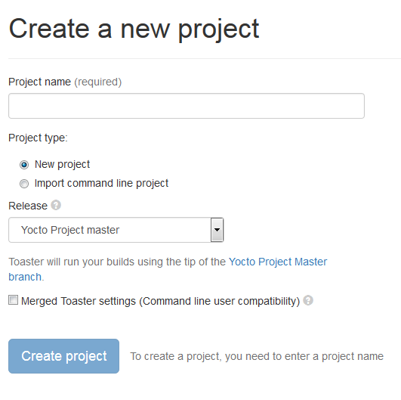
Toaster: Latest Features (2/2)
Compatibility between Command Line and Toaster builds
New “Import command line build” option
New “Merge Toaster Settings” into standard conf files”

Slide 174
Intel System Studio 2019: Yocto Project Compatible
The Wind River Application and Project plug-ins have been shared with Intel System Studio, with the idea of open sourcing them to Eclipse.org
Implementation is architecture agnostic
Application Project Features:
Awareness of YP compatible SDKs/eSDKs
Ability to register multiple SDKs
Automatic generation of “Build Specs” for each machine variant in each SDK
Ability to enable/disable debug flags
Debugger deploy and access over GDB/TCF
Set of sample applications

Slide 175
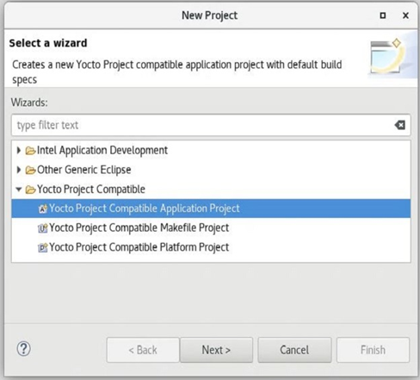
Intel System Studio 2019: Yocto Project Compatible
Platform Project Features:
Configuration/Updates via Toaster
Basic build targets directly from ISS
Eclipse-based Kernel Configuration Tool
Tree view to browse deploy artifacts

Slide 176
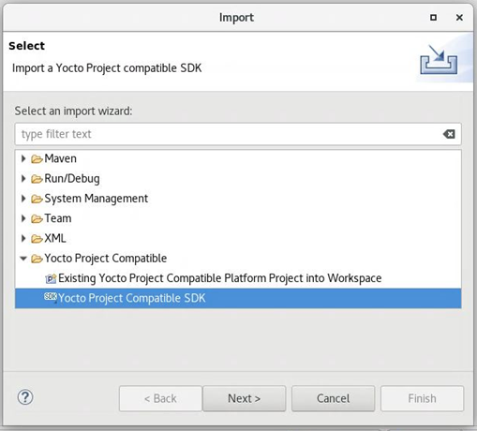
Intel System Studio 2019: Yocto Project Compatible
Import:
Existing command line project
Existing SDK/eSDK

