Slide 1
Yocto Project Summit – Lyon Day 2 : Friday 1 November 2019
Marco Cavallini, Leon Anavi, Jaewon Lee, Bernardo A. Rodrigues,
Manjukumar Harthikote Matha, Chandana Kalluri, Tim Orling, David Reyna
Presenter Slides: https://wiki.yoctoproject.org/wiki/YP_Summit_Lyon_2019

Slide 2
Agenda – Yocto Project Summit - Day 2
9:00- 9:45 Strenghten your Yocto deployments with Autobuilder2 CI tool
9:50- 10:35 Working with NVIDIA Tegra BSP and Supporting Latest CUDA Versions
10:40-10:50 Morning Break
10:55-11:40 Sstate-cache Magic!
11:45-12:30 Bringing IOTA Distributed Ledger Technology (DLT) into Yocto/OpenEmbedded
12:35-1:20 Lunch
1:25- 2:55 Class: Devtool hands-on Seminar
3:00- 3:10 Afternoon Break
3:15- 4:45 Class: User Space 2.0 Seminar

Slide 3
1. Strengthen your Yocto deployments with Autobuilder2 CI tool
Marco Cavallini

Slide 4
2. Working with NVIDIA Tegra BSP and Supporting Latest CUDA Versions
Leon Anavi

Slide 5
Download the slides from here:
https://wiki.yoctoproject.org/wiki/File:Yocto-dev-summit-leon-anavi-2019.pdf

Slide 6
3. Sstate-cache Magic!
Jaewon Lee
Presented by Mark Hatle

Slide 7
Abstract
From-scratch builds, even using server grade machines (with 40+ cores) will take just under an hour to complete. Additionally this estimate is just for minimal, stripped down images; Bigger images that bring up more than just core functionality and support things like web browsers/multimedia would take much longer (on the order of several hours).
Use of the sstate cache drastically cuts down on build times, especially for fresh projects. Xilinx makes full use of the sstate cache to speed up builds for its customers by hosting a comprehensive sstate cache (for all packages for different types of architectures) and allowing users to point their builds to this prebuilt and maintained sstate cache.
There are different ways of distributing the sstate. When building an esdk (An extensible software development kit), the sstate of all non-native components is packaged so that any build using the esdk will happen in the blink of an eye. However, when building an sdk from within another sdk, the sstate for the native components were missing , hence making the sdk build disproportionately long compared to regular builds. We introduced a patch into core that allows users to toggle the inclusion of nativesdk packages into the esdk by correctly handling sstate cache artifacts themselves as well as the corresponding signatures that are used to reference if anything has changed. With this change, a bigger esdk will be built, when required, that will skip rebuilding native components.

Slide 8
Agenda

Slide 9
Agenda
What is sstate-cache and how is it used
Tips and tricks
How is sstate-cache used in Xilinx
Upstreamed native sdk patch

Slide 10
What is sstate-cache and how is it used?

Slide 11
What is the sstate-cache?
All of this and more can be found in the sstate-cache section of the mega-manual
https://www.yoctoproject.org/docs/latest/mega-manual/mega-manual.html#shared-state-cache

Slide 12
What is the sstate-cache?
The sstate-cache allows incremental builds
Checksums are calculated on a per-task basis to minimize rebuilding unnecessarily
If the hash of any task is changed, task will be re-run
Configuration (local.conf, distro.conf, etc)
Recipe (.bb / .bbappend / dependency / function)
Files (src_uri)
If all inputs remained the same, build artifacts will be copied from the sstate-cache to the destination
This task as well all tasks this was dependent on, will be skipped

Slide 13
What is the sstate-cache?
To illustrate how useful the sstate-cache can be:
Build, no external sstate-cache: ~1.5 Hours
How long it takes to parse all of the files, execute all of the tasks.
Re-build with no changes: ~10 sec
How long it takes to check all the hashsums and figure out there’s nothing to do, parsing is already cached.
Removing tmp/ and rerunning build: ~1.5 min
How long it takes to restore minimum necessary build artifacts from the sstate-cache, build image, etc.
Note: this is approximately how long it would take customers to do a build if provided with a full sstate-cache, and no additional transfer time was required.

Slide 14
Sstate-cache details
Sstate-cache wiring
The _setscene task is the final wiring needed that will check if the sstate-cache can be used to skip this task
Flags: sstate-inputdirs, sstate-outputdirs, sstate-plaindirs, sstate-lockfile, sstate-lockfile-shared, sstate-interceptfuncs, sstate-fixmedir
Example:
package.bbclass
SSTATETASKS += "do_package"
do_package[cleandirs] = "${PKGDEST} ${PKGDESTWORK}"
do_package[sstate-plaindirs] = "${PKGD} ${PKGDEST} ${PKGDESTWORK}"
do_package_setscene[dirs] = "${STAGING_DIR}"
python do_package_setscene () {
sstate_setscene(d)
}
addtask do_package_setscene

Slide 15
Sstate task flags
sstate-inputdirs – where function places it’s output to be cached
sstate-outputdirs – where the output sstate cache copies to
sstate-plaindirs – use when input/output is the same
sstate-lockfile, sstate-lockfile-shared – special locks
sstate-interceptfuncs – post processing sstate funcs
sstate-fixmedir – directory to scan “fixme” ops

Slide 16
Sstate-cache details (cont)
sstate-cache is stored under build/sstate-cache (default but can be changed)
As an example, In the following:
sstate-cache/01/sstate:sstate:make::4.2.1:r0::3:01397ee06dba53ce572b63b9242fe29c_populate_lic.tgz
The build artifacts that would be copied into the cache, then placed into the outputdir:
do_populate_lic[sstate-inputdirs] = ${LICSSTATEDIR}:
./license-destdir/make/generic_GPLv3
./license-destdir/make/recipeinfo
./license-destdir/make/COPYING
./license-destdir/make/generic_LGPLv2
./license-destdir/make/COPYING.LIB
do_populate_lic[sstate-outputdirs] = ${LICENSE_DIRECTORY}

Slide 17
Tips and Tricks

Slide 18
Tips and tricks
You can point to an external sstate-cache (either on a server or local host)
SSTATE_MIRRORS ?= "\
file://.* http://someserver.tld/share/sstate/PATH;downloadfilename=PATH \n \
file://.* file:///some/local/dir/sstate/PATH”
Using SSTATE_MIRRORS is preferred (read only access)
Using a single shared directory (read write access)
If unfamiliar with mirroring, note the ‘\n’ and ‘\’!

Slide 19
Tips and tricks
There are cases where a scratch build is preferred
Often useful when debugging, or verifying deterministic builds
Clean the sstate-cache for individual packages by running: bitbake $PN –c cleansstate
To invalidate a specific task and rerun everything starting from that task (For ex. If you just want to recompile without rerunning the do_configure task)
bitbake $PN –C compile (Note the capital –C )
you will see: “NOTE: Tainting hash to force rebuild of task”
Since the hash has been tained, output is not shareable!

Slide 20
Tips and tricks
Check differences in sstate-cache
bitbake-dumpsig “/path to .siginfo file”
Dump everything that makes up the inputs of the sstate-cache (all variables, dependencies, hashsums, etc)
For example:
Variable TARGET_CXXFLAGS value is ${TARGET_CFLAGS}
basehash: 033325ee84d07cd82674a6827c1ea4a7b398da10430f41cffcaa488c4d0b3947
List of dependencies for variable EXTRA_OEMAKE is {'BUILD_CFLAGS', 'BUILD_CC’, 'BUILD_LDFLAGS', 'BUILD_CPP'}
Hash for dependent task /workspaces/jaewon/CORE/poky/meta/recipes-kernel/linux/linux-yocto_5.2.bb:do_kernel_configcheck is 36dad4284470c4ca656cfc981630cecbe4afac71a26a26b3ca706381be4f92cc

Slide 21
Tips and tricks
Find out why something rebuilt
bitbake-diffsigs “/path to first .siginfo file” “/path to second .siginfo file”
Example output after rebuilding with comment appended to compile task:

Slide 22
Tips and tricks
Ignore variables:
Often there are variables in the hash that don’t actually affect the output…
For example:
BB_HASHBASE_WHITELIST_append = “TOPDIR”
PACKAGE_ARCHS[vardepsexclude] = “MACHINE”
Manually add variables:
Sometimes there are variables you want to trigger a rebuild.. Often used with vardepsexclude.
For example:
PACKAGE_ARCHS[vardeps] = “MACHINE”

Slide 23
How is sstate-cache used at Xilinx

Slide 24
How sstate cache is used at Xilinx
A full image esdk (Extensible SDK) is built on a daily basis
The sstate-cache packaged within this esdk is extracted and synced daily to an internal NFS mount point and tools internally points builds to this sstate-cache through the SSTATE_MIRRORS variable.
For every release, the final full sstate-cache is also synced http://petalinux.xilinx.com for external use

Slide 25
Sstate cache usage stats
External usage from petalinux.xilinx.com

Slide 26
Upstreamed native sdk patch

Slide 27
Include native sdk in esdk
By default, native components (tools needed on the host) are not packaged into the esdk sstate-cache (originally because an esdk is targeted for a specific host).
We introduced a mechanism to enable including native components so developers could make changes within an esdk, and package that up again to distribute by creating another derivative sdk, in a much shorter time.

Slide 28
Include native sdk in esdk
Users would need to enable the flag, i.e. SDK_INCLUDE_NATIVESDK = "1“
And then build the esdk by running:
bitbake $IMAGE_NAME –c populate_sdk_ext

Slide 29
Include native sdk in esdk
The result is a bigger esdk that enables a much quicker derivative sdk build
Default:
Esdk size of ~1G
Sdk build time of ~20 min
By enabling SDK_INCLUDE_NATIVESDK
Esdk size of ~1.4G
Sdk build time of ~2 min

Slide 30
4. Bringing IOTA Distributed Ledger Technology (DLT) into Yocto/OpenEmbedded
Bernardo A. Rodrigues

Slide 31
Presenters
Bernardo A. Rodrigues
meta-iota Maintainer
bernardoaraujor@gmail.com
Philipp Blum
Developer Advocate (IOTA Foundation)
philipp.blum@iota.org

Slide 32
Table of Contents
What is IOTA?
IOTA Nodes
meta-iota
IOTA Ecosystem Development Fund

Slide 33
What is IOTA?
Context

Slide 34
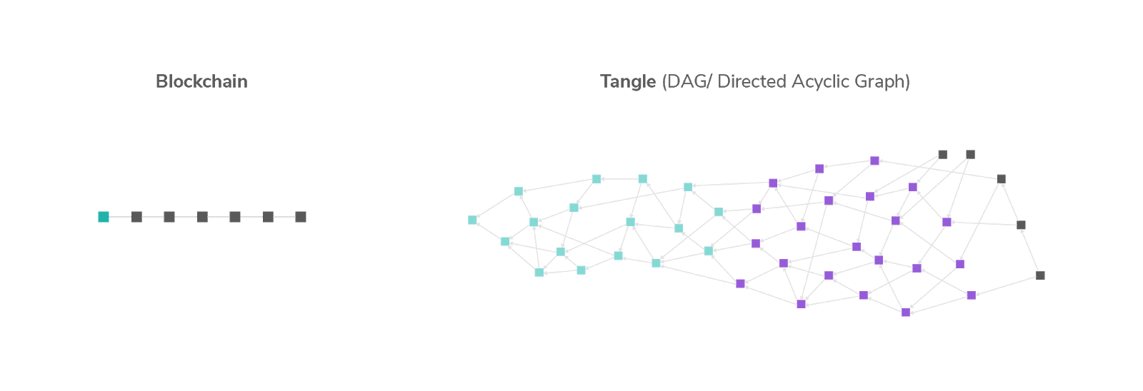
Distributed Ledger Technologies
Blockchain
Tangle
(DAG - Directed Acyclic Graph)

Slide 35
Tangle (DAG)
Each Vertex represents a transaction (squares)
Each Edge represents na approval (lines)

Slide 36
Zero Fee Transactions
-$0.01
+$0.01
​ No mining = No fees = Zero fee micro-transactions

Slide 37
IOTA Foundation
Non-Profit Foundation registered in Berlin
~100 employees in 17 countries
Funded through donations from IOTA Token holders, Research Grants and Project-based corporate financial support

Slide 38
IOTA Foundation

Slide 39
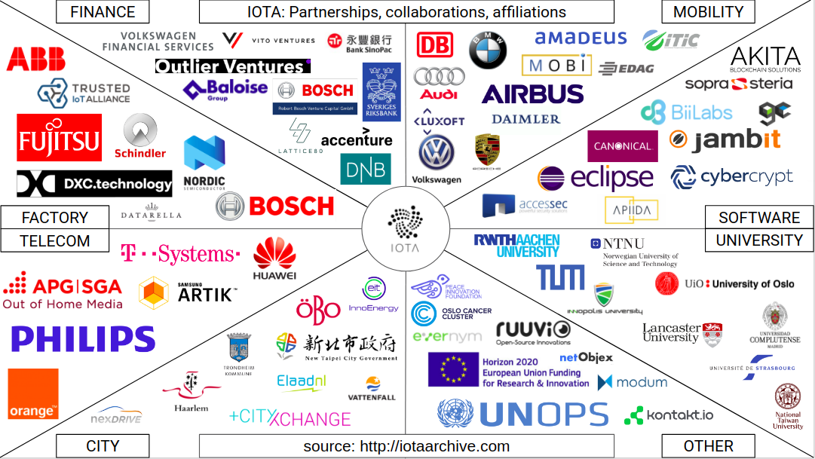
IOTA Foundation: Collaborations & Partnerships

Slide 40
IOTA Nodes
Pre Coordicide vs Post Coordicide

Slide 41
IOTA Nodes
DLT Node:
transaction relay
ledger copy

Slide 42
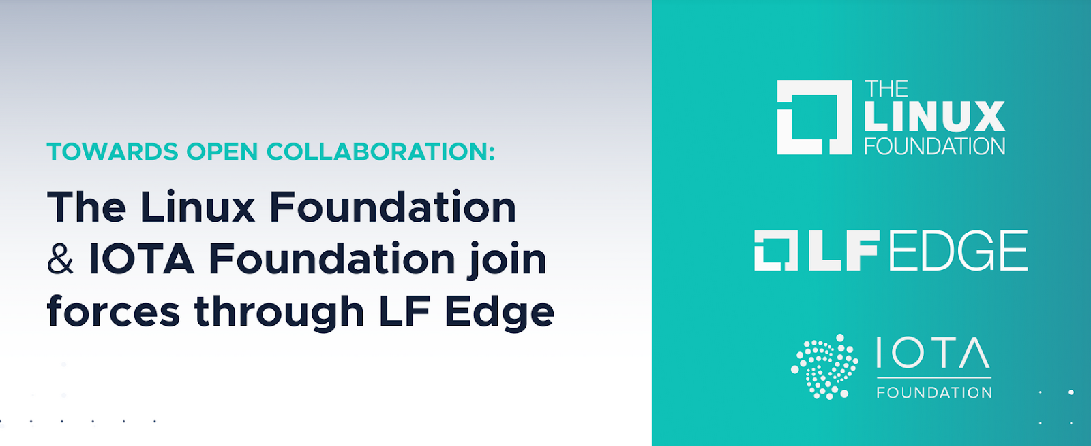
IOTA Nodes
Ethereum, Bitcoin, etc: Nodes on the Cloud (↑ hw resources)
IOTA: Nodes on the Edge (↓ hw resources)
https://blog.iota.org/towards-open-collaboration-1926e94514b8

Slide 43
Coordicide
To make it possible for the network to grow and protect it against certain attacks, IOTA currently relies on a coordinator.
The coordinator checkpoints valid transactions, which are then validated by the entire network.
The coordinator is being run by the IOTA Foundation.
Removing the Coordinator from the IOTA network will realize a long sought after goal in the field of DLT: scalability without centralization.
Coordicide: the death of the Coordinator.

Slide 44
Pre Coordicide vs Post Coordicide
Pre-Coordicide Node implementation:
IRI (Java)
cIRI (C)
Coordicide Proof of Concept Node implementation:
GoShimmer (Go)
Post-Coordicide Node implementation:
Bee (Rust)
Hornet (Go)
Since Coordicide is still a topic under R&D, meta-iota focuses on Pre Coordicide (for the moment).

Slide 45
meta-iota
Recipes

Slide 46
cIRI
low level implementation of an IOTA node in C
Users to become part of the IOTA network:
transaction relay
network information provider
JSON-REST HTTP interface
Suited for Embedded (SoC, SoM):
RAM: down to ~140MB RAM for solid node, ~500MB while syncing

Slide 47
cIRI: Bazel
IF development team chose Bazel as build system for cIRI
I borrowed the Bazel recipe and bbclass from meta-tensorflow
Plans to switch to CMake

Slide 48
ciri_0.1.0.bb
https://github.com/bernardoaraujor/meta-iota/blob/master/recipes-iota/ciri/ciri_0.1.0.bb

Slide 49
Let's ping the cIRI node on the BBB
$ curl http://104.155.135.221:14265/ \ -X POST \ -H 'Content-Type: application/json' \ -H 'X-IOTA-API-Version: 1' \ -d '{"command": "getNodeInfo"}'

Slide 50
CClient
IOTA client library implementation in C.
Recipe exports libcclient.a into the target rootfs/sysroot.
CMake support
Patch CMakeLists.txt to avoid the ExternalProject_add feature of CMake
Recipe for c-iota-workshop repository as an example of how to integrate with libcclient

Slide 51
libcclient_1.0.0.bb
https://github.com/bernardoaraujor/meta-iota/blob/master/recipes-iota/cclient/libcclient_1.0.0.bb
https://github.com/bernardoaraujor/meta-iota/blob/master/recipes-iota/cclient/c-iota-workshop_git.bb

Slide 52
Playing around with c-iota-workshop
Install Bazel: https://docs.bazel.build/versions/master/install.html
Clone repo: $ git clone https://github.com/iota-community/c-iota-workshop
Run an example: $ cd c-iota-workshop $ bazel run -c opt examples:[EXAMPLE_NAME]
Following examples are available:
hello_world send_hello receive_hello generate_address check_balances send_tokens

Slide 53
iota.go
IOTA Go API Library allows:
Create transactions
Sign transactions
Interact with an IRI node
Recipe written, although more testing is needed for validation.
Recipe lists all golang package dependencies explicitly.
Recipe for go-iota-workshop repository as an example of how to integrate with iota.go library

Slide 54
iota.go_1.0.0.bb
https://github.com/bernardoaraujor/meta-iota/blob/go-dev/recipes-iota/iota.go/iota.go_1.0.0.bb
https://github.com/bernardoaraujor/meta-iota/blob/go-dev/recipes-iota/iota.go/go-iota-workshop_git.bb

Slide 55
Playing around with go-iota-workshop
Install Golang (1.10+) https://golang.org/doc/install
Clone repo and download dependencies: $ git clone https://github.com/iota-community/go-iota-workshop $ cd go-iota-workshop; go mod download
Run an example: $ go run iota_go_[EXAMPLE_NAME]/main.go
Following examples are available:
helloworld send_data receive_data create_address check_balance
send_tx receive_tx zmq

Slide 56
iota.lib.py / PyOTA
Official Python library for the IOTA Core.
Implements both the official API, as well as signing, bundles, utilities and conversion.
Python 3.6, 3.5 and 2.7.
inherit setuptools
Integration is planned for the near future
https://github.com/iotaledger/iota.lib.py

Slide 57
Playing around with python-iota-workshop
Install Python 3 and PIP https://www.python.org/downloads/ https://pip.pypa.io/en/stable/installing/
Clone repo and donwload dependencies: $ git clone https://github.com/iota-community/python-iota-workshop $ cd python-iota-workshop; pip install -r requirements.txt
Run an example: $ python code/[EXAMPLE_NAME].py
Following examples are available: e01_hello_world.py e04_generate_address.py e07_send_data.py e02_send_hello.py e05_check_balance.py e08_receive_data.py e03_receive_hello.py e06_send_tokens.py e09_zmq_listen.py

Slide 58
IOTA CLI App
Command Line wallet and node management tool.
It is implemented in nodejs, and it’s available as a npm package.
To be integrated with the help of devtool npm functionality.
Integration planned for the near future.
https://github.com/iotaledger/cli-app
https://wiki.yoctoproject.org/wiki/TipsAndTricks/NPM

Slide 59
recipes-support
In order to fulfill dependencies, I had to write a few support recipes.
nanopb_0.3.9.3.bb: small code-size Protocol Buffers implementation in ansi C. Especially suitable for use in microcontrollers, but fits any memory restricted system
keccak_git.bb: keccak sponge function family including SHA3 implementation. Recipe needs improvement to support more architectures)
logger_4.0.0.bb: simple logging facility for the C language)
libzmq_4.3.2.bb: ZeroMQ core engine in C++
Extra contribution to the OE community.

Slide 60
Future of meta-iota (2020-21)
Bee
Post Coordicide Reference Implementation
Official IOTA Foundation
Rust (meta-rust and meta-rust-bin?)
Hornet
Post Coordicide Implementation
Community based (EDF)
Go

Slide 61
Ecosystem Development Fund
Boards for Proof-of-Concept

Slide 62
IOTA Ecosystem Development Fund
The IOTA EDF will allow me to validate Proof-of-Concepts on a few different boards with potential for IOTA Industrial applications.
There is a big interest for FPGA projects in the IOTA Community. This is due to the Quorum Based computations, as well as accelerated Proof-of-Work (PoW), Address Generation and Signing.
Board | Manufacturer | Comment | OpenEmbedded BSP Layer
STM32MP157C-DK2 | STMicroelectronics | The discovery SBC for STMicroelectronics STM32MP1 Series microprocessors | meta-st-stm32mp
Colibri iMX6 Solo SoM + Viola Carrier | Toradex | Toradex is a swiss manufacturer of Industrial-grade System on Modules. | meta-freescale-3rdparty
Zynq-7000 SoC ZC702 Evaluation Kit | Xilinx | The Zynq-7000 is a SoC+FPGA with great potential to accelerate PoW, Mini-PoW, Address Generation and Signing, as well as future Qubic implementations. | meta-xilinx

Slide 63
IOTA Ecosystem Development Fund
Board | Manufacturer | Comment | OpenEmbedded BSP Layer
DE10-Nano Development Kit | Terasic Technologies | The E10-Nano Development Kit is built around the Intel/Altera CycloneV SoC+FPGA. Also great potential to accelerate PoW, Mini-PoW, Address Generation and Signing, as well as future Qubic implementations. | meta-de10-nano meta-altera
BeagleBone Black | Texas Instruments | The most popular SBC in the Yocto Community. | meta-yocto-bsp meta-ti meta-beagleboard meta-bbb
DragonBoard 410c | 96Boards | SBC with a Qualcomm Snapdragon 400 | meta-qcom
Orange Pi Zero | Orange Pi | Popular small SBC with an AllWinner H2 chip. | meta-sunxi meta-allwinner-hx
Raspberry Pi Zero W | Raspberry Pi Foundation | Miniature version of the RPi, with Wireless support. | meta-raspberrypi

Slide 64
Class Account Setup

Slide 65
Yocto Project Dev Day Lab Setup
The virtual host’s resources can be found here:
Your Project: "/scratch/poky/build-qemuarm“
Extensible-SDK Install: "/scratch/sdk/qemuarm“
Sources: "/scratch/src“
Poky: "/scratch/poky"
Downloads: "/scratch/downloads"
Sstate-cache: "/scratch/sstate-cache“
You will be using SSH to communicate with your virtual server.

Slide 66
FYI: How class project was prepared (1/2)
$
$ cd /scratch
$ git clone -b zeus git://git.yoctoproject.org/poky.git
$ cd poky
$
$ bash # set up local shell
$ # Prepare the project
$ ./scratch/poky/oe-init-build-env build
$ echo "MACHINE = \"qemuarm\"" >> conf/local.conf
$ echo "SSTATE_DIR = \"/scratch/sstate-cache\"" >> conf/local.conf
$ echo "DL_DIR = \"/scratch/downloads\"" >> conf/local.conf
$ echo "IMAGE_INSTALL_append = \" gdbserver openssh libstdc++ \
curl \"" >> conf/local.conf
$ $ # Build the project
$ bitbake core-image-base
$
Notes:
ilab01@devday010:/scratch/poky/build-qemuarm$ du -sh tmp/
34G tmp/
ilab01@devday010:/scratch/poky/build-qemuarm$
$ time bitbake core-image-base
real 1m3.721s
user 0m1.805s
sys 0m0.227s
ilab01@devday010:/scratch/poky/build-qemuarm$ du -sh tmp/
2.0G tmp/

Slide 67
FYI: How class project was prepared (2/2)
$ # Build the eSDK
$
$ bitbake core-image-base -c populate_sdk_ext
$ cd /scratch/poky/build/tmp/deploy/sdk/
$ ./poky-glibc-x86_64-core-image-base-armv5e-toolchain-ext-*.sh \
-y -d /scratch/sdk/qemuarm
$ exit # return to clean shell
$
$
$ bash # set up local shell
$ cd /scratch/sdk/qemuarm
$ . /scratch/sdk/qemuarm/environment-setup-armv5e-poky-linux-gnueabi
$ devtool modify virtual/kernel
$ exit # return to clean shell
$
Notes:
ilab01@devday010:/scratch/poky/build-qemuarm$ du -sh tmp/
34G tmp/
ilab01@devday010:/scratch/poky/build-qemuarm$
$ time bitbake core-image-base
real 1m3.721s
user 0m1.805s
sys 0m0.227s
ilab01@devday010:/scratch/poky/build-qemuarm$ du -sh tmp/
2.0G tmp/

Slide 68
NOTE: Clean Shells!
We are going to do a lot of different exercises in different build projects, each with their own environments.
To keep things sane, you should have a new clean shell for each exercise.
There are two simple ways to do it:
Close your existing SSH connection and open a new one -- or –
Do a “bash” before each exercise to get a new sub-shell, and “exit” at the end to remove it, in order to return to a pristine state.

Slide 69
5. Devtool hands-on Seminar Part 1
Manjukumar Harthikote Matha, Chandana Kalluri
Presented by Mark Hatle

Slide 70
Summary
Current devtool flow
Devtool flow for kernel
Devtool menuconfig

Slide 71
Initial Devtool flow for kernel
Fetch fresh copy of source from “SRC_URI”
(Takes about 5 mins to complete the command)
Devtool Modify
Make manual changes to .config file and save it
Devtool build
Compile and check for breakages
Devtool finish
Save changes to the recipe
The kernel source is fetched and copied to work-shared during the normal workflow either by running bitbake linux-yocto or bitbake <image-name>
User runs devtool modify linux-yocto
The command will take about 5 mins because it will extract a new copy of source into workspace even though a copy of kernel source is present in a shared location from normal flow. Next it will configure the kernel.

Slide 72
New Devtool flow for kernel – case 1
Devtool Modify
Fetch fresh copy of source from “SRC_URI”
(Takes about 15 seconds )
Devtool menuconfig
Use menuconfig GUI to make
modifications to kernel configs
Devtool build
Compile and check for breakages
Devtool finish
Save changes to the recipe
The kernel source is fetched and copied to work-shared during the normal workflow either by running bitbake linux-yocto or bitbake <image-name>
User runs devtool modify linux-yocto
The devtool modify command will take about 15 seconds because it will copy source from work-shared and configure the kernel.

Slide 73
New Devtool flow for kernel – case 2
Devtool Modify
Fetch fresh copy of source from “SRC_URI”
(Takes about 5 mins )
Devtool menuconfig
Use menuconfig GUI to make
modifications to kernel configs
Devtool build
Compile and check for breakages
Devtool finish
Save changes to the recipe
The kernel source is not fetched and copied to work-shared during the normal workflow either by not running bitbake linux-yocto or bitbake <image-name>
User runs devtool modify linux-yocto
The devtool modify command will take about 5 mins because it will fetch new copy of source into workspace and place a copy in work-shared. Any dependent packages that need kernel-source will now find a copy in work-shared instead of fetching the source again.

Slide 74
Commands

Slide 75
Original Devtool modify flow commands
$ source oe-init-build-env
$ bitbake linux-yocto <this takes about 5 mins>
$ devtool modify linux-yocto <this takes about 5 mins>
New Devtool modify flow commands – Case 1
$ source oe-init-build-env
$ bitbake linux-yocto <this takes about 5 mins>
$ # Observe that the kernel souce was fetched:
$ ls tmp/work-shared/qemuarm64/kernel-source
$ devtool modify linux-yocto <this takes about 15 seconds>

Slide 76
New Devtool modify flow commands – Case 2
$ source oe-init-build-env
$ ls tmp/work-shared/qemuarm64/kernel-source <kernel source not present>
$ devtool modify linux-yocto <this takes about 5 mins>
$ ls tmp/work-shared/qemuarm64/kernel-source <kernel source copied >

Slide 77
Devtool menuconfig:
$ source oe-init-build-env
$ devtool modify linux-yocto
$ devtool menuconfig linux-yocto
1. Enable this kernel option
2. Save this change

Slide 78
Devtool menuconfig summary:
$ devtool menuconfig linux-yocto
…
Sstate summary: Wanted 0 Found 0 Missed 0 Current 48 (0% match, 100% complete)
NOTE: Executing Tasks
NOTE: Setscene tasks completed
NOTE: Tasks Summary: Attempted 380 tasks of which 372 didn't need to be rerun and all
succeeded.
INFO: Updating config fragment /workspaces/ckalluri/poky/builds/menuconfig/
workspace/sources/linux-yocto/oe-local-files/devtool-fragment.cfg

Slide 79
Devtool finish
$ devtool finish linux-yocto meta-yocto-bsp
$cat ../../meta-yocto-bsp/recipes-kernel/linux/linux-yocto_%.bbappend
FILESEXTRAPATHS_prepend := "${THISDIR}/${PN}:"
SRC_URI += "file://devtool-fragment.cfg"
$cat ../../meta-yocto-bsp/recipes-kernel/linux/linux-yocto/devtool-fragment.cfg
# CONFIG_INITRAMFS_FORCE is not set
CONFIG_CMDLINE_FORCE=y

Slide 80
6. User Space Topics
Rudi Streif
Presented by David Reyna

Slide 81
Overview
Activity Setup
Users, Groups and Passwords
Login Shells
Sudo Configuration
SSH Server Configuration
Please ask questions.
Your questions might help others too.

Slide 82
Activity Setup
Create an activity layer and add it to the build environment
$ cd /scratch/poky
$ source oe-init-build-env build
$ bitbake-layers create-layer meta-activity3
NOTE: Starting bitbake server…
Add your new layer with ‘bitbake-layers add-layer meta-activity3’
$ bitbake-layers add-layer meta-activity3
NOTE: Starting bitbake server…
$ cat conf/bblayers.conf
…
BBLAYERS ?= “ \
/scratch/poky/meta \
/scratch/poky/meta-poky \
/scratch/poky/meta-yocto-bsp \
/scratch/poky/build/meta-activity3 \
“

Slide 83
Activity Setup
Create an image recipe
$ mkdir -p meta-activity3/recipes-core/images
$ pushd meta-activity3/recipes-core/images
$ vi core-image-activity3.bb
SUMMARY = "Activity 3 Test Image"
DESCRIPTION = "Activity 3 Test Image for Yocto Project DevDay"
LICENSE = "MIT"
IMAGE_INSTALL = "packagegroup-core-boot \
packagegroup-base-extended \
${CORE_IMAGE_EXTRA_INSTALL} \
"
inherit core-image
$ bitbake core-image-activity3
$ runqemu qemuarm nographic

Slide 84
Users, Groups and Passwords
The extrausers class provides a mechanism for managing users, groups and passwords.
Available commands:
useradd
usermod
userdel
groupadd
groupmod
groupdel
Commands are added to the EXTRA_USERS_PARAMS variable.
Passwords must be provided in encrypted form.

Slide 85
Setting root user password and creating a user
$ vi core-image-activity3.bb
SUMMARY = "Activity 3 Test Image"
DESCRIPTION = "Activity 3 Test Image for Yocto Project DevDay"
LICENSE = "MIT"
IMAGE_INSTALL = "packagegroup-core-boot \
packagegroup-base-extended \
${CORE_IMAGE_EXTRA_INSTALL} \
"
inherit core-image
inherit extrausers
ROOT_PASSWORD = "secret"
DEV_PASSWORD = "hackme"
EXTRA_USERS_PARAMS = " \
groupadd developers; \
useradd -p `openssl passwd ${DEV_PASSWORD}` developer; \
useradd -g developers developer; \
usermod -p `openssl passwd ${ROOT_PASSWORD}` root; \
"
$ bitbake core-image-activity3
$ runqemu qemuarm nographic

Slide 86
Works, but...
Changing the image recipe for new users is not really elegant.
It would be better if we could set the users we want to add and their passwords in a configuration file such as local.conf or a distro configuration.

Slide 87
A little script goes a long way...
$ vi user-setup.inc
# Image post-processing to setup user accounts
inherit extrausers
# Space-delimited list of user:password:<group,group,...> tuples
NEWUSERS ??= ""
# root password
ROOT_PASSWORD ??= ""
python () {
params = ""
# add new users
newusers = (d.getVar("NEWUSERS", True) or "").split()
if newusers:
for user in newusers:
name,password,groups = user.split(":")
for group in groups.split(","):
params += "groupadd -f " + group + "; "
params += "useradd -p `openssl passwd " + password + "` "
if groups:
params += "-G " + groups + " "
params += name + "; "
# modify root password
rootpw = d.getVar("ROOT_PASSWORD", True) or ""
if rootpw:
params += "usermod -p `openssl passwd " + rootpw + "` root; "
d.setVar("EXTRA_USERS_PARAMS", params)
}

Slide 88
Using the script
$ vi core-image-activity3.bb
SUMMARY = "Activity 3 Test Image"
DESCRIPTION = "Activity 3 Test Image for Yocto Project DevDay"
LICENSE = "MIT"
IMAGE_INSTALL = "packagegroup-core-boot \
packagegroup-base-extended \
${CORE_IMAGE_EXTRA_INSTALL} \
"
inherit core-image
require user-setup.inc
$ vi /scratch/poky/build/conf/local.conf
# Users to be added: space-delimited list of name:password:groups tuples.
# groups is comma-delimited list of additional group names
NEWUSERS = "developer:hackme:developers"
# Root User Password
ROOT_PASSWORD = "secret"
$ bitbake core-image-activity3
$ runqemu qemuarm nographic

Slide 89
5. Devtool hands-on Seminar Part 2
TBD

Slide 90
Image Post Processing
Sometimes it is necessary to processing such as adding, modifying files and more after the root file system has been created but before it is packaged into the different formats.
Through the variable ROOTFS_POSTPROCESS_COMMAND you can specify a list of shell functions to be executed.
Commonly the variable and the functions are added to the image recipe.
The functions are executed in the order they appear in the variable.
The search path for shell commands includes the native system root of the build environment and build host PATH from the user environment.
The variable IMAGE_ROOTFS points to the directory where the build system assembles the root file system.

Slide 91
Setting Login Shells
$ vi core-image-activity3.bb
SUMMARY = "Activity 3 Test Image"
DESCRIPTION = "Activity 3 Test Image for Yocto Project DevDay"
LICENSE = "MIT"
IMAGE_INSTALL = "packagegroup-core-boot \
packagegroup-base-extended \
${CORE_IMAGE_EXTRA_INSTALL} \
"
inherit core-image
modify_shells() {
printf "# /etc/shells: valid login shells\n/bin/sh\n/bin/bash\n" \
> ${IMAGE_ROOTFS}/etc/shells
}
ROOTFS_POSTPROCESS_COMMAND += "modify_shells;"
$ bitbake core-image-activity3
$ runqemu qemuarm nographic

Slide 92
Sudo Configuration
$ vi core-image-activity3.bb
SUMMARY = "Activity 3 Test Image"
DESCRIPTION = "Activity 3 Test Image for Yocto Project DevDay"
LICENSE = "MIT"
IMAGE_INSTALL = "packagegroup-core-boot \
packagegroup-base-extended \
${CORE_IMAGE_EXTRA_INSTALL} \
sudo \
"
inherit core-image
modify_sudoers() {
sed 's/# %sudo/%sudo/' < ${IMAGE_ROOTFS}/etc/sudoers > \
${IMAGE_ROOTFS}/etc/sudoers.tmp
mv ${IMAGE_ROOTFS}/etc/sudoers.tmp ${IMAGE_ROOTFS}/etc/sudoers
}
ROOTFS_POSTPROCESS_COMMAND += "modify_sudoers;"
$ bitbake core-image-activity3
$ runqemu qemuarm nographic
Note: You have to add a regular user to the sudo group for this to work.

Slide 93
SSH Server Configuration
$ vi core-image-activity3.bb
configure_sshd() {
# disallow password authentication
echo “PasswordAuthentication no” >> ${IMAGE_ROOTFS}/etc/ssh/sshd_config
# create keys in tmp/deploy/keys
mkdir -p ${DEPLOY_DIR}/keys
if [ ! -f ${DEPLOY_DIR}/keys/root-sshkey ]; then
/usr/bin/ssh-keygen -t rsa -N '' \
-f ${DEPLOY_DIR}/keys/root-sshkey
fi
# add public key to authorized_keys for root
mkdir -p ${IMAGE_ROOTFS}/home/root/.ssh
cat ${DEPLOY_DIR}/keys/root-sshkey.pub \
>> ${IMAGE_ROOTFS}/home/root/.ssh/authorized_keys
}
ROOTFS_POSTPROCESS_COMMAND += "configure_sshd;"
$ bitbake core-image-activity3
$ runqemu qemuarm nographic
[in a new ssh shell to your build system]
$ ssh -i \
/scratch/poky/build/tmp/deploy/keys/root-sshkey root@192.168.7.2

Slide 94
Nice, but once again not very flexible...
$ vi sshd-setup.inc
# Image post-processing to configure sshd
# Setup ssh key login for these users
SSH_USERS ??= ""
configure_sshd() {
# disallow password authentication
echo "PasswordAuthentication no" >> ${IMAGE_ROOTFS}/etc/ssh/sshd_config
# keys will be stored tmp/deploy/keys
mkdir -p ${DEPLOY_DIR}/keys
# create the keys for the users
for user in ${SSH_USERS}; do
if [ ! -f ${DEPLOY_DIR}/keys/${user}-sshkey ]; then
/usr/bin/ssh-keygen -t rsa -N '' \
-f ${DEPLOY_DIR}/keys/${user}-sshkey
fi
# add public key to authorized_keys for the user
mkdir -p ${IMAGE_ROOTFS}/home/${user}/.ssh
cat ${DEPLOY_DIR}/keys/${user}-sshkey.pub \
>> ${IMAGE_ROOTFS}/home/${user}/.ssh/authorized_keys
done
}
ROOTFS_POSTPROCESS_COMMAND += "configure_sshd;"

Slide 95
Using the script
$ vi core-image-activity3.bb
SUMMARY = "Activity 3 Test Image"
DESCRIPTION = "Activity 3 Test Image for Yocto Project DevDay"
LICENSE = "MIT"
IMAGE_INSTALL = "packagegroup-core-boot \
packagegroup-base-extended \
${CORE_IMAGE_EXTRA_INSTALL} \
"
inherit core-image
require sshd-setup.inc
$ vi /scratch/poky/build/conf/local.conf
# Users for whom to create ssh login with key
SSH_USERS = "root developer"
$ bitbake core-image-activity3
$ runqemu qemuarm nographic
[in a new ssh shell to your build system]
$ ssh -i \
/scratch/poky/build/tmp/deploy/keys/developer-sshkey \
developer@192.168.7.2

Slide 96
EoA (End of Activity)
Cleanup
Thank You!
$ cd /scratch/poky/build
$ bitbake-layers remove-layer meta-activity3

Slide 97
Questions and Answers

Slide 98
Thank you for your participation!

Slide 99
Activity Eight
Tools, Toaster, User Experience
David Reyna

Slide 100
Toaster: Latest Features (1/2)
Toaster Documentation
https://www.yoctoproject.org/docs/latest/toaster-manual/toaster-manual.html
Toaster Service Without a Web Server (“noweb”)
Good for capturing command line build(s) directly into the db
Toaster Service Without Remote Builds (“nobuild”)
Good for sharing build local status, without enabling external people creating projects and starting builds on your host
Toaster Service – Build Status within Containers
New REST/JSON API to access the progress and health of bitbake builds via HTTP; very handy for containers
Build Status options: “Completed”, “In Progress”, “Specific Status”

Slide 101
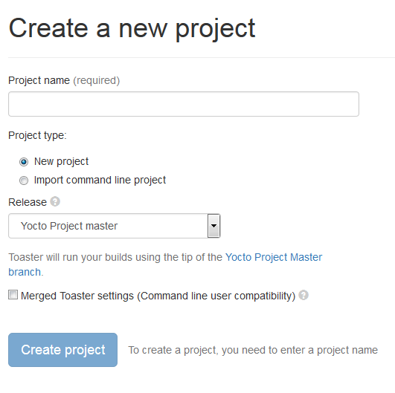
Toaster: Latest Features (2/2)
Compatibility between Command Line and Toaster builds
New “Import command line build” option
New “Merge Toaster Settings” into standard conf files”

Slide 102
Intel System Studio 2019: Yocto Project Compatible
The Wind River Application and Project plug-ins have been shared with Intel System Studio, with the idea of open sourcing them to Eclipse.org
Implementation is architecture agnostic
Application Project Features:
Awareness of YP compatible SDKs/eSDKs
Ability to register multiple SDKs
Automatic generation of “Build Specs” for each machine variant in each SDK
Ability to enable/disable debug flags
Debugger deploy and access over GDB/TCF
Set of sample applications

Slide 103
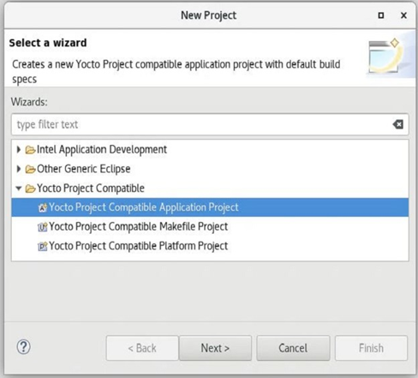
Intel System Studio 2019: Yocto Project Compatible
Platform Project Features:
Configuration/Updates via Toaster
Basic build targets directly from ISS
Eclipse-based Kernel Configuration Tool
Tree view to browse deploy artifacts

Slide 104
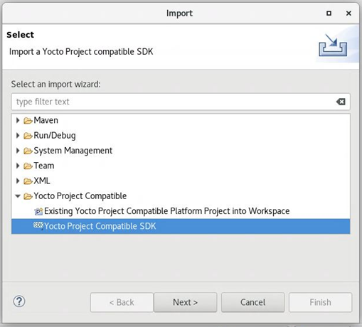
Intel System Studio 2019: Yocto Project Compatible
Import:
Existing command line project
Existing SDK/eSDK

Slide 105
New Security Response Tool (SRTool)
While there is heighten awareness about device vulnerabilities, what is often missing is awareness about the process of managing the security response process itself
Wind River is sharing to open source a tool to help manager the organization’s security response management:
Better ways to handle 1000+ CVEs per month
Better ways to connect CVE’s to defects to product
Better ways to allow easy access to the full vulnerability status, generate reports, clean exports to public CVE DB
Better ways to use automation to keep all the data sources automatically up to date
Community Page:
https://wiki.yoctoproject.org/wiki/Contribute_to_SRTool
ELCE Presentation:
https://sched.co/HOLr

