Slide 1
Yocto Project Summit – Lyon Day 2 : Friday 1 November 2019
Marco Cavallini, Leon Anavi, Jaewon Lee, Bernardo A. Rodrigues,
Manjukumar Harthikote Matha, Chandana Kalluri, Tim Orling, David Reyna
Presenter Slides: https://wiki.yoctoproject.org/wiki/YP_Summit_Lyon_2019

Slide 2
Agenda – Yocto Project Summit - Day 2
9:00- 9:45 Strenghten your Yocto deployments with Autobuilder2 CI tool
9:50- 10:35 Working with NVIDIA Tegra BSP and Supporting Latest CUDA Versions
10:40-10:50 Morning Break
10:55-11:40 Sstate-cache Magic!
11:45-12:30 Bringing IOTA Distributed Ledger Technology (DLT) into Yocto/OpenEmbedded
12:35-1:20 Lunch
1:25- 2:55 Class: Devtool hands-on Seminar
3:00- 3:10 Afternoon Break
3:15- 4:45 Class: User Space 2.0 Seminar

Slide 3
1. Strenghten your Yocto deployments with Autobuilder2 CI tool
Marco Cavallini

Slide 4
2. Working with NVIDIA Tegra BSP and Supporting Latest CUDA Versions
Leon Anavi

Slide 5
3. Sstate-cache Magic!
Jaewon Lee

Slide 6
4. Bringing IOTA Distributed Ledger Technology (DLT) into Yocto/OpenEmbedded
Bernardo A. Rodrigues

Slide 7
Class Account Setup

Slide 8
Yocto Project Dev Day Lab Setup
The virtual host’s resources can be found here:
Your Project: "/scratch/poky/build-qemuarm“
Extensible-SDK Install: "/scratch/sdk/qemuarm“
Sources: "/scratch/src“
Poky: "/scratch/poky"
Downloads: "/scratch/downloads"
Sstate-cache: "/scratch/sstate-cache“
You will be using SSH to communicate with your virtual server.

Slide 9
FYI: How class project was prepared (1/2)
$
$ cd /scratch
$ git clone -b zeus git://git.yoctoproject.org/poky.git
$ cd poky
$
$ bash # set up local shell
$ # Prepare the project
$ ./scratch/poky/oe-init-build-env build
$ echo "MACHINE = \"qemuarm\"" >> conf/local.conf
$ echo "SSTATE_DIR = \"/scratch/sstate-cache\"" >> conf/local.conf
$ echo "DL_DIR = \"/scratch/downloads\"" >> conf/local.conf
$ echo "IMAGE_INSTALL_append = \" gdbserver openssh libstdc++ \
curl \"" >> conf/local.conf
$ $ # Build the project
$ bitbake core-image-base
$
Notes:
ilab01@devday010:/scratch/poky/build-qemuarm$ du -sh tmp/
34G tmp/
ilab01@devday010:/scratch/poky/build-qemuarm$
$ time bitbake core-image-base
real 1m3.721s
user 0m1.805s
sys 0m0.227s
ilab01@devday010:/scratch/poky/build-qemuarm$ du -sh tmp/
2.0G tmp/

Slide 10
FYI: How class project was prepared (2/2)
$ # Build the eSDK
$
$ bitbake core-image-base -c populate_sdk_ext
$ cd /scratch/poky/build/tmp/deploy/sdk/
$ ./poky-glibc-x86_64-core-image-base-armv5e-toolchain-ext-*.sh \
-y -d /scratch/sdk/qemuarm
$ exit # return to clean shell
$
$
$ bash # set up local shell
$ cd /scratch/sdk/qemuarm
$ . /scratch/sdk/qemuarm/environment-setup-armv5e-poky-linux-gnueabi
$ devtool modify virtual/kernel
$ exit # return to clean shell
$
Notes:
ilab01@devday010:/scratch/poky/build-qemuarm$ du -sh tmp/
34G tmp/
ilab01@devday010:/scratch/poky/build-qemuarm$
$ time bitbake core-image-base
real 1m3.721s
user 0m1.805s
sys 0m0.227s
ilab01@devday010:/scratch/poky/build-qemuarm$ du -sh tmp/
2.0G tmp/

Slide 11
NOTE: Clean Shells!
We are going to do a lot of different exercises in different build projects, each with their own environments.
To keep things sane, you should have a new clean shell for each exercise.
There are two simple ways to do it:
Close your existing SSH connection and open a new one -- or –
Do a “bash” before each exercise to get a new sub-shell, and “exit” at the end to remove it, in order to return to a pristine state.

Slide 12
5. Devtool hands-on Seminar
Manjukumar Harthikote Matha, Chandana Kalluri, Tim Orling

Slide 13
6. User Space Topics
Rudi Streif
Presented by David Reyna

Slide 14
Overview
Activity Setup
Users, Groups and Passwords
Login Shells
Sudo Configuration
SSH Server Configuration
Please ask questions.
Your questions might help others too.

Slide 15
Activity Setup
Create an activity layer and add it to the build environment
$ cd /scratch/poky
$ source oe-init-build-env build
$ bitbake-layers create-layer meta-activity3
NOTE: Starting bitbake server…
Add your new layer with ‘bitbake-layers add-layer meta-activity3’
$ bitbake-layers add-layer meta-activity3
NOTE: Starting bitbake server…
$ cat conf/bblayers.conf
…
BBLAYERS ?= “ \
/scratch/poky/meta \
/scratch/poky/meta-poky \
/scratch/poky/meta-yocto-bsp \
/scratch/poky/build/meta-activity3 \
“

Slide 16
Activity Setup
Create an image recipe
$ mkdir -p meta-activity3/recipes-core/images
$ pushd meta-activity3/recipes-core/images
$ vi core-image-activity3.bb
SUMMARY = "Activity 3 Test Image"
DESCRIPTION = "Activity 3 Test Image for Yocto Project DevDay"
LICENSE = "MIT"
IMAGE_INSTALL = "packagegroup-core-boot \
packagegroup-base-extended \
${CORE_IMAGE_EXTRA_INSTALL} \
"
inherit core-image
$ bitbake core-image-activity3
$ runqemu qemuarm nographic

Slide 17
Users, Groups and Passwords
The extrausers class provides a mechanism for managing users, groups and passwords.
Available commands:
useradd
usermod
userdel
groupadd
groupmod
groupdel
Commands are added to the EXTRA_USERS_PARAMS variable.
Passwords must be provided in encrypted form.

Slide 18
Setting root user password and creating a user
$ vi core-image-activity3.bb
SUMMARY = "Activity 3 Test Image"
DESCRIPTION = "Activity 3 Test Image for Yocto Project DevDay"
LICENSE = "MIT"
IMAGE_INSTALL = "packagegroup-core-boot \
packagegroup-base-extended \
${CORE_IMAGE_EXTRA_INSTALL} \
"
inherit core-image
inherit extrausers
ROOT_PASSWORD = "secret"
DEV_PASSWORD = "hackme"
EXTRA_USERS_PARAMS = " \
groupadd developers; \
useradd -p `openssl passwd ${DEV_PASSWORD}` developer; \
useradd -g developers developer; \
usermod -p `openssl passwd ${ROOT_PASSWORD}` root; \
"
$ bitbake core-image-activity3
$ runqemu qemuarm nographic

Slide 19
Works, but...
Changing the image recipe for new users is not really elegant.
It would be better if we could set the users we want to add and their passwords in a configuration file such as local.conf or a distro configuration.

Slide 20
A little script goes a long way...
$ vi user-setup.inc
# Image post-processing to setup user accounts
inherit extrausers
# Space-delimited list of user:password:<group,group,...> tuples
NEWUSERS ??= ""
# root password
ROOT_PASSWORD ??= ""
python () {
params = ""
# add new users
newusers = (d.getVar("NEWUSERS", True) or "").split()
if newusers:
for user in newusers:
name,password,groups = user.split(":")
for group in groups.split(","):
params += "groupadd -f " + group + "; "
params += "useradd -p `openssl passwd " + password + "` "
if groups:
params += "-G " + groups + " "
params += name + "; "
# modify root password
rootpw = d.getVar("ROOT_PASSWORD", True) or ""
if rootpw:
params += "usermod -p `openssl passwd " + rootpw + "` root; "
d.setVar("EXTRA_USERS_PARAMS", params)
}

Slide 21
Using the script
$ vi core-image-activity3.bb
SUMMARY = "Activity 3 Test Image"
DESCRIPTION = "Activity 3 Test Image for Yocto Project DevDay"
LICENSE = "MIT"
IMAGE_INSTALL = "packagegroup-core-boot \
packagegroup-base-extended \
${CORE_IMAGE_EXTRA_INSTALL} \
"
inherit core-image
require user-setup.inc
$ vi /scratch/poky/build/conf/local.conf
# Users to be added: space-delimited list of name:password:groups tuples.
# groups is comma-delimited list of additional group names
NEWUSERS = "developer:hackme:developers"
# Root User Password
ROOT_PASSWORD = "secret"
$ bitbake core-image-activity3
$ runqemu qemuarm nographic

Slide 22
Image Post Processing
Sometimes it is necessary to processing such as adding, modifying files and more after the root file system has been created but before it is packaged into the different formats.
Through the variable ROOTFS_POSTPROCESS_COMMAND you can specify a list of shell functions to be executed.
Commonly the variable and the functions are added to the image recipe.
The functions are executed in the order they appear in the variable.
The search path for shell commands includes the native system root of the build environment and build host PATH from the user environment.
The variable IMAGE_ROOTFS points to the directory where the build system assembles the root file system.

Slide 23
Setting Login Shells
$ vi core-image-activity3.bb
SUMMARY = "Activity 3 Test Image"
DESCRIPTION = "Activity 3 Test Image for Yocto Project DevDay"
LICENSE = "MIT"
IMAGE_INSTALL = "packagegroup-core-boot \
packagegroup-base-extended \
${CORE_IMAGE_EXTRA_INSTALL} \
"
inherit core-image
modify_shells() {
printf "# /etc/shells: valid login shells\n/bin/sh\n/bin/bash\n" \
> ${IMAGE_ROOTFS}/etc/shells
}
ROOTFS_POSTPROCESS_COMMAND += "modify_shells;"
$ bitbake core-image-activity3
$ runqemu qemuarm nographic

Slide 24
Sudo Configuration
$ vi core-image-activity3.bb
SUMMARY = "Activity 3 Test Image"
DESCRIPTION = "Activity 3 Test Image for Yocto Project DevDay"
LICENSE = "MIT"
IMAGE_INSTALL = "packagegroup-core-boot \
packagegroup-base-extended \
${CORE_IMAGE_EXTRA_INSTALL} \
sudo \
"
inherit core-image
modify_sudoers() {
sed 's/# %sudo/%sudo/' < ${IMAGE_ROOTFS}/etc/sudoers > \
${IMAGE_ROOTFS}/etc/sudoers.tmp
mv ${IMAGE_ROOTFS}/etc/sudoers.tmp ${IMAGE_ROOTFS}/etc/sudoers
}
ROOTFS_POSTPROCESS_COMMAND += "modify_sudoers;"
$ bitbake core-image-activity3
$ runqemu qemuarm nographic
Note: You have to add a regular user to the sudo group for this to work.

Slide 25
SSH Server Configuration
$ vi core-image-activity3.bb
configure_sshd() {
# disallow password authentication
echo “PasswordAuthentication no” >> ${IMAGE_ROOTFS}/etc/ssh/sshd_config
# create keys in tmp/deploy/keys
mkdir -p ${DEPLOY_DIR}/keys
if [ ! -f ${DEPLOY_DIR}/keys/root-sshkey ]; then
/usr/bin/ssh-keygen -t rsa -N '' \
-f ${DEPLOY_DIR}/keys/root-sshkey
fi
# add public key to authorized_keys for root
mkdir -p ${IMAGE_ROOTFS}/home/root/.ssh
cat ${DEPLOY_DIR}/keys/root-sshkey.pub \
>> ${IMAGE_ROOTFS}/home/root/.ssh/authorized_keys
}
ROOTFS_POSTPROCESS_COMMAND += "configure_sshd;"
$ bitbake core-image-activity3
$ runqemu qemuarm nographic
[in a new ssh shell to your build system]
$ ssh -i \
/scratch/poky/build/tmp/deploy/keys/root-sshkey root@192.168.7.2

Slide 26
Nice, but once again not very flexible...
$ vi sshd-setup.inc
# Image post-processing to configure sshd
# Setup ssh key login for these users
SSH_USERS ??= ""
configure_sshd() {
# disallow password authentication
echo "PasswordAuthentication no" >> ${IMAGE_ROOTFS}/etc/ssh/sshd_config
# keys will be stored tmp/deploy/keys
mkdir -p ${DEPLOY_DIR}/keys
# create the keys for the users
for user in ${SSH_USERS}; do
if [ ! -f ${DEPLOY_DIR}/keys/${user}-sshkey ]; then
/usr/bin/ssh-keygen -t rsa -N '' \
-f ${DEPLOY_DIR}/keys/${user}-sshkey
fi
# add public key to authorized_keys for the user
mkdir -p ${IMAGE_ROOTFS}/home/${user}/.ssh
cat ${DEPLOY_DIR}/keys/${user}-sshkey.pub \
>> ${IMAGE_ROOTFS}/home/${user}/.ssh/authorized_keys
done
}
ROOTFS_POSTPROCESS_COMMAND += "configure_sshd;"

Slide 27
Using the script
$ vi core-image-activity3.bb
SUMMARY = "Activity 3 Test Image"
DESCRIPTION = "Activity 3 Test Image for Yocto Project DevDay"
LICENSE = "MIT"
IMAGE_INSTALL = "packagegroup-core-boot \
packagegroup-base-extended \
${CORE_IMAGE_EXTRA_INSTALL} \
"
inherit core-image
require sshd-setup.inc
$ vi /scratch/poky/build/conf/local.conf
# Users for whom to create ssh login with key
SSH_USERS = "root developer"
$ bitbake core-image-activity3
$ runqemu qemuarm nographic
[in a new ssh shell to your build system]
$ ssh -i \
/scratch/poky/build/tmp/deploy/keys/developer-sshkey \
developer@192.168.7.2

Slide 28
EoA (End of Activity)
Cleanup
Thank You!
$ cd /scratch/poky/build
$ bitbake-layers remove-layer meta-activity3

Slide 29
Questions and Answers

Slide 30
Thank you for your participation!

Slide 31
Activity Eight
Tools, Toaster, User Experience
David Reyna

Slide 32
Toaster: Latest Features (1/2)
Toaster Documentation
https://www.yoctoproject.org/docs/latest/toaster-manual/toaster-manual.html
Toaster Service Without a Web Server (“noweb”)
Good for capturing command line build(s) directly into the db
Toaster Service Without Remote Builds (“nobuild”)
Good for sharing build local status, without enabling external people creating projects and starting builds on your host
Toaster Service – Build Status within Containers
New REST/JSON API to access the progress and health of bitbake builds via HTTP; very handy for containers
Build Status options: “Completed”, “In Progress”, “Specific Status”

Slide 33
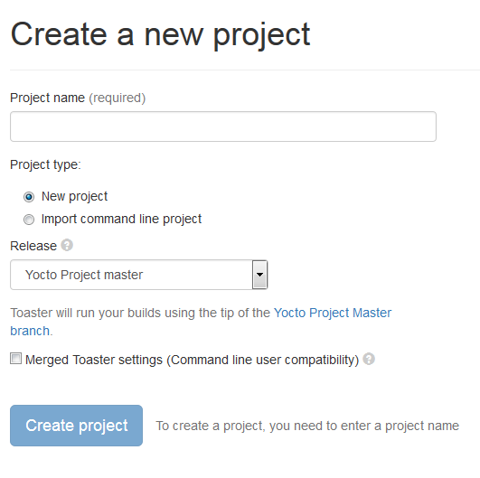
Toaster: Latest Features (2/2)
Compatibility between Command Line and Toaster builds
New “Import command line build” option
New “Merge Toaster Settings” into standard conf files”

Slide 34
Intel System Studio 2019: Yocto Project Compatible
The Wind River Application and Project plug-ins have been shared with Intel System Studio, with the idea of open sourcing them to Eclipse.org
Implementation is architecture agnostic
Application Project Features:
Awareness of YP compatible SDKs/eSDKs
Ability to register multiple SDKs
Automatic generation of “Build Specs” for each machine variant in each SDK
Ability to enable/disable debug flags
Debugger deploy and access over GDB/TCF
Set of sample applications

Slide 35
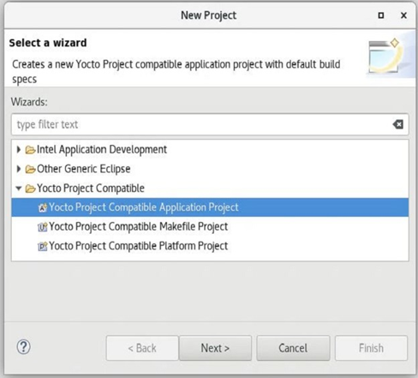
Intel System Studio 2019: Yocto Project Compatible
Platform Project Features:
Configuration/Updates via Toaster
Basic build targets directly from ISS
Eclipse-based Kernel Configuration Tool
Tree view to browse deploy artifacts

Slide 36
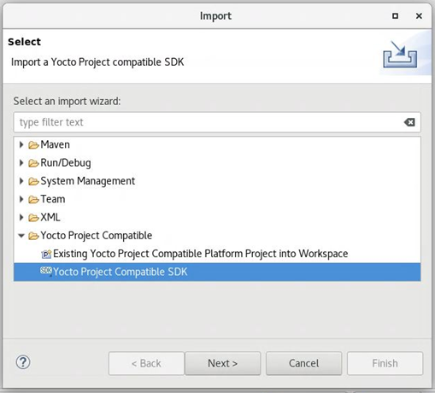
Intel System Studio 2019: Yocto Project Compatible
Import:
Existing command line project
Existing SDK/eSDK

Slide 37
New Security Response Tool (SRTool)
While there is heighten awareness about device vulnerabilities, what is often missing is awareness about the process of managing the security response process itself
Wind River is sharing to open source a tool to help manager the organization’s security response management:
Better ways to handle 1000+ CVEs per month
Better ways to connect CVE’s to defects to product
Better ways to allow easy access to the full vulnerability status, generate reports, clean exports to public CVE DB
Better ways to use automation to keep all the data sources automatically up to date
Community Page:
https://wiki.yoctoproject.org/wiki/Contribute_to_SRTool
ELCE Presentation:
https://sched.co/HOLr

