Slide 1
Yocto Project® Kernel Lab, Hands-On
Trevor Woerner, Togán Labs
Yocto Project DevDay Virtual, North America, 2020

Slide 2
Ignoring TheYocto Project (briefly)
Notes:
2

Slide 3
Kernel Workflow - first pass
obtain kernel
obtain cross-toolchain
setup cross-toolchain/environment
configure kernel/tweak DT
build kernel/modules/dtb
install kernel/modules/dtb
test

Slide 4
Kernel Workflow - later
edit kernel
write kernel module
do -rt stuff
build, install, test

Slide 5
Obtain Kernel
upstream Linus
upstream linux-stable
vendor kernel (tries to be good)
evil vendor kernel (franken-kernel)

Slide 6
Obtain Cross-Toolchain
cross-compiler from your distro
gnu.gcc.org (compile your own, good luck)
crosstool-NG (compile your own, with help)
ARM/Linaro
Bootlin
kernel.org (NOTE: kernel only)
vendor

Slide 7
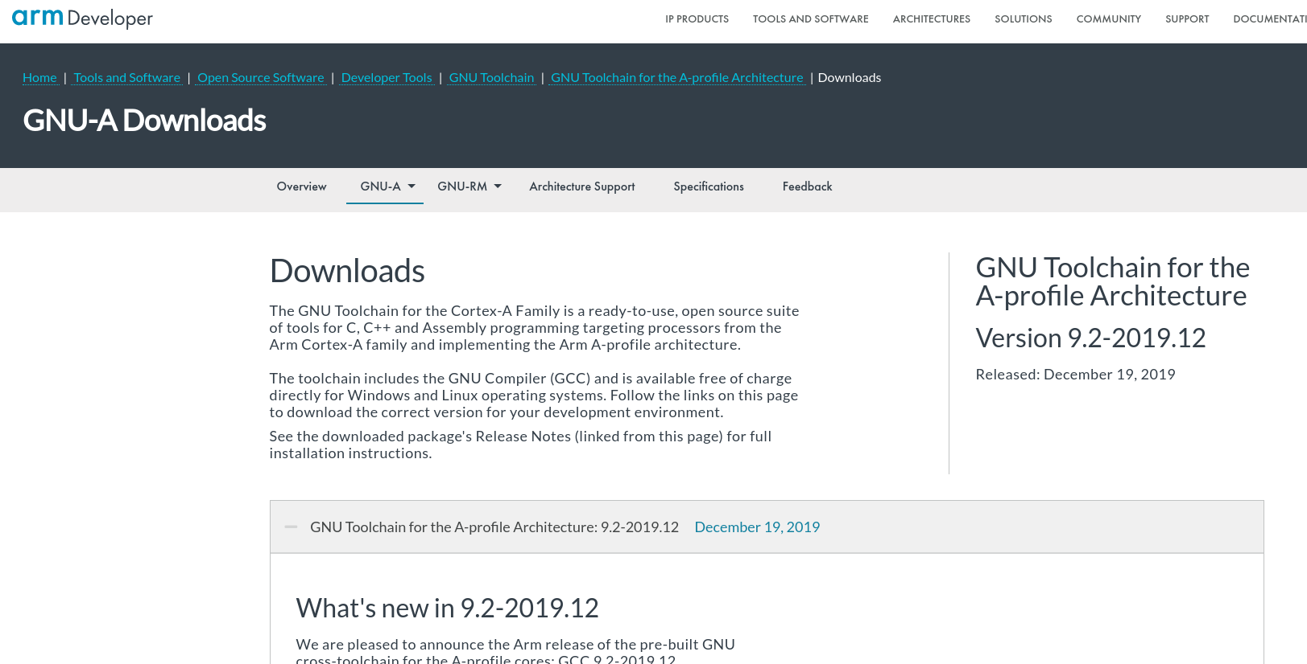
Obtain Cross-Toolchain ARM/Linaro

Slide 8
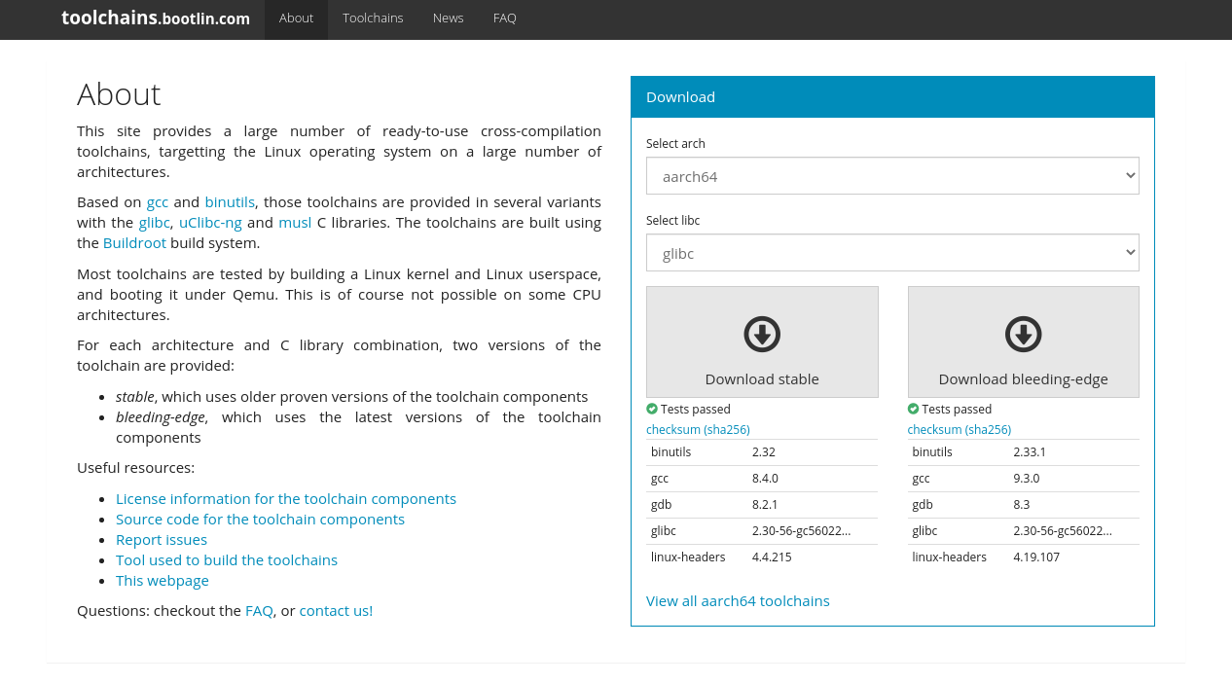
Obtain Cross-Toolchain Bootlin - https://toolchains.bootlin.com

Slide 9
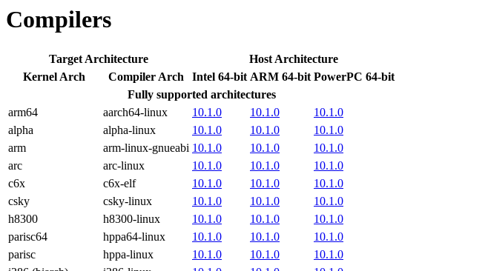
Obtain Cross-Toolchain kernel.org - https://www.kernel.org/pub/tools/crosstool

Slide 10
Setup Toolchain/Environment
(compile +) install toolchain
setup $PATH
either:
tweak environment
specify on cmdline
$ export ARCH=arm
$ export CROSS_COMPILE=<toolchain-prefix>
$ ARCH=arm CROSS_COMPILE=<toolchain-prefix> make

Slide 11
Build Kernel, Modules, DTB
$ ARCH=arm CROSS_COMPILE=<toolchain-prefix> make

Slide 12
Install Kernel, Modules, DTB
by default:
kernel: $INSTALL_PATH (default: /boot)
modules: $INSTALL_MOD_PATH/lib/modules/$VER
dtb: $INSTALL_PATH/dtbs/$VER
this doesn't work for embedded
each board is… "unique"

Slide 13
Install Kernel, Modules, DTB
how and where these various parts are installed is highly board-specific:
extlinux.conf
uEnv.txt
separate partitions
APPENDED_DTB (i.e. "bundled")
U-Boot FIT image

Slide 14
Install Kernel, Modules, DTB
how and where these various parts are installed is highly board-specific:
"magic" offsets on storage device
multi-partition UBI (raw flash)
initial FAT/VFAT partition

Slide 15
Install Kernel, Modules, DTB
there is a very tight coupling between
bootloader
kernel cmdline
kernel + modules + dtb
final image assembly (e.g. wic)

Slide 16
Edit Kernel
not too difficult, locate and edit kernel sources
just make sure you're editing the correct sources (multiple boards, multiple projects, multiple configurations) and using the correct toolchain (correctly)

Slide 17
Write Kernel Module
need to copy+paste an example Makefile to get the out-of-kernel-tree build plumbing correct
otherwise the mechanics aren't too complicated

Slide 18
Do -rt Stuff
I hope the kernel version you're using is one for which there is an -rt patch available, otherwise forget it
if the above is true, manually applying the -rt patch against an unmodified base isn't too difficult

Slide 19
Kernel Workflow Without Yocto
it's not too hard if you've done it once or twice before
but can be tricky to get it right the first time
the amount of work compounds with the number of boards you need to support
multiple toolchains
multiple configurations
multiple install layouts

Slide 20
Can TheYocto Project Help?
Notes:
20

Slide 21
Kernel Workflow - multiple users
tweaking a kernel/config or writing a kernel module using an existing BSP
board bring-up (creating a BSP) for a new board

Slide 22
Kernel Workflow - existing BSP
obtain kernel
obtain cross-toolchain
setup cross-toolchain/environment
configure kernel/tweak DT
build kernel/modules/dtb
install kernel/modules/dtb
DONE!

Slide 23
Kernel Workflow TODO - existing BSP
change kernel
obtain cross-toolchain
setup cross-toolchain/environment
configure kernel/tweak DT
build kernel/modules/dtb
install kernel/modules/dtb
edit kernel sources
write a kernel module

Slide 24
Kernel Workflow TODO - existing BSP change kernel
many kernels from which to choose (upstream, vendor, stable)
The Yocto Project provides its own (linux-yocto) plus tooling for use with linux-yocto, or your own
linux-yocto comes in a couple variants:
(base)
-dev
-tiny
-rt

Slide 25
Kernel Workflow TODO - existing BSP tweak config
use your own defconfig
use an in-kernel _defconfig
generate one or more config "fragments" which are applied on top of the base configuration

Slide 26
Kernel Workflow TODO - existing BSP edit kernel code
good for pr_notice() debugging
edit/add device IDs (PCI, USB) for new hardware

Slide 27
Kernel Workflow TODO - existing BSP write a module
a frequent activity with embedded devices
autoload on boot with KERNEL_MODULE_AUTOLOAD
be sure to include your modules into your image (MACHINE_EXTRA_RRECOMMENDS)

Slide 28
Kernel Workflow - new BSP
obtain kernel
obtain cross-toolchain
setup cross-toolchain/environment
configure kernel/tweak DT
build kernel/modules/dtb
install kernel/modules/dtb
DONE!

Slide 29
Kernel Workflow - new BSP
obtain kernel
obtain cross-toolchain
setup cross-toolchain/environment
configure kernel/tweak DT
build kernel/modules/dtb
install kernel/modules/dtb
… but with a lot of help!
DONE!

Slide 30
Kernel Workflow - new BSP
obtain kernel
implicit understanding of how to fetch code
setup cross-toolchain/environment
set the processor "TUNE" in $MACHINE
configure kernel/tweak DT
lots of linux-yocto tooling
install kernel/modules/dtb
lots of kernel-handling classes

Slide 31
Hands On: Existing BSP
Notes:
31

Slide 32
Hands-On: Prep
ilab01:~$ cd scratch
ilab01:~/scratch$ git clone -b dunfell git://git.yoctoproject.org/poky.git
Cloning into 'poky'...
remote: Enumerating objects: 479650, done.
remote: Counting objects: 100% (479650/479650), done.
remote: Compressing objects: 100% (113534/113534), done.
remote: Total 479650 (delta 359015), reused 478925 (delta 358472)
Receiving objects: 100% (479650/479650), 164.40 MiB | 28.37 MiB/s, done.
Resolving deltas: 100% (359015/359015), done.

Slide 33
Hands-On: Prep
ilab01:~/scratch$ . poky/oe-init-build-env
...
### Shell environment set up for builds. ###
...
ilab01:~/scratch/build$
I like to remind myself this is now a modified-environment shell for builds:
ilab01:~/scratch/build$ export $PS1="${PS1}lab> "
ilab01:~/scratch/build$ lab>

Slide 34
Hands-On: Prep
ilab01:~/scratch/build$ lab> $EDITOR conf/local
here's what you need to change:
MACHINE = "qemux86-64"
DL_DIR = "/scratch/downloads"
SSTATE_DIR = "/scratch/sstate-cache"
SDKMACHINE = "x86_64"
OE_TERMINAL = "screen"

Slide 35
Hands-On: Prep
baseline build:
ilab01:~/scratch/build$ lab> bitbake core-image-minimal
Build Configuration:
BB_VERSION = "1.46.0"
BUILD_SYS = "x86_64-linux"
NATIVELSBSTRING = "universal"
TARGET_SYS = "x86_64-poky-linux"
MACHINE = "qemux86-64"
DISTRO = "poky"
DISTRO_VERSION = "3.1.1"
TUNE_FEATURES = "m64 core2"
TARGET_FPU = ""
meta
meta-poky
meta-yocto-bsp = "dunfell:93ef4736915090ac9a2402916df8924ac4439490"

Slide 36
Hands-On: Prep
verify it runs
ilab01:~/scratch/build$ lab> runqemu slirp nographic serial
...
hwclock: settimeofday: Invalid argument
chmod: /var/log/wtmp: No such file or directory
Failed to set mode -0664- for -/var/log/wtmp-.
INIT: Entering runlevel: 5
Configuring network interfaces... ip: RTNETLINK answers: File exists
hwclock: settimeofday: Invalid argument
Starting syslogd/klogd: done
Poky (Yocto Project Reference Distro) 3.1.1 qemux86-64 /dev/ttyS0
qemux86-64 login:

Slide 37
Hands-On: Prep
shutdown
Poky (Yocto Project Reference Distro) 3.1.1 qemux86-64 /dev/ttyS0
qemux86-64 login: root
root@qemux86-64:~# uname -a
Linux qemux86-64 5.4.43-yocto-standard #1 SMP PREEMPT Thu May 28 15:33:30 UTC 2020
root@qemux86:~# shutdown -h now
...
[ 130.239174] ACPI: Preparing to enter system sleep state S5
[ 130.242375] reboot: Power down
runqemu - INFO - Cleaning up
ilab01:~/scratch/build$ lab>

Slide 38
Hands-On: Prep
create/add a layer for your changes
ilab01:~/scratch/build$ lab> bitbake-layers create-layer meta-mytweaks
NOTE: Starting bitbake server...
Add your new layer with 'bitbake-layers add-layer meta-mytweaks'
ilab01:~/scratch/build$ lab> bitbake-layers add-layer meta-mytweaks
NOTE: Starting bitbake server...
ilab01:~/scratch/build$ lab>

Slide 39
Hands-On: Edit the Kernel

Slide 40
Hands-On: Edit the Kernel
use devtool
ilab01:~/scratch/build$ lab> devtool modify virtual/kernel
...
Currently 1 running tasks (431 of 437) 98% | ############################ |
0: linux-yocto-5.4.43+gitAUTOINC+aafb8f095e_9e1b13d7f9-r0 do_kernel_checkout - 1m49s (pid 1615575)
INFO: Copying kernel config to srctree
INFO: Source tree extracted to /scratch/build/workspace/sources/linux-yocto
INFO: Recipe linux-yocto now set up to build from /scratch/build/workspace/sources/linux-yocto

Slide 41
Hands-On: Edit the Kernel
edit init/main.c
ilab01:~/scratch/build$ lab> $EDITOR workspace/sources/linux-yocto/init/main.c
1137 /*
1138 * We try each of these until one succeeds.
1139 *
1140 * The Bourne shell can be used instead of init if we are
1141 * trying to recover a really broken machine.
1142 */
1143 pr_notice("*** --- >>> edit <<< --- ***\n");
1144 if (execute_command) {
1145 ret = run_init_process(execute_command);
1146 if (!ret)
1147 return 0;
1148 panic("Requested init %s failed (error %d).",
1149 execute_command, ret);

Slide 42
Hands-On: Edit the Kernel
build
ilab01:~/scratch/build$ lab> bitbake core-image-minimal
...
NOTE: linux-yocto: compiling from external source tree /scratch/build/workspace/sources/linux-yocto
...

Slide 43
Hands-On: Edit the Kernel
test (you might have to scroll up)
ilab01:~/scratch/build$ lab> runqemu slirp nographic serial
...
[ 5.209719] VFS: Mounted root (ext4 filesystem) on device 253:0.
[ 5.211596] devtmpfs: mounted
[ 5.312611] Freeing unused kernel image memory: 1580K
[ 5.313286] Write protecting kernel text and read-only data: 20480k
[ 5.313744] *** --- >>> edit <<< --- ***
[ 5.313980] Run /sbin/init as init process
INIT: version booting
Starting udev
[ 6.096177] udevd[138]: starting version 3.2.9
[ 6.162295] udevd[139]: starting eudev-3.2.9
...

Slide 44
Hands-On: Edit the Kernel
commit your changes (don't forget upstream-status)
ilab01:~/scratch/build$ lab> pushd workspace/sources/linux-yocto
~/scratch/build/workspace/sources/linux-yocto ~/scratch/build
ilab01:~/scratch/build$ lab> git commit -avs -m "init/main.c: add my tweaks"
ilab01:~/scratch/build$ lab> popd
~/scratch/build

Slide 45
Hands-On: Edit the Kernel
update your metadata (emphasis mine)
ilab01:~/scratch/build$ lab> devtool finish linux-yocto meta-mytweaks
...
NOTE: Writing append file /scratch/build/meta-mytweaks/recipes-kernel/linux/linux-yocto_%.bbappend
NOTE: Copying 0001-init-main.c-add-my-tweaks.patch to /scratch/build/meta-mytweaks/recipes-kernel/linux/linux-yocto/0001-init-main.c-add-my-tweaks.patch
INFO: Cleaning sysroot for recipe linux-yocto...
INFO: Leaving source tree /scratch/build/workspace/sources/linux-yocto as-is; if you no longer need it then please delete it manually
ilab01:~/scratch/build$ lab> rm -fr workspace/sources/linux-yocto

Slide 46
Hands-On: Edit the Kernel
check
ilab01:~/scratch/build$ lab> tree meta-mytweaks
meta-mytweaks/
├── COPYING.MIT
├── README
├── conf
│ └── layer.conf
└── recipes-kernel
└── linux
├── linux-yocto
│ └── 0001-init-main.c-add-my-tweaks.patch
└── linux-yocto_%.bbappend

Slide 47
Hands-On: Tweak the Kernel Configuration

Slide 48
Hands-On: Tweak the Kernel Configuration
use devtool, setup
ilab01:~/scratch/build$ lab> devtool modify virtual/kernel
...
NOTE: Tasks Summary: Attempted 437 tasks of which 426 didn't need to be rerun and all succeeded.
INFO: Copying kernel config to srctree
INFO: Source tree extracted to /z/3.1-build-dunfell/kernellab/x86-64/build/workspace/sources/linux-yocto
INFO: Recipe linux-yocto now set up to build from /z/3.1-build-dunfell/kernellab/x86-64/build/workspace/sources/linux-yocto

Slide 49
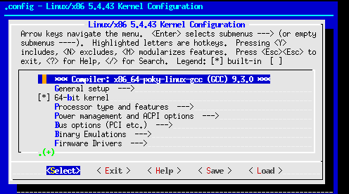
Hands-On: Tweak the Kernel Configuration
use devtool
ilab01:~/scratch/build$ lab> devtool menuconfig linux-yocto

Slide 50
Hands-On: Tweak the Kernel Configuration
navigate to: General Setup Preemption Model
select: No Forced Preemption (Server)
hit double-esc or <Exit> and save your changes
INFO: Updating config fragment /z/3.1-build-dunfell/kernellab/x86-64/build/workspace/sources/linux-yocto/oe-local-files/devtool-fragment.cfg

Slide 51
Hands-On: Tweak the Kernel Configuration
test
ilab01:~/scratch/build$ lab> bitbake core-image-minimal
NOTE: linux-yocto: compiling from external source tree /scratch/build/workspace/sources/linux-yocto
ilab01:~/scratch/build$ lab> runqemu slirp nographic serial
...
[ 0.223909] rcu: Hierarchical RCU implementation.
...
qemux86-64 login: root
root@qemux86-64:~# uname -a
Linux qemux86-64 5.4.43-yocto-standard #1 SMP Wed Jul 1 20:06:32 UTC 2020 x86_64 GNU/Linux
NOTE: missing "Preemptible hierarchical RCU" and "PREEMPT" in "uname -a"

Slide 52
Hands-On: Tweak the Kernel Configuration
update metadata
ilab01:~/scratch/build$ lab> devtool finish linux-yocto meta-mytweaks
...
NOTE: Writing append file /scratch/build/meta-mytweaks/recipes-kernel/linux/linux-yocto_%.bbappend
NOTE: Copying devtool-fragment.cfg to /scratch/build/meta-mytweaks/recipes-kernel/linux/linux-yocto/devtool-fragment.cfg
INFO: Cleaning sysroot for recipe linux-yocto...
INFO: Leaving source tree /scratch/build/workspace/sources/linux-yocto as-is; if you no longer need it then please delete it manually
ilab01:~/scratch/build$ lab> rm -fr workspace/sources/linux-yocto

Slide 53
Hands-On: Tweak the Kernel Configuration
check
ilab01:~/scratch/build$ lab> tree meta-mytweaks
meta-mytweaks/
├── COPYING.MIT
├── README
├── conf
│ └── layer.conf
└── recipes-kernel
└── linux
├── linux-yocto
│ ├── 0001-init-main.c-add-my-tweaks.patch
│ └── devtool-fragment.cfg
└── linux-yocto_%.bbappend

Slide 54
Hands-On: Tweak the Kernel Configuration
check
ilab01:~/scratch/build$ lab> cat meta-mytweaks/recipes-kernel/linux/linux-yocto/devtool-fragment.cfg
CONFIG_PREEMPT_NONE=y
# CONFIG_PREEMPT is not set
CONFIG_TREE_RCU=y
CONFIG_INLINE_SPIN_UNLOCK_IRQ=y
CONFIG_INLINE_READ_UNLOCK=y
CONFIG_INLINE_READ_UNLOCK_IRQ=y
CONFIG_INLINE_WRITE_UNLOCK=y
CONFIG_INLINE_WRITE_UNLOCK_IRQ=y

Slide 55
Hands-On: Tweak the Kernel Configuration
NOTE: subsequent menuconfig changes clobber previous changes, so you'll need to move/rename them if you're generating more than one

Slide 56
Hands-On: alt
if you're not "sold" on the devtool workflow, you could generate an SDK and use that instead
ilab01:~/scratch/build$ lab> bitbake core-image-minimal -c populate_sdk
it is then very much like using any other SDK, but this one is tailored to your image
it comes with an environment file that you source which includes (among other things) settings for ARCH and CROSS_COMPILE

Slide 57
The Yocto Project Kernel Metadata
Notes:
57

Slide 58
Kernel Metadata
in the hands-on portion you saw an example of a kernel configuration fragment and a patch
the Linux kernel configuration system has always had the ability to handle config fragments, but few have made use of it
patches and configs can be grouped into features
we have tooling to help organize and apply fragments and patches in various conditions

Slide 59
Kernel Metadata
3 types of kernel metadata:
scc files
patches
config fragments

Slide 60
Kernel Metadata - config fragments
we saw this in the hands-on
use devtool or -c menuconfig/-c diffconfig to generate
filename has a *.cfg extension

Slide 61
Kernel Metadata - patches
we also saw this in the hands-on
use devtool+git or patch or manually use git --format-patch to generate
filename has a *.patch extension

Slide 62
Kernel Metadata - scc
"scc" = Series Configuration Control
ties together config fragments and/or patches with extra metadata that is useful to the build
filename has an *.scc extension

Slide 63
Kernel Metadata - e.g. 1
you have a set of 6 boards:
2 have graphics capabilities
3 can make sounds
1 uses raw flash
4 have DVD devices
you could create sets of *.cfg/*.patch for each feature, described in *scc files, then apply them as required

Slide 64
Kernel Metadata - e.g. 2
you have "development" and "production" builds
for development builds you might want to enable more kernel debugging and/or verbosity or NFS or lax security
for production builds you might want to enable more kernel hardening and disable potential security things (i.e. disable modules)

Slide 65
Kernel Metadata - e.g. 3
you're creating a BSP layer and some of your boards use one GPU while others use a second GPU and the rest use yet another GPU
you can create metadata for each GPU and include them in your builds as required

Slide 66
Kernel Metadata - storage
there are 2 places you can store the kernel metadata:
in-tree
in a separate repository
regardless, add the location of the metadata to your SRC_URI variable and be sure to specify "type=kmeta"

Slide 67
Kernel Metadata - enabling
reference the *.scc file with KERNEL_FEATURES

Slide 68
Kernel Metadata - down the rabbit hole
it's much more sophisticated
you can define kernel types (i.e. KTYPE) and have features enabled based on the kernel type (e.g. -tiny, -dev, -rt)
*.scc files can include other *.scc files but there are ways to say "include this *.scc file but not anything it wants to include"

Slide 69
Kernel Metadata
examples of in-tree kmeta include:
https://github.com/akuster/meta-odroid
git.yoctoproject.org/meta-arm
git.yoctoproject.org/meta-xilinx
git.yoctoproject.org/meta-raspberrypi is an example of just using *.cfg files without *.scc

Slide 70
Kernel Metadata
an example of out-of-tree kmeta is:
git.yoctoproject.org/yocto-kernel-cache

Slide 71
Recommendations
Notes:
71

Slide 72
Recommendations
use linux-yocto if at all possible
your users will appreciate being able to take advantage of the tooling and features that come with The Yocto Project (i.e. they can tweak the config)
otherwise base your kernel recipe on poky/meta-skeleton/recipes-kernel/linux/linux-yocto-custom.bb
inherit kernel
require recipes-kernel/linux/linux-yocto.inc

Slide 73
Thank You!

Slide 74
Notes:
74

