Slide 1
Yocto Project®️ Long Term Support (LTS) Releases
David Reyna, Wind River
Nicolas Dechesne, Linaro
ELC North America, 2020

Slide 2
About us!
 | Yocto Project Community Manager
 | Yocto Project Training and Dev Day

Slide 3
Agenda
Yocto Project®️ organisation and membership
Current release process
Automated testing improvements
LTS background and overview
How can you help?

Slide 4
What is the Yocto Project®️ ?
IT'S NOT AN EMBEDDED LINUX DISTRIBUTION, IT CREATES A CUSTOM ONE FOR YOU.
The Yocto Project (YP) is an open source collaboration project that helps developers create custom Linux-based systems regardless of the hardware architecture.
The project provides a flexible set of tools and a space where embedded developers worldwide can share technologies, software stacks, configurations, and best practices that can be used to create tailored Linux images for embedded and IOT devices, or anywhere a customized Linux OS is needed.

Slide 5
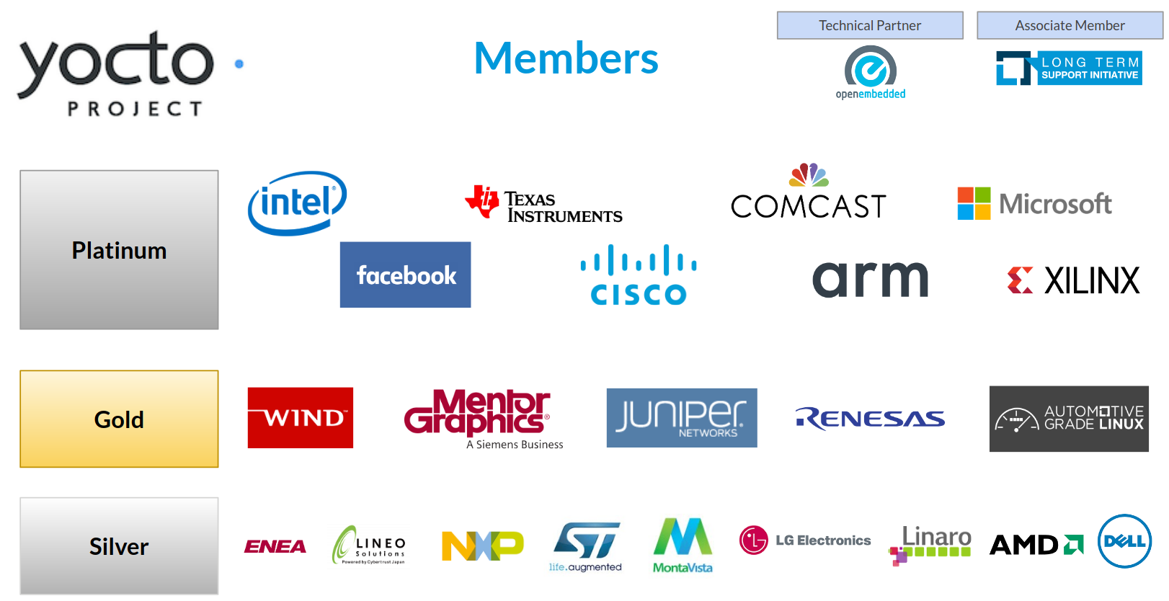
Yocto Project®️ organisation
An open source, collaborative project
Hosted by the Linux Foundation in 2010
Project architect is Richard Purdie.
Uses OpenEmbedded (started in 2003).
Yocto Project Governing Board
Platinum, Gold and Silver member organizations
Linux Foundation corporate members
Influence the project direction (vote)
Contribute financially to its infrastructure and stability.
Nominate/vote: Technical Steering Committee (TSC)
https://www.yoctoproject.org/ecosystem/members/ https://www.yoctoproject.org/how-to-join/

Slide 6
Yocto Project®️ governance model
Governing Board
Oversee business decisions, budgets, and general administration
Technical Steering Committee
Technical oversight to project and upstream
Advisory Board
Advocacy Team
Oversee Marketing, Communication, Outreach, Events, and Training
Community
Oversee Community and ecosystem

Slide 7
Current release process

Slide 8
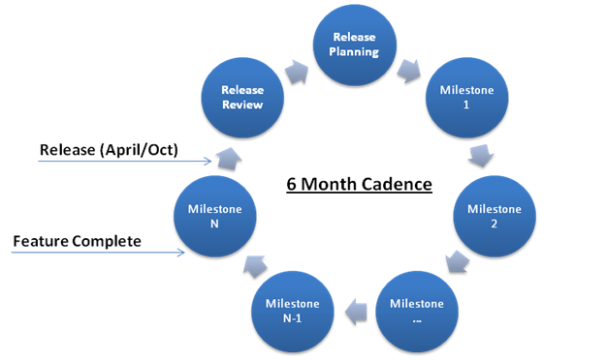
Predictable release cadence: twice a year since inception

Slide 9
A Yocto Project®️ typical release content
A release is the aggregation of:
OE-core
bitake
meta-yocto
yocto-docs
Major component upgrades
Includes ABI/API changes
Include major version upgrades
New features
Using Long Term Support kernels
New Yocto Project features
Test infrastructure changes
Automation changes
Architectures added/removed
Bug fixes for issues reported to Yocto Project
Tight integration loop with upstreams

Slide 10
Yocto Project®️ Stable release content
Acceptable | Unacceptable
Security and CVE fixes Fixes for bugs Fixes so codebase works with newly released distros Bug fix only version upgrades (especially where follows upstream policy) | General version upgrades New Features
Strict backport policy (master first)
Same testing as regular releases

Slide 11
Stable release challenges
Typically, alongside the latest release the previous two releases are also maintained
Maintenance window is up to one year.
Done thanks to developers volunteering community time
Manual testing overhead relying on Yocto Project®️ members resources.

Slide 12
Automated testing improvements

Slide 13
Yocto Project®️ automated testing improvements
Continuous integration using Yocto Project autobuilder infrastructure
https://autobuilder.yoctoproject.org/
25+ builders to validate 12+ numbers of host distros
Fairly large project expense in 2019 to modernize builders
Major improvements (last two years) to reduce needs for manual testing
ptests on x86 and arm for ~60 pieces of software
LTP and LTP posix tests
Test reproducibility of our toolchain and minimal images
gcc, binutils and glibc testsuites on all arm/mips/powerpc/x86 32/64 bit
Over 1.9 million tests in 8 hours

Slide 14
LTS background and overview

Slide 15
Yocto Project®️ Long term support background
Six month release cadence aligns well with pace of open source development
However too frequent for some use cases and markets
Many companies using Yocto Project releases end up doing some LTS on their own
Over the years it became a common complain at developers’ events and BoF.
YP TSC presented to the governing board a request to establish a formal LTS process at ELCE 2019
LTS announced in March 2020
https://www.yoctoproject.org/yocto-project-long-term-support-announced/

Slide 16
Yocto Project®️ LTS proposal in a nutshell
An LTS every two years
Maintained for two years (initial plan)
Yocto Project 3.1 is the first LTS
Regular stable release maintenance is reduced to seven months
Funded by the Yocto Project membership
20 hours a week of maintainer duties
Steve Sakoman is the Yocto Project maintainer for v3.1
The TSC is responsible for LTS releases, processes and maintainer.

Slide 17
Yocto Project®️ LTS releases
Components to be covered
Bitbake, OpenEmbedded-core
meta-yocto-bsp, meta-poky, yocto-docs
Not covered
meta-openembedded, vendor layers, …
Only on a subset of supported native build platforms
Rely on Yocto Project AB resources and automated testing
Follow the same testing process as the original release
Only run virtualized tests
Evaluate use of CVE automated tools (cve-check)
Notes:
Subset of supported host distro: distros with LTS that match our own timescales which realistically is ubuntu. Newer distros may work through new buildtools tarball work

Slide 18
Yocto Project®️ LTS : is / is not
IS | IS NOT
A major change for the Yocto Project, which requires significant resources from the membership An initiative to create a place for the community to collaborate on LTS A guarantee that we have resources available to integrate and test changes in a timely manner and to have fast turn around of point releases | A replacement for commercial offering from OSVs which offer very long term support (5y, 10y, …) A guarantee of "all" CVE fixes, we only agree to integrate what is submitted and passes testing Is not able to check your own additions and customisations

Slide 19
Release cycle overview
April
October
April
October
April
LTS
stable
stable
stable
master

Slide 20
How to contribute to Yocto Project®️ LTS
Follows standard Yocto Project / OpenEmbedded contributions guidelines.
Submit patches to appropriate mailing list, tagged with [dunfell]
Submitted patches should be on master, except when incorporating a CVE/bug fix for an old version.
LTS maintainer
assemble and test ‘group of patches’
submit working set on the list once a week for review
submit pull request to Richard Purdie
The branch stable/dunfell-nut always contains the ‘work in progress’ patches.

Slide 21
How can you help?

Slide 22
How can you help?
Contribute, share your bug fixes, CVEs and security patches
Test LTS branch with your distro and BSP
Report bugs
Continue to test and develop the main release branch
Join us and support the Yocto Project

