Slide 1
Highly Scalable Yocto Project® Build Automation
Paul Barker, Konsulko Group
Yocto Project Dev Day Virtual, North America, 2020

Slide 2
Introduction

Slide 3
About This Talk
Introduction
Automating Yocto Project Builds
Scaling Up & Scaling Out
A low-cost example setup
Including public sstate cache & download mirror
Summary & Future Work

Slide 4
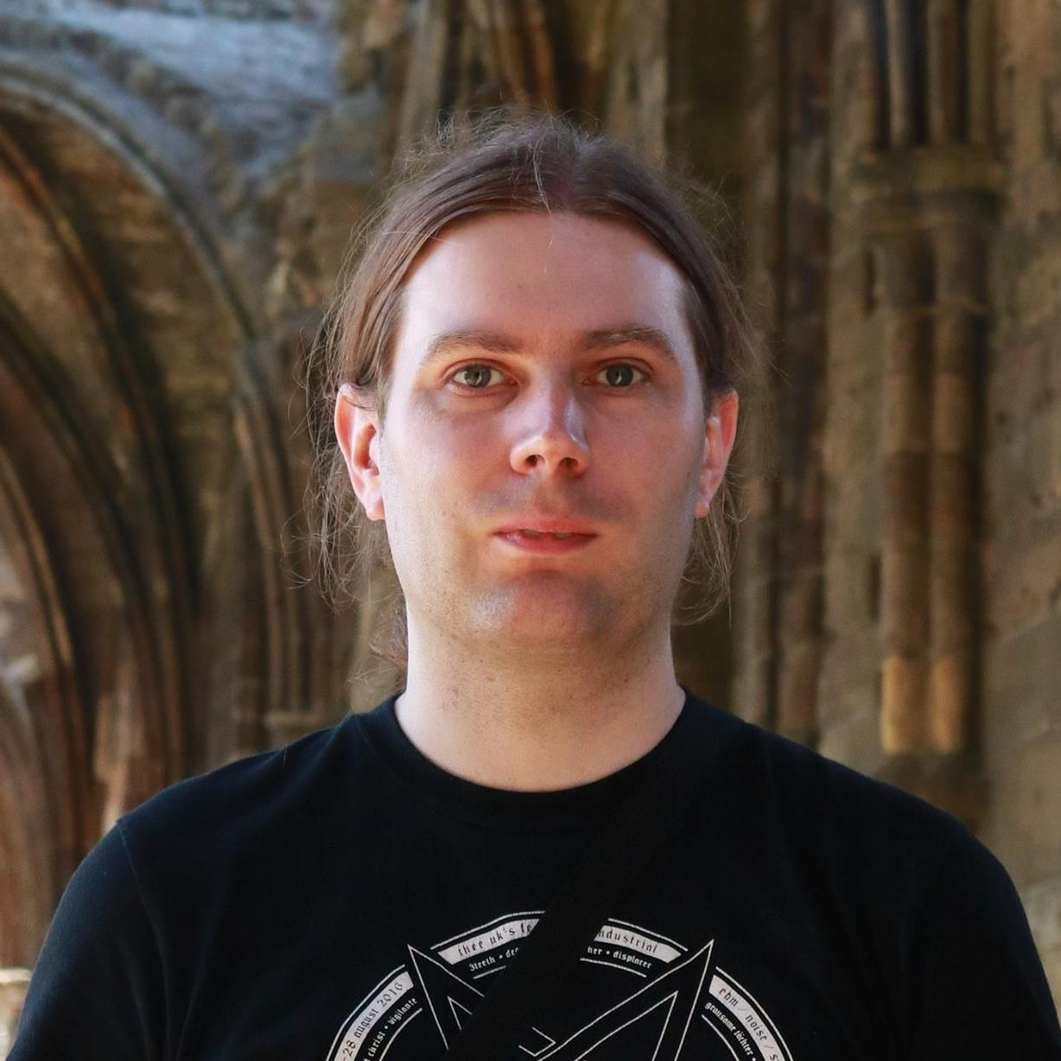
About Me
Involved in Yocto Project since 2013
Work across the whole embedded stack
Principal Engineer @ Konsulko Group
pbarker@konsulko.com
https://twitter.com/pbarker_dev

Slide 5
About Konsulko Group
Embedded Linux & Open Source Software Consultancy
Globally distributed team of community and industry veterans
Contributors to the Linux kernel, U-Boot, Yocto Project, OpenEmbedded, Automotive Grade Linux (AGL) and many more projects
https://konsulko.com

Slide 6
Caveat Emptor
Opinions are mine
Not my employers
Not those of the Yocto Project as a whole
Gather performance data & test thoroughly before spending lots of money on hardware/services

Slide 7
Automating Yocto Project Builds

Slide 8
Simple Setup
Dedicated CI build environment
CI build script
Update layers
Run the build
Copy artifacts to shared storage
Some form of trigger
When new commits are pushed to your layers
On a schedule

Slide 9
Other Requirements
Capture build logs
Manual command to clean working directory and/or sstate cache
Sometimes needed when debugging issues

Slide 10
Yocto Project Autobuilder
Used and maintained by Yocto Project itself
Based on buildbot
Highly customisable

Slide 11
Other Solutions
Buildbot
GitLab CI
Jenkins
… The list is endless

Slide 12
Scripting the Build
CI configuration should be as simple as possible
Ideally just runs one command
Ensure you can run the same script locally
Makes debug much easier
Allows you to build & release manually if your CI system breaks

Slide 13
Pulling in Other Layers
Many possibilities
Git submodules
Repo
oe-layersetup
kas
Depends on your preference, team and workflow

Slide 14
Scaling Up & Scaling Out

Slide 15
Re-examining the Simple Setup
Let’s break the setup into components:
Build environment
sstate cache
Download cache
Artifact storage
Log storage
Management interface

Slide 16
Scaling Up
Just get a bigger build machine…
We can also increase efficiency
NVMe > SATA SSD > SATA HDD
Check the write endurance on SSDs
Server/Workstation Hardware > Desktop > Laptop
I’ve seen CI on an old laptop and people wondering why it’s slow

Slide 17
CPU and RAM
Don’t just blindly assume more expensive is better
Check for single threaded bottlenecks
If they dominate build time go for high clock frequency
If not, go for high core count
Profile your RAM usage during a build
Use the fastest supported RAM

Slide 18
Other Factors
Use a dedicated machine not a VM
Containers are ok as the I/O overhead is low
Look closely at the docs if you’re using docker
Separate the management interface
Smaller controller machine or VM

Slide 19
Preparing to Scale Out
Centralised NAS or other storage solution
sstate cache
Download mirror
Artifact storage
Multiple build machines

Slide 20
Other Benefits of Scaling Out
Developer machines can use central sstate cache
Maintaining a download mirror is important anyway
Helps with license compliance
Protects you if upstream sources disappear
Can reduce single points of failure

Slide 21
Local Scale Out
High-speed networking
10 Gbps between build machines & NAS is recommended
Reliable network
Very low likelihood of transfer errors
Serve and update caches over NFS

Slide 22
Global Scale Out
Limited network speeds
Packet drops & errors will happen
May see errors accessing the sstate cache
Serve caches over HTTP(S)
Update caches over SSH or an API

Slide 23
Distributed Cache & Artifacts Storage
You can build your own storage cluster
Using Ceph, Glusterfs, etc
Minio is also an option with an S3 compatible API
Or you can use a cloud service
Amazon S3, Azure, Google Cloud or similar
BackBlaze B2 is a low-cost option
Avoid Dropbox, OneDrive, Google Drive, etc as they’re not designed for this

Slide 24
A Low-Cost Example

Slide 25
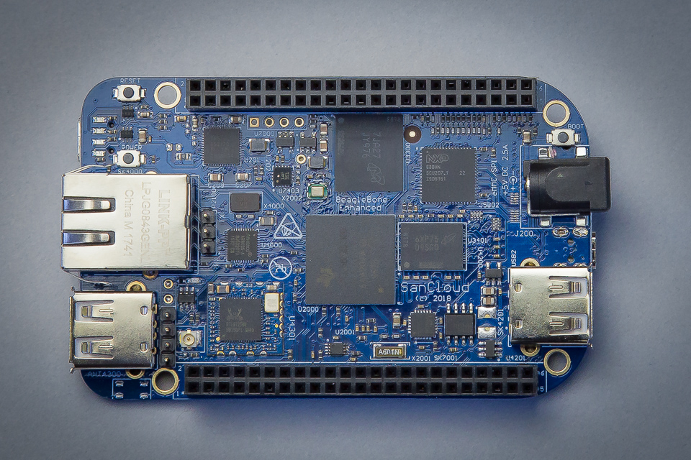
Use Case
meta-sancloud BSP layer
SanCloud BeagleBone Enhanced (BBE)
https://github.com/SanCloudLtd/meta-sancloud
Supports multiple distros
Poky
Arago
AGL

Slide 26
High Level Design
Uses kas to set up layers and build configuration
GitLab CI is used to trigger builds and collect logs
Dedicated build servers running GitLab Runner
Cache, mirrors & artifacts stored in BackBlaze B2
CloudFlare used to eliminate bandwidth costs

Slide 27
kas
Records build configuration in a YAML file
Source repository and refspec for each layer
Local patches to apply
MACHINE, DISTRO and bitbake targets to build
Content of local.conf
Simple command line usage:
kas build kas/bbe-poky.yml
kas shell kas/bbe-poky.yml for custom commands

Slide 28
GitLab CI
Continuous Integration system integrated with GitLab
Configuration stored in YAML file in the Git repository
Variables and secret values set in the web interface
Builds triggered automatically
On git push
On a schedule (nightly builds)

Slide 29
Build Agent
CPU: Ryzen 7 3700X (8c/16t)
RAM: 64 GB DDR4 ECC
Storage: 2x 1 TB NVMe drives in a RAID1 pair
Internet Connection: 1 Gbps symmetric
Rented from Hetzner (Germany)

Slide 30
GitLab Runner configuration
GitLab runner has very minimal configuration
Limit concurrent jobs (default is unlimited)
Select the Docker job executor
Register with GitLab server
Set docker image in Gitlab CI YAML file
CROPS images are perfect for this
We also use custom images with additional tools installed

Slide 31
BackBlaze B2
Cloud storage solution from BackBlaze
Their main product is cloud backup
Cheap: $0.005 per GB per month
Pay only for used storage space
Allows costs to be capped
No upload cost
Downloads cost $0.01 per GB but we can avoid that…

Slide 32
CloudFlare
Bandwidth Alliance between CloudFlare & BackBlaze
Downloads from BackBlaze B2 are free via CloudFlare
The free tier of CloudFlare is sufficient for this
Requires a dedicated domain
Make sure you disable Browser Integrity Check

Slide 33
Uploading to BackBlaze B2
Use rclone
Like rsync but for cloud storage
BackBlaze API key stored as a GitLab CI variable
Not stored in the git repository
Only repository admins can view/edit this

Slide 34
Monthly Costs
Build Agents: approx. €60 per month each
BackBlaze B2: approx. $2.00 per month
No long term commitments
Can scale up or down as required

Slide 35
Example references
GitLab CI config
Kas build configurations:
Poky
Arago (based on poky config with changes)
Bitbake inc files:
Enable download mirror
Enable sstate mirror

Slide 36
Summary & Future Work

Slide 37
Summary
A scalable automated build system can be deployed cheaply
Requires some sysadmin work in setup & maintenance
Many choices available for all components
You can start with a low cost solution and replace components as needed

Slide 38
Future Work
Extend kas capabilities
Improve handling of sstate download failures in bitbake
Provide better linkage between CI logs in GitLab and artifacts stored on BackBlaze
Automatically expire old sstate caches

Slide 39
Thanks for your time

