Slide 1
Yocto Project® Image Size Optimization
KHEM RAJ, COMCAST
Yocto Project Dev Day Virtual, North America, 2020

Slide 2
What is the Yocto Project®️ ?
IT'S NOT AN EMBEDDED LINUX DISTRIBUTION, IT CREATES A CUSTOM ONE FOR YOU.
The Yocto Project (YP) is an open source collaboration project that helps developers create custom Linux-based systems regardless of the hardware architecture.
The project provides a flexible set of tools and a space where embedded developers worldwide can share technologies, software stacks, configurations, and best practices that can be used to create tailored Linux images for embedded and IOT devices, or anywhere a customized Linux OS is needed.

Slide 3
Agenda
Introduction
"poky-tiny” Distribution
Image analysis tools
Compiler and toolchain optimizations
C/C++ this time
package refactoring
Package selection

Slide 4
Introduction
Reference Distributions (meta-poky/conf/distro)
poky – Standard default distribution
poky-tiny – Geared towards small size
Uses musl, linux-yocto-tiny, mdev, custom init
poky-altconfig – Uses systemd, LTSI kernel
Most of examples here are based on yoe distribution
Derives from poky distribution policies

Slide 5
poky-tiny
Use baseline for custom distro
require conf/distro/poky-tiny.conf
DISTRO = ”my-tiny-distro”
…

Slide 6
Package Selections
Use musl C library
Use busybox init system
Use mdev instead of udev. ⎨
See if you can live without it
- IMAGESIZE = 37668
+ IMAGESIZE = 35532
-IMAGESIZE = 35532
+IMAGESIZE = 3120

Slide 7
Compiler Flags
Check global optimization flags
SELECTED_OPTIMIZATION
Use –Os instead of –O2
TARGET_CFLAGS = "${TARGET_CPPFLAGS} ${SELECTED_OPTIMIZATION}"
…
DEBUG_FLAGS ?= "-g -feliminate-unused-debug-types ${DEBUG_PREFIX_MAP}"
# Disabled until the option works properly -feliminate-dwarf2-dups
FULL_OPTIMIZATION = "-O2 -pipe ${DEBUG_FLAGS}"
DEBUG_OPTIMIZATION = "-Og ${DEBUG_FLAGS} -pipe"
SELECTED_OPTIMIZATION = "${@d.getVar(oe.utils.vartrue('DEBUG_BUILD', 'DEBUG_OPTIMIZATION', 'FULL_OPTIMIZATION', d))}"
-IMAGESIZE = 3120
+IMAGESIZE = 2992

Slide 8
LTO
Modern compilers support LTO ( clang/gcc )
Enable –flto switch
LTO_pn-glibc = ""
LTO_pn-gcc-runtime = ""
LTO_pn-libgcc-initial = ""
LTO_pn-libgcc = ""
LTO_pn-libpam = ""
LTO_pn-elfutils = ""
LTO_pn-perl = ""
LTO_pn-busybox = ""
LTO_pn-libxcrypt = ""
LTO_pn-curl = ""
LTO_pn-libcap = ""
LTO_pn-python3 = ""
LTO_pn-libproxy = ""
LTO ?= "-flto"
SELECTED_OPTIMIZATION_append_class-target = " ${LTO}"
TARGET_LDFLAGS_append_class-target = " ${LTO}"
SELECTED_OPTIMIZATION[vardeps] += "LTO"
PACKAGE_DEBUG_SPLIT_STYLE = "debug-without-src"
-IMAGESIZE = 2992
+IMAGESIZE = 2956

Slide 9
LTO
Clang support (needs work for arm arch )
Thin LTO
Faster to compile
Full LTO
More optimizations
Needs gold linker
Gold ld + LTO does not like “Os” ( Use O2 or O3)
# Enable LTO based on global distro settings
TOOLCHAIN_OPTIONS_append_toolchain-clang = "${@bb.utils.contains('DISTRO_FEATURES', 'thin-lto', ' -flto=thin -fuse-ld=gold', '', d)}"
TOOLCHAIN_OPTIONS_append_toolchain-clang = "${@bb.utils.contains('DISTRO_FEATURES', 'full-lto', ' -flto=full -fuse-ld=gold', '', d)}"

Slide 10
Check Image
Enable buildhistory
Build Image
USER_CLASSES ?= " buildhistory”
BUILDHISTORY_COMMIT ?= "1"

Slide 11
Refine Image
IMAGE_LINGUAS
“en-us”
Use “as needed”, prefer empty
IMAGE_FEATURES
Remove package-management
Remove splash
SSH – Use dropbear instead of OpenSSH
Add ssh-server-dropbear to IMAGE_FEATURES

Slide 12
Default Tunes
For ARM 32-bit
Ensure Thumb ISA is used
Select proper DEFAULTTUNE
DEFAULTTUNE ?= "cortexa7thf-neon-vfpv4"
Build Configuration:
BB_VERSION = "1.47.0"
BUILD_SYS = "x86_64-linux"
NATIVELSBSTRING = "arch"
TARGET_SYS = "arm-yoe-linux-gnueabi"
MACHINE = "raspberrypi4"
DISTRO = "yoe"
DISTRO_VERSION = "3.1"
TUNE_FEATURES = "arm vfp cortexa7 neon vfpv4 thumb callconvention-hard"
TARGET_FPU = "hard"
-IMAGESIZE = 3320
+IMAGESIZE = 2956

Slide 13
Default Tunes
16-bit ISA for MIPS
Enable MIPS16e ASE instructions
Use mips16e in TUNE_FEATURES
Set MIPS_INSTRUCTION_SET to mips16e

Slide 14
Inspect Buildhistory
Buildhistory is in TOPDIR/buildhistory
[kraj@apollo /mnt/b/yoe/master/buildhistory/images/raspberrypi4/glibc/yoe-simple-image]
% tree
.
├── build-id.txt
├── depends.dot
├── depends-nokernel.dot
├── depends-nokernel-nolibc.dot
├── depends-nokernel-nolibc-noupdate.dot
├── depends-nokernel-nolibc-noupdate-nomodules.dot
├── files-in-image.txt
├── image-files
│ └── etc
│ ├── group
│ └── passwd
├── image-info.txt
├── installed-package-names.txt
├── installed-package-sizes.txt
└── installed-packages.txt

Slide 15
Inspect installed-package-sizes.txt
Package sizes listed in size order
3023 KiB bluez5
2568 KiB shared-mime-info
2266 KiB libglib-2.0-0
1652 KiB libc6
1630 KiB kernel-module-btrfs-5.4.47-v7l
1609 KiB kernel-module-xfs-5.4.47-v7l
1397 KiB libunistring2
1292 KiB kernel-module-ocfs2-5.4.47-v7l
1202 KiB ofono
1191 KiB libgnutls30
1186 KiB libstdc++6
1123 KiB kernel-module-snd-soc-wm5102-5.4.47-v7l
1040 KiB shadow
954 KiB libx11-6
920 KiB kernel-module-mac80211-5.4.47-v7l
886 KiB kernel-module-cfg80211-5.4.47-v7l
884 KiB kernel-module-cifs-5.4.47-v7l
883 KiB wpa-supplicant

Slide 16
Why a package is pulled into image ?
digraph depends {
node [shape=plaintext]
"96boards-tools" -> "e2fsprogs-resize2fs"
"96boards-tools" -> "gptfdisk"
"96boards-tools" -> "parted"
"96boards-tools" -> "udev"
"96boards-tools" -> "update-rc.d" [style=dotted]
"96boards-tools" -> "util-linux"
"alsa-utils-alsactl" -> "alsa-states" [style=dotted]
"alsa-utils-alsactl" -> "libasound2"
"alsa-utils-alsactl" -> "libc6"
"alsa-utils-alsamixer" -> "libasound2"
"alsa-utils-alsamixer" -> "libc6"
"alsa-utils-alsamixer" -> "libformw5"
"alsa-utils-alsamixer" -> "libmenuw5"
"alsa-utils-alsamixer" -> "libncursesw5"
"alsa-utils-alsamixer" -> "libpanelw5"
"alsa-utils-alsamixer" -> "libtinfo5"
"apmd" -> "initd-functions"
"apmd" -> "libapm1"
"apmd" -> "libc6"
"apmd" -> "update-rc.d" [style=dotted]
"apm" -> "libapm1"
"apm" -> "libc6"
"avahi-daemon" -> "base-files"
"avahi-daemon" -> "base-passwd"
"avahi-daemon" -> "libavahi-common3"
"avahi-daemon" -> "libavahi-core7"
"avahi-daemon" -> "libc6"
Buildhistory has the information
.dot files
RHS expresses the dependence
Search for
-> “<package-name>”

Slide 17
Kernel Tweaks
BSPs may enforce installing all kmods
Inspect MACHINE_EXTRA_RRECOMMENDS
Remove "kernel-modules”
Add only needed kmods
Avoid duplicate kernel image in rootfs
RDEPENDS_${KERNEL_PACKAGE_NAME}-base = "”
Inspect kernel config for unneeded features
Compile with size optimizations (kernel/configs/tiny.config)
tiny.config
CONFIG_CC_OPTIMIZE_FOR_SIZE=y
CONFIG_KERNEL_XZ=y
CONFIG_SLOB=y

Slide 18
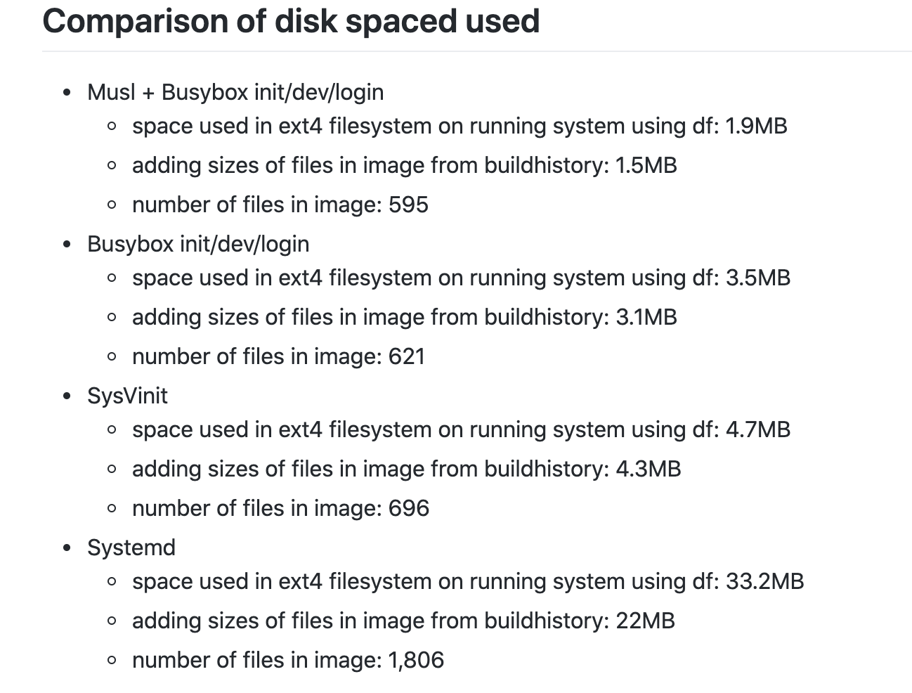
Size comparisons
https://github.com/YoeDistro/yoe-distro/blob/dunfell/docs/libc-init.md

Slide 19
Future Work
Experiment with toybox as init system
Link Time Optimization Enabled system builds
Additional compiler options for size (More than Os)
More language runtime optimization information
Go, rust, python …

Slide 20
Thanks for your time

