Slide 1
Binary Package Feeds for Yocto Project
Jon Mason, Arm
Bruce Ashfield, Xilinx
Yocto Project Summit 2019

Slide 2

Notes:
https://pxhere.com/en/photo/1453999

Slide 3


What scares Yocto Project people?

Slide 4
What should we fear?

Slide 5
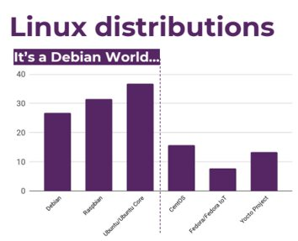
Notes:
https://iot.eclipse.org/resources/iot-developer-survey/iot-developer-survey-2019.pdf

Slide 6
Why are people running full distros on embedded devices?

Slide 7
CPUs
x86
Arm
Core 2 Quad (Q6600) - 2006 - 2-3GHz
Phenom X4 9850 - 2008 - 4 cores @ 2.5GHz
Phenom II X4 925 - 2009 - 4 cores @ 2.8GHz
Via Nano QuadCore C4650 - 2015 - 4 Cores @ 2GHz
Core i3-8300 - 2018 - 4 Cores at 3.7GHz
Celeron 5205U - 2019 - 2 Cores at 1.9GHz
SDM845 - 2018 - 4 + 4 cores (2.8 GHz + 1.8GHz)
RK3399 - 2016 - 2 + 4 cores (2.0GHz + 1.5)
Broadcom BCM2711 - 2019 - Quad core Cortex-A72 - 1.5GHz
Qualcomm Snapdragon 855+ Mobile Platform - 2019 - 485 Octa-core CPU @ up to 2.96 GHz

Slide 8
Others
Memory
Storage
PCIE

Slide 9
Distros
Easy to install
Easy to update
Easy to install new software
The cost for using distros is the higher amount of resources (e.g., CPU, RAM, and Storage), but now embedded devices have similar amounts to desktops

Slide 10
Yocto is not just for embedded
Containers
Desktop?

Slide 11
What can YP do to address this?

Slide 12
Extensibility - Binary Package Feeds
The biggest benefit of a traditional distro is their ability to install and upgrade packages
Yocto already has the ability to build rpms, debs, and ipkgs. So, all we need to do is collect those into a standard location, and have a way of installing them

Slide 13
Issues
The point of Yocto/OE is the high level of configurability
A binary package feed would need to be generic to be useful

Slide 14
How would this look?
x86
Build for the generic x86_64
Arm
32bit, Little Endien, hard float, ARMv7
Aarch64
Build for the generic ARMv8

Slide 15
Alternative funding for software vendors?
could provide a trusted package location for paying customers that contains packages with the latest CVE fixes for a given release
A way to fund LTS?
Vendor lock-in for this, as the customer would need to keep paying as long as they wanted access

Slide 16
Open Questions
Initial installation?
How do we want to handle release upgrades?
How do we want to handle arches, sub-arches, and other variants

Slide 17
Thanks

